Slide 1
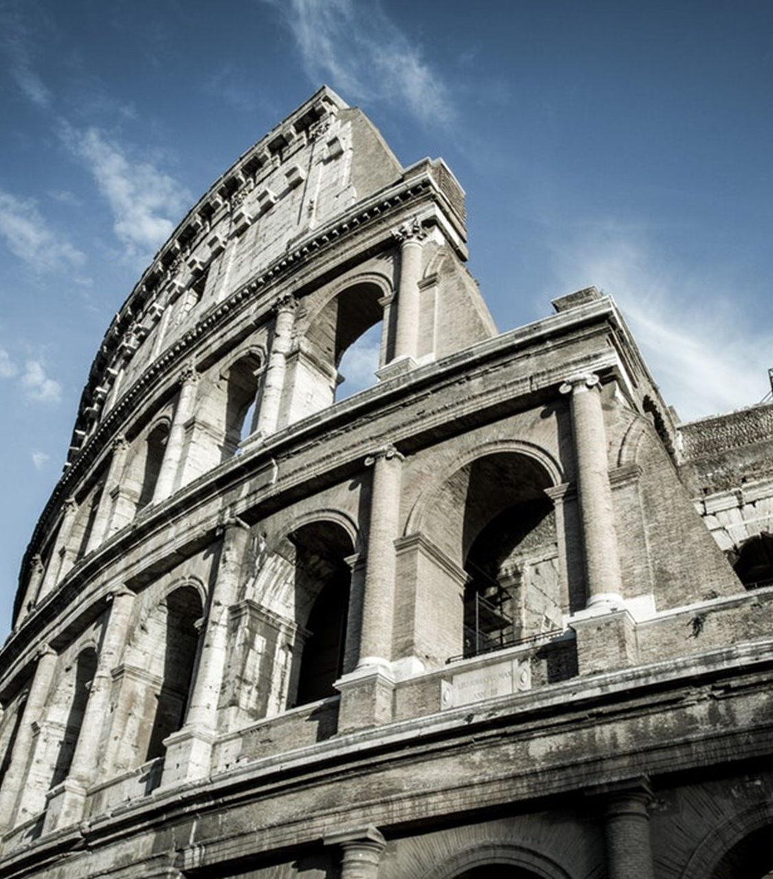
The Epistle to the Romans
Chapter 2

Slide 2
God’s Righteous Judgment
God’s Judgment is Righteous (vv. 1-16)
The Guilt of the Jews (vv. 17-29)

Slide 3
God’s Righteous Judgment
God’s Judgment is Righteous (vv. 1-16)
The Hypocritical Judgment, and Self-Condemnation of the Jews (v. 1)
The Judgement of God (vv. 2-16)
Is according to truth. (v. 2)
Does the guilty Jew think he will escape the judgment of God? (v. 3)
The Jew despises God’s efforts toward repentance. (v. 4)
In their hardness and impenitence, the Jew is treasuring up wrath (vv. 5-11)
In the day of wrath. (v. 5)
And the revelation of God’s righteous judgment (vv. 5-10)
who “will render to each one according to his deeds” (v. 6):
Eternal life to those who (v. 7):
Endure in doing good.
Seek for glory, honor, and immortality.
Wrath to those who (vv. 8-9):
Do evil.
Both Jew and Greek.
Glory, honor, and peace to those (v. 10):
Who work good.
Both Jew and Greek.
For there is no partiality with God. (v. 11)

Slide 4
God’s Righteous Judgment
God’s Judgment is Righteous (vv. 1-16)
Is without partiality. (vv. 11-16)
Sinners will be judged according to the law they were under – Jew or Greek (v. 12).
Doers of law, not hearers only, are those justified – Gentiles as an example in observation of Jewish law (vv. 13-15).
All will be judged by the gospel Paul preaches (v. 16).

Slide 5
God’s Righteous Judgment
The Guilt of the Jews (vv. 17-29)
The knowledge of the Jews (vv. 17-20)
Their relation to the law (vv. 17-18)
Their confidence in relation to others (vv. 19-20)
The disobedience, hypocrisy, and blasphemy of the Jews (vv. 21-24).
The guilt of the Jews expressed in circumcision (vv. 25-29).
Circumcision is profitable to the law keeper (v. 25).
Breaking the law causes uncircumcision (v. 25).
Circumcision (physical) becomes uncircumcision (spiritual) if the law is broken (v. 25)
Uncircumcision (physical) becomes circumcision (spiritual) if the law is kept (v. 26).
The Gentile who observes the law judges the Jew who transgresses (v. 27).
The true circumcision – inward, of the heart, in the Spirit (vv. 28-29)

Slide 6
God’s Righteous Judgment
God’s Judgment is Righteous (vv. 1-16)
The Guilt of the Jews (vv. 17-29)

