Slide 1
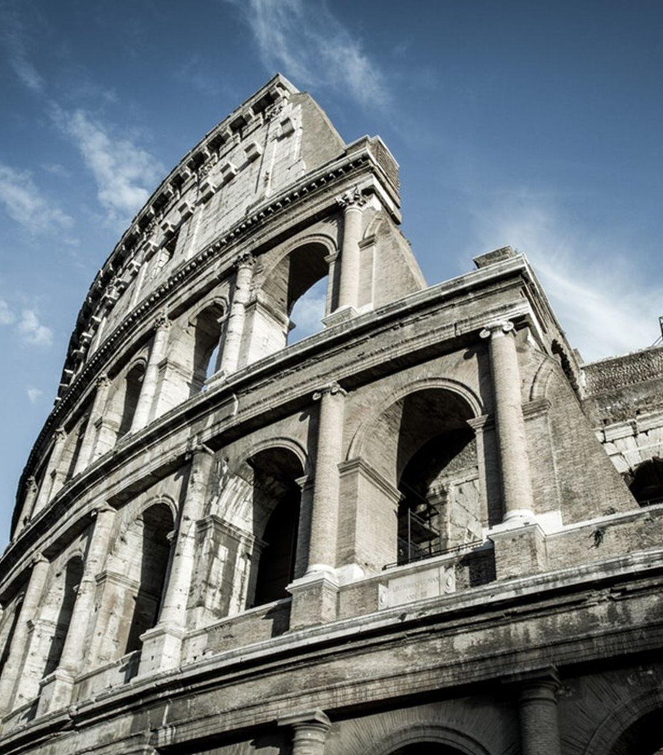
The Epistle to the Romans
Chapter 3

Slide 2
The Righteousness of God
God’s Judgment Defended from Possible Objections (vv. 1-8)
All are Under Sin (vv. 9-19)
The Righteousness of God Through Faith in Jesus Christ (vv. 20-31)

Slide 3
The Righteousness of God
God’s Judgment Defended from Possible Objections (vv. 1-8)
Concerning Jewish Pride (vv. 1-2)
Concerning God’s Faithfulness to the Jew (vv. 3-4)
Concerning God’s Justice in Inflicting Wrath on the Jew (vv. 5-6)
Paul’s Use of Their Logic Against Them – Concerning the Jewish Perspective of His Ministry (vv. 7-8)

Slide 4
The Righteousness of God
All are Under Sin (vv. 9-19)
Is the Jew better than the Gentile due to their advantage in the law? (vv. 9-18)
Not at all. (v. 9b)
Both Jew and Greek have previously been charged under sin. (v. 9c)
As it is written in the law (vv. 10-18)
The law speaks to those under it; thus, shows the Jews to be guilty as well. (v. 19)

Slide 5
The Righteousness of God
The Righteousness of God Through Faith in Jesus Christ (vv. 20-31)
Justification does not come by the Law. Rather, knowledge of sin does. (v. 20)
The righteousness of God apart from the law is revealed (v. 21a)
Witnessed by the Law and the Prophets (v. 21b)
Through faith in Jesus Christ (v. 22a)
To all and on all who believe. (vv. 22b-23)
Justification is by grace through redemption in Christ (v. 24)
Christ set forth as a propitiation by His blood (v. 25a)
Accessed through faith (v. 25b)
Christ as a propitiation demonstrates God’s righteousness (v. 25c)
God had passed over the previous sins (before Christ) (v. 25d)
To presently demonstrate His righteousness (v. 26a)
That He might be just and the justifier of the one who has faith in Jesus. (v. 26b)

Slide 6
The Righteousness of God
The Righteousness of God Through Faith in Jesus Christ (vv. 20-31)
Implications of the Righteousness of God by Faith (vv. 27-31)
Boasting is Excluded (vv. 27-30)
By the law of faith (v. 27b)
Justification is apart from the law. (v. 28)
He is the God of both Jew and Gentile since both are justified the same way. (vv. 29-30)
The law is not voided, but established through the righteousness of God by faith (v. 31)

Slide 7
The Righteousness of God
God’s Judgment Defended from Possible Objections (vv. 1-8)
All are Under Sin (vv. 9-19)
The Righteousness of God Through Faith in Jesus Christ (vv. 20-31)

