Slide 1
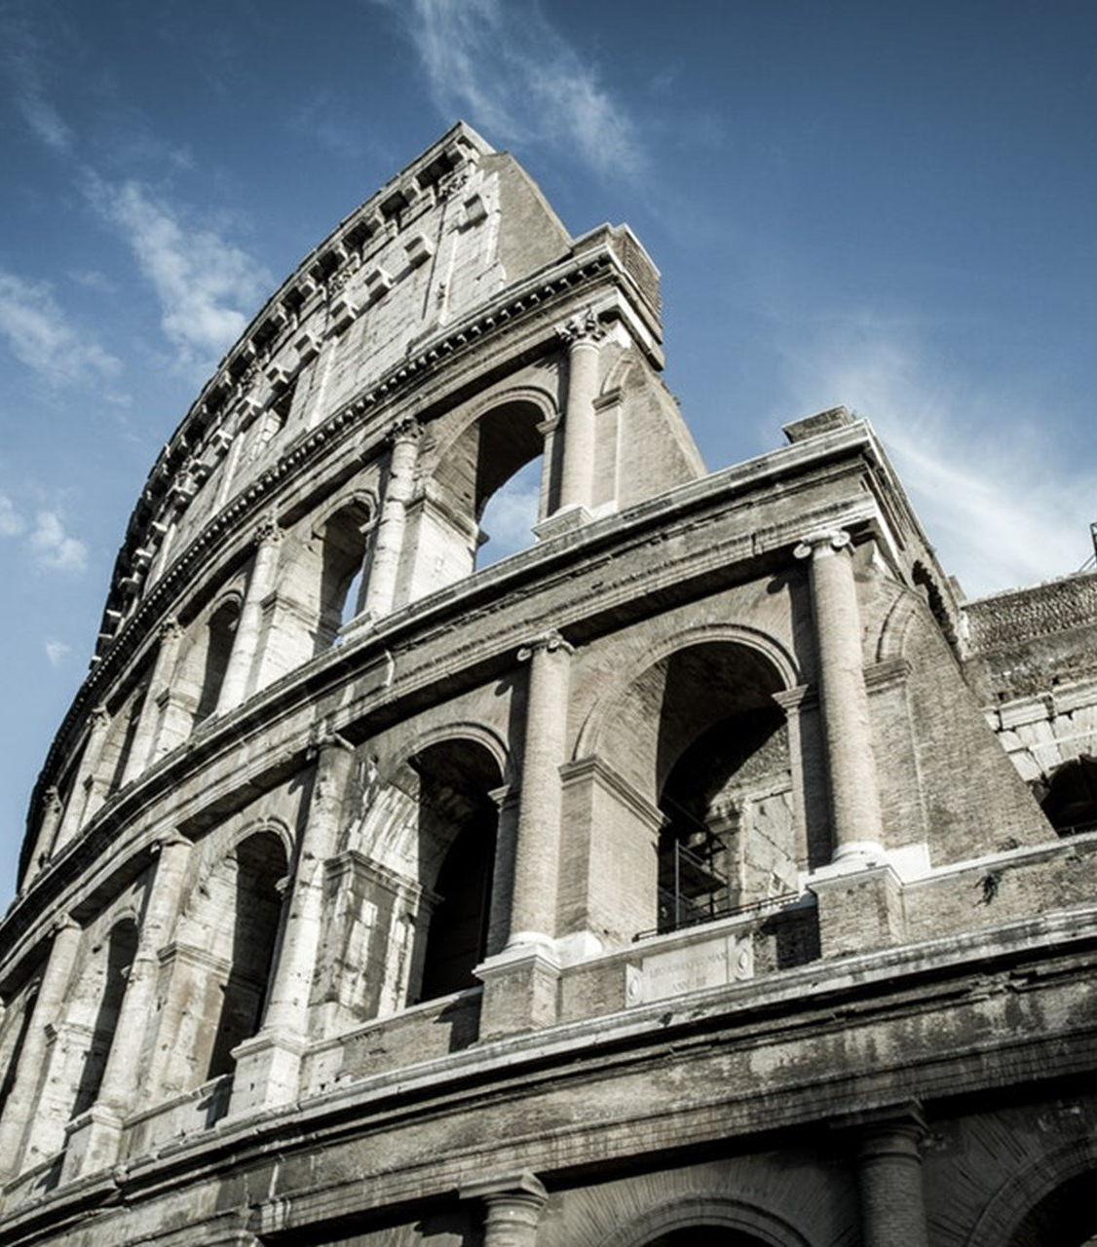
The Epistle to the Romans
An Introduction

Slide 2
An Introduction to Romans
Author
Time and Place of Writing
The church in Rome
Theme

Slide 3
Author – Paul (1:1)
An Apostle to the Gentiles
As seen in his commission – Acts 9:15; 26:16-18; Galatians 2:8
As noted in the Roman epistle – Romans 1:5, 13
As observed in his 1st missionary journey – Acts 13:1-3; 14:26-28

Slide 4
Author – Paul (1:1)
An Apostle to the Gentiles
An Apologist Before the Jews and Judaizers
Jews – Acts 9:20-25 – faced opposition immediately following his conversion.
Eventually led to his arrest, progressing to incarceration in Rome – Acts 21:28-31
Noted apprehension in the Roman epistle about his visit to Jerusalem – Romans 15:30-33

Slide 5
Author – Paul (1:1)
An Apostle to the Gentiles
An Apologist Before the Jews and Judaizers
Jews – Acts 9:20-25 – faced opposition immediately following his conversion.
Judaizers – Galatians 2:14 – “to live as Jews” – Ioudaizō; to become a Judaean, i.e. “Judaize” (Strong)
Had to deal with their heresy after his first missionary journey – Acts 15:1-2; Galatians 2:1-5
Deals with the topic in the Roman epistle – Romans 3:20-22 – A man is justified by grace through faith in Christ apart from the deeds of the law.

Slide 6
Time and Place of Writing
Time – 55-59 A.D. during Paul’s 3rd missionary journey
Place – Corinth
Gaius is Paul’s host – Romans 16:23; 1 Corinthians 1:14
Erastus is the treasurer of the city – Romans 16:23; 2 Timothy 4:20
Phoebe is commended – Romans 16:1-2 – member at the church in Cenchrea (suburb of Corinth)
Time? – Just before Paul’s journey to Jerusalem with benevolence for the needy saints – Romans 15:20-26; Acts 20:1-3, 16

Slide 7
The church in Rome
Establishment Unknown
By those saved at Pentecost? – Acts 2:10
By those scattered in the persecution? – Acts 8:4
Aquila and Priscilla from Rome – Acts 18:1-2; Romans 16:3-5
Faith of the Romans was widespread and known – Romans 1:8; 16:19

Slide 8
The church in Rome
Establishment Unknown
The City was Cosmopolitan
Idolatry and immorality – 1:18-32; 13:12-14
Mainly Gentile, but with Jewish presence – 1:5-7, 13; 3:1; 11:13-15
Arguments for salvation by faith apart from the law of Moses – 1:16; 3:20
Time given to Jewish/Gentile disputes – 14-15

Slide 9
Theme
Salvation by Faith in Christ Apart from the Law
“For I am not ashamed of the gospel of Christ, for it is the power of God to salvation for everyone who believes, for the Jew first and also for the Greek. For in it the righteousness of God is revealed from faith to faith; as it is written, ‘The just shall live by faith.’” (1:16-17)
Brief Outline
Justification by Faith Apart from the Law (Ch. 1-8)
Rejection of Jews and Acceptance of Gentiles (Ch. 9-11)
The Life Transformed by the Gospel (Ch. 12-16)

Slide 10
An Introduction to Romans
Author
Time and Place of Writing
The church in Rome
Theme

