Slide 2
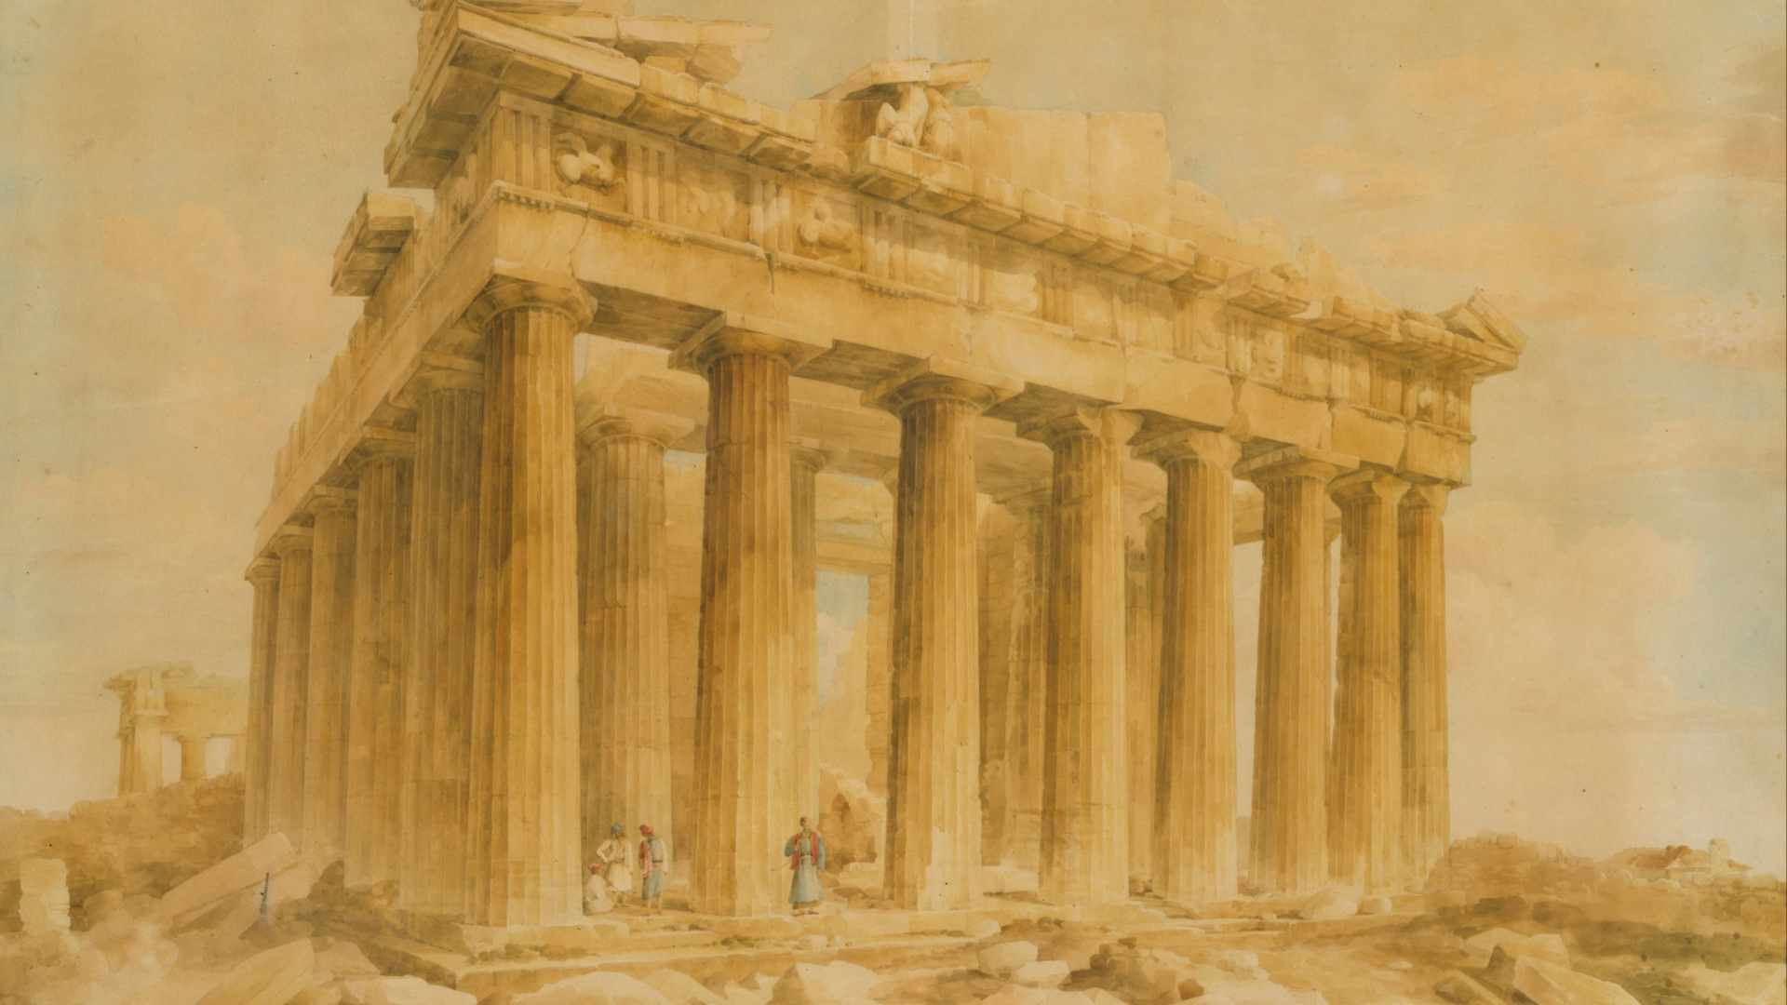
The House of God and the
Mystery of Godliness
1 Timothy 3:14-16

Slide 3
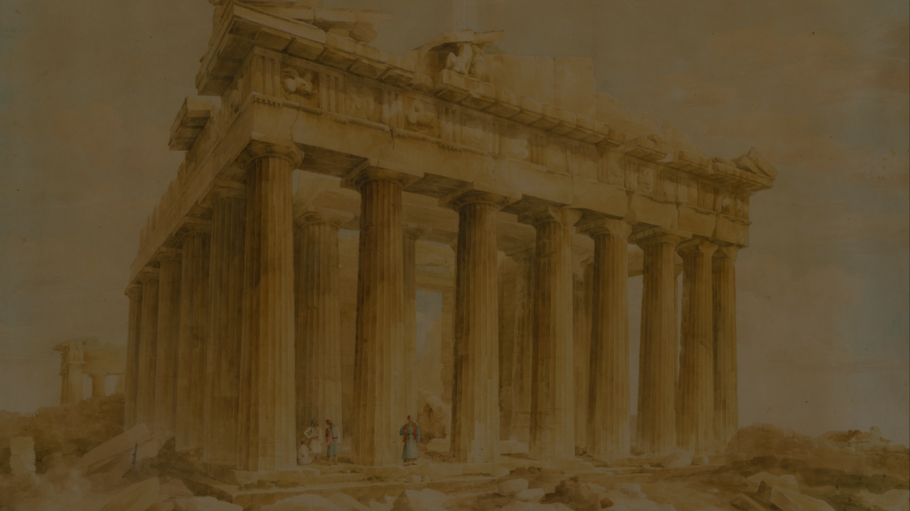
The House of God
The House of God is the Church of the Living God
God’s house in the Old Testament – Acts 7:44-50
We are God’s house (household/family) – Hebrews 3:6; 1 Peter 2:4-5; Ephesians 2:19-22
The nature of the kingdom (church) – Luke 17:20-21; 1 Peter 2:9-10 (Colossians 1:13)
“of the living God” – cf. Habakkuk 2:18-20

Slide 4
The House of God
The House of God is the Church of the Living God
The Pillar and Ground of the Truth
The church is the fullness of Christ – Ephesians 1:22-23
God is glorified in the church – Ephesians 3:21
Romans 1:8; 16:19 – Faith and obedience well known.
1 Thessalonians 1:6-8 – Word of the Lord sounded forth.
The church is the pillar and ground of the truth as it adheres to sound doctrine – Titus 2:1, 15

Slide 5
The House of God
The House of God is the Church of the Living God
The Pillar and Ground of the Truth
Upholding the Truth by Proper Conduct
Faithful obedience – Revelation 3:7-8, 10
True worship – John 4:24
Evangelism – Matthew 28:18-20
Waging the good warfare – Jude 3

Slide 6
The Mystery of Godliness
Its Value – “without controversy great is the mystery of godliness”
What? – The truth (v. 15).
  Once a mystery, now revealed – Colossians 1:26; 1 Corinthians 2:9-10
  Of godliness (metonymy – effect put for the cause) – 2 Timothy 3:17
The house of God knows the mystery is great! – Matthew 13:44-46

Slide 7
The Mystery of Godliness
Its Value
The Mystery Revealed
“God was manifested in the flesh”
“Justified in the Spirit”
“Seen by angels”
“Preached among the Gentiles”
“Believed on in the world”
“Received up in glory”

Slide 8
The House of God and the
Mystery of Godliness
1 Timothy 3:14-16

