Slide 1
.

Slide 2
A Flat Tyre
(Ezekiel 26)

Slide 3
I. A Truth Claim: A Forced Conclusion

Slide 4
God’s infinite knowledge
1. Premise: Bible foretold future events; not one failure; Bible is word of God
2. Prophesy: not guesswork, but fore-knowledge
3. Purpose: prophecy proves God’s deity

Slide 5
God’s use of prophecy
1. Timing, Is.41:23
2. Specific details, Is.41:25-26
3. Exact fulfillment, Is.41:23

Slide 6
I. A Truth Claim: A Forced Conclusion
II. Test Case: A Flat Tyre

Slide 7
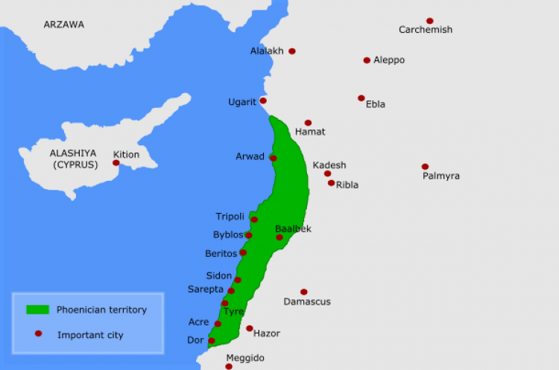
Phoenicia

Slide 8
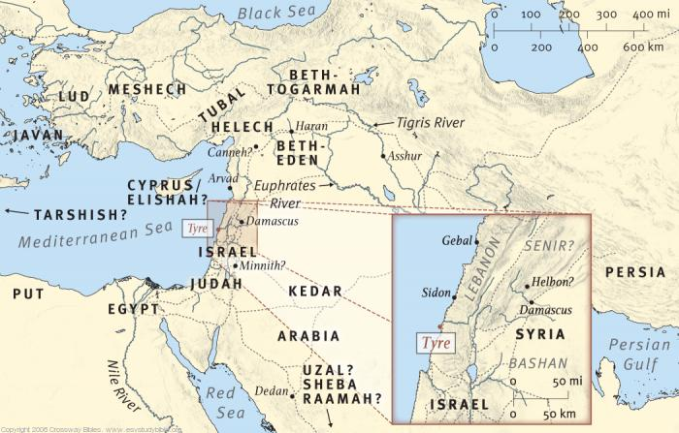
Tyre

Slide 9
Tyre’s sins
1. Sold Israelites as slaves to Greeks, Joel 3:4-6
2. Delivered Israelites to Edomites, Amos 1:9-10

Slide 10
Tyre’s judgment Ezekiel 26 (1/2)
1. Many nations would attack, 26:3
2. Walls and towers destroyed, 26:4
3. Dust scraped away; rocky top, 26:4
4. Ruins…place for spreading nets, plunder for nations, 26:5
5. Nebuchadnezzar to besiege her, 26:7-8

Slide 11
Tyre’s judgment Ezekiel 26 (2/2)
6. Enemies would break through walls, break down towers, trample streets, slay w. sword, 26:9-11
7. Ruins of city dumped in water, 26:12
8. City uninhabited, desolate rocky top, 26:14
9. Never to be rebuilt, 26:14

Slide 12
Destruction in two stages 1. Nebuchadnezzar
Besieged mainland city 13 yrs. (585-572)
No navy; could not flatten island city
Loss of mainland city devastated Tyre
Destroyed influence in world
Severely reduced trade

Slide 13
What Nebuchadnezzar did
Broke down gates of Tyre (vv.9-10)
Found city almost empty
Most had moved by ship to island ½ mile off coast

Slide 14
What Nebuchadnezzar did

Slide 15
What Nebuchadnezzar did
Broke down gates of Tyre (vv.9-10)
Found city almost empty
Most had moved by ship to island ½ mile off coast
Neuchadnezzar and soldiers did not receive adequate wages, Ezk.29:17-20

Slide 16
Destruction in two stages 2. Alexander
Took Sidon, then turned to Tyre
Small island ½ m. off shore
Heavily fortified; high, stout walls: 150’ high, 20’ thick at bottom
Supply of food, water
Fleet of 80 triremes
Sent messengers with peace terms.
Tyre agreed; sent gifts to Alexander.

Slide 17
Destruction in two stages 2. Alexander
Alexander asked to enter city to worship statue of Heracles.
“Sacrilegious” – would allow sacrifice on mainland at Old Tyre.
Alexander sent envoys to say this was unacceptable: Tyre must surrender.
Tyrians cut throats of envoys…

Slide 18
Alexander’s rage
Built 2000 ft. causeway to island
Hauled cedars from Lebanon mtns.
Drove them as piles into sandbar between mainland and island
Used debris and timber of ruined mainland city as solid material for mole, 200 ft. wide. Ezk.26:12,19

Slide 19
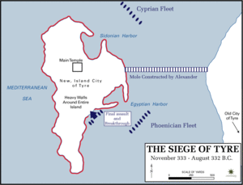
Alexander’s mole

Slide 20
Alexander’s allies
Offshore a fleet of 160 ships accom-panied his men (Sidon, Greek allies, etc.); attacked from three sides
His men were hindered by steady hail of missiles
On shore, engineers built ‘helepoleis’ (mobile protective towers) 160’ high

Slide 21
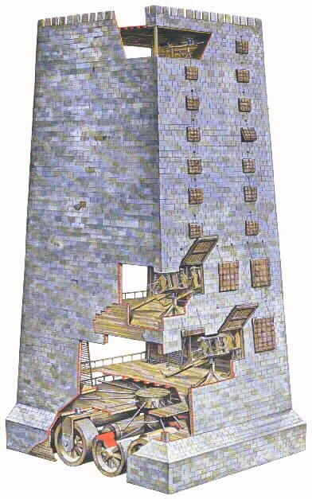
Helepolis,
a fortified,
wheeled
tower
(tortoise)
Battering rams
Catapults
Drills
Drawbridge

Slide 23
Tyre fell after 7 month siege (332 BC)
6000 Tyrian defenders died; 400 Greeks
30,000 from Tyre became slaves
2000 were crucified along beach
Repopulated Tyre with Greek emigrants & loyal Phoenicians, with a Macedonian garrison

Slide 24
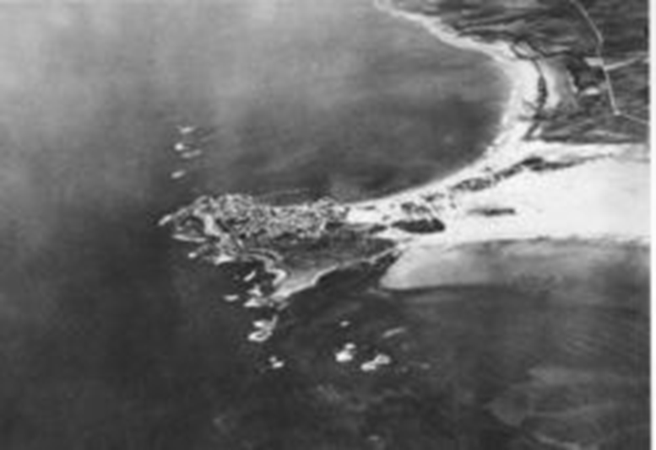
Fishermen spread nets on causeway (Ezk.26:14)
Tyre became a ‘peninsula’ (Ency. Brit.)

Slide 25
Alexander founded Alexandria
Became Tyre’s substitute; changed commercial structure of ancient world
Through the years, various nations recaptured small towns on the site, killing citizens, burning city
Mainland city never rebuilt

Slide 26
Summary of Fulfillment
Nations attack, 3
Destroy walls…, 4
Dust scraped, 4
Nets, plunder, 5
Nebuchadnezzar, 7-8
Enemies break through, slay, 9-11
Ruins dumped in water, 12
Uninhabited, 14
Never rebuilt, 14

Slide 27
Lessons
1. Sovereignty of God; Ezk.27:32; 28:2; Isa.40
2. Word of God; we must submit to it, Mt.11:21
3. Judgment of God; He will punish sin, Mt.11:22
4. Truth of God; predictive prophecy proves Word true

