Slide 1
.

Slide 2
Are Our Translations Reliable?

Slide 3
Depth and Breadth
Oceanographers
No one knows every verse…
of every translation…
in every language…
over a 3400 year period

Slide 4
Old Scottish Proverb
“Greek, Hebrew, and Latin all have their proper place. But it is not at the head of the cross, where Pilate put them, but at the foot of the cross, in humble service to Christ”

Slide 5
How To Determine Truth
Truth is never settled or proven by Greek words or grammar alone
In any language, a text out of context is a pretext
“If only I knew the Greek…”
We don’t have to know Greek to know God…but somebody did

Slide 6
NT Writers and Foreign Words
Talitha koum Mk.5:41
Siloam Jn.9:7
Tabitha Ac.9:36
Melchizedek Hb.7:1-2

Slide 7
I. Difficulties Of Translating

Slide 8
1. Traduttori, traditori
Translators are traitors
Traitors betray their country
Translators inevitably betray the meaning of the author. A translation does not give the complete meaning of the original
Mt.26:41, English – Russian – English:
“The vodka is fine but the meat is rotten”

Slide 9
Illustration: Gal.3:24
No single English word can tell us what function the Jewish law performed
Schoolmaster and tutor imply a teacher
Pedagogue: a household slave whose duty was to conduct boys of the family to and from school and to superintend their conduct generally
Custodian or attendant are better.
Mr. French
‘School bus’

Slide 10
2. Lexical problems
Many words have multiple meanings
“Set”: 194 different meanings [noun 58x; verb 126x; adjective 10x]
“Ball”: sphere; game to play; Cinderella; on the ball; have a ball
Latin, ago:
drive
do
discuss
live
spend

Slide 11
Translation difficulties
Some words in target language are unfamiliar to translators; the target language may not have a word that corresponds to the Greek/Hebrew
Algonquians: no word for “love”

Slide 12
Context clarifies meaning
Vulgate of Mt.11:5, series of opposites
caeci . . . vident, et
claudi . . . ambulant
leprosi . . . mundantur et
surdi . . . audiunt et
mortui . . . resurgunt et
pauperes . . . evangelizantur

Slide 13
Collection, 1 Co.16:1-2
(logeia) “…not found in profane authors” [Thayer, 379]
Thayer lists “Biblical words” [705]
Correctly defines it collection (based on context)
2nd Century B.C. papyri uses the word in this sense (M-M, xv)

Slide 14
3. Grammatical problems
Passive voice
Jack was hit by the ball.
Contrast: The ball hit Jack.
Many West African languages have no passive voice. Translators must supply an agent and an active verb

Slide 15
4. Cultural context
Ex.7:13, Pharaoh’s hard heart
In some languages, hard heart means “to be courageous”
Translators must find a way to convey the idea that he was stubborn

Slide 16
5. Idioms
A saying that cannot be understood by the individual words that compose it.
“My girlfriend is cool”
Uduks of Ethiopia: “worry”
“Do not shiver in your livers; you believe in God, believe also in me” (Jn.14:1)
“Peace” in some languages must be translated, ‘to sit down in one’s heart’

Slide 17
I. Difficulties Of Translating
II. The Septuagint (LXX)

Slide 18
Translated 200+ B.C.
Met needs of Jews in Egypt who spoke Greek
Autographs are actually inspired.
Accurate translations are virtually inspired.

Slide 19
Why is LXX so important?
1. First attempt to reproduce Scriptures in another language.
Style: Koine
Before the discovery of the Dead Sea Scrolls (1947), LXX was 1000 years older than earliest Hebrew MS

Slide 20
Why is LXX so important?
2. Majority of NT writers quote it
More than 300 quotations
Approved examples of quoting from a translation to establish God's will
1 Pt.2:7 (LXX), 8 (MT). Ac.2:11

Slide 21
Why is LXX so important?
3. NT reflects LXX influence
Both content and vocabulary
Augustus and Tiberius scorned the title “Lord”; it contradicted Roman conception of the empire as a principate
LXX: 6000+ times of JHVH
NT: In reign of Nero (Ac.25:26) “Lord” increases in frequency in NT as title of Jesus (cf. Ph.2:9, 11)

Slide 22
Why is LXX so important?
4. LXX helped evangelize the world
Alexander spread the Greek language around the world. LXX helped to prepare people for the coming Messiah
Jews rejected the LXX about AD 100
Ac.8:32-33, word for word from LXX of Is.53:7-8

Slide 23
Why is LXX so important?
5. LXX clarifies many NT words
“Church” does not occur in OT, but the same Greek word occurs about 100 times (LXX)

Slide 24
Why is LXX so important?
6. Contributes to understanding of OT passages
Gn.3:15, seed of woman who would defeat Satan in LXX is “he,” not “it”
Is.7:14, LXX uses term that undoubtedly means virgin
Dt.32:43, quoted in Hb.1:6, “let all the angels of God worship Him” (LXX and DSS; not in MT)

Slide 25
I. Difficulties Of Translating
II. The Septuagint (LXX)
III. Wise and Foolish Versions

Slide 26
Why do we need translations?
Hebrew OT (Gn.1:1):
בְּרֵאשִׁ֖ית בָּרָ֣א אֱלֹהִ֑ים אֵ֥ת הַשָּׁמַ֖יִם וְאֵ֥ת הָאָֽרֶץ׃
LXX (Gn.1:1):
Ἐν ἀρχῇ ἐποίησεν ὁ θεὸς τὸν οὐρανὸν καὶ τὴν γῆν.
Greek NT (Jn.1:1):
Ἐν ἀρχῇ ἦν ὁ λόγος, καὶ ὁ λόγος ἦν πρὸς τὸν θεόν, καὶ θεὸς ἦν ὁ λόγος.

Slide 27
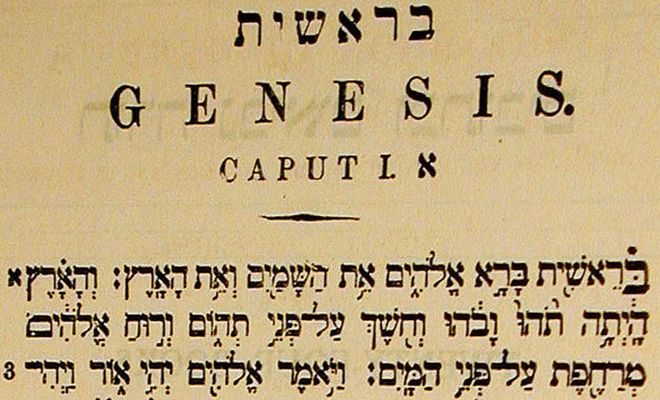
Why do we need translations?
Hebrew OT (Gn.1:1):

Slide 28
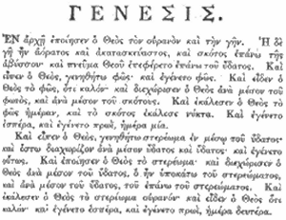
Why do we need translations?
LXX (Gn.1:1):

Slide 29
Why do we need translations?
Greek NT (Jn.1:1):

Slide 30
Which version to use?
1. Scholarship - Individual or group?
Robert Bratcher, TEV (Good News For Modern Man): Acts 20:7, “On Saturday evening we gathered together for the fellowship meal. Paul spoke to the people, and kept on speaking until midnight, since he was going to leave the next day”
7: Roman time (next day; Gentile territory; midnight is Monday)
11: Paul alone ate
11: talked (not = 7, 9). Assembly is over.

Slide 31
Which version to use?
2. Translation or paraphrase?
Formal Equivalence: attempts to translate the original as literally as possible, w/o doing violence to English usage
Dynamic Equivalence: attempts to convey thoughts of the text in free and idiomatic English with less regard for the exact wording of the original
Many commentaries come disguised as translations

Slide 32
Which version to use?
Four basic types of translations
Literal
Interlinear
Standard
[N]KJV; [N]ASV
“Thought”
NEB
NIV
Paraphrase
Phillips, Living Bible

Slide 33
Which version to use?
3. Theological bias?
“LIMITS OF SYNTAX. After all is done, instances remain where syntax cannot say the last word, where theological bias will inevitably determine how one interprets the Greek idiom . . .”

Slide 34
Which version to use?
3. Theological bias?
“…So in Ac.2:38 (eis) does not of itself express design (see Mt.10: 41), but it may be so used. When the gram-marian has finished, the theologian steps in, and sometimes before the grammarian is through” (A. T. Robertson, A Grammar Of The Greek New Testament… p. 389)

Slide 35
Which version to use?
3. Theological bias?
J. H. Thayer obtained permission from Professor Grimm to make changes in his work that might better adapt it to the needs of English speaking students, placing these additions in brackets ( [ ] )

Slide 36
Which version to use?
3. Theological bias?
3. of Christian baptism; this, according to the view of the apostles, is a rite of sacred immersion, commanded by Christ, by which men confessing their sins and professing their faith in Christ are born again by the Holy Spirit unto a new life, come into the fellowship of Christ and the church (1 Co. xii. 13), and are made partakers of eternal salvation; [but see art. “Baptism” in BB.DD., McC. and S., Schaff-Herzog]: Eph. iv. 5; Col. ii. 12 ...

Slide 37
Which version to use?
3. Theological bias?
3. of Christian baptism; this, according to the view of the apostles, is a rite of sacred immersion, commanded by Christ, by which men confessing their sins and professing their faith in Christ are born again by the Holy Spirit unto a new life, come into the fellowship of Christ and the church (1 Co. xii. 13), and are made partakers of eternal salvation; [but see art. “Baptism” in BB.DD., McC. and S., Schaff-Herzog]: Eph. iv. 5; Col. ii. 12 ...

Slide 38
Which version to use?
4. How does it differ from [NASV] and [N]KJV?
Ro.3:28, “For we conclude that a man is put right with God only through faith, and not by doing what the Law commands” (TEV)
Ro.1:17, “For the gospel reveals how God puts men right with himself: it is through faith alone, from beginning to end. As the scripture says, ‘He who is put right with God through faith shall live’” (TEV)

Slide 39
Which version to use?
1. Scholarship – Individual or Group?
2. Translation or paraphrase?
3. Theological bias?
4. How does it differ from [N]ASV, [N]KJV?
5. Does it teach doctrinal error?

