Slide 1
.

Slide 2
Terrible Lizards

Slide 3
Gideon Mantell

Slide 4
Sir Richard Owen
Leading British anatomist.
1842: coined ‘dinosaurs’ . . . dino▪saurs
terrible lizards
American fossil hunters
March, 1877: two schoolmasters found colossal bones projecting from rocks in different sections of Colorado…

Slide 5
Ongoing war: evolutionists – creationists
Issue: time
Evolutionists claim dinosaurs evolved from ancient reptile 200 million years ago
Became extinct 65-70 million yrs. ago
Man (in some form) evolved 2-3 million years ago
Based on assumption; no proof.
No fossil comes with date stamped on side.

Slide 6
I. Why Are Dinosaurs Important?

Slide 7
Dinosaurs are important because of…
Interest … especially children.
Indoctrination … from kindergarten to college.
Teachers: dinos prove old earth; birds evolved from dinos.
Children: accept what teachers say.
Stephen Jay Gould
Edward O. Wilson

Slide 8
I. Why Are Dinosaurs Important?
II. “Why Is The Bible Silent?”

Slide 9
Facts –
1. Whatever Bible discusses, it is accurate.
Bible was not intended to be zoology book
Bible does not mention many animals

Slide 10
Facts –
1. Whatever Bible discusses, it represents accurately.
2. ‘Dinosaur’ did not exist until 1842.
Wyclif: English Bible, 1392 – 450 years before the word ‘dinosaur’
KJV: English Bible, 1611 – 231 years before the word ‘dinosaur’
If Bible refers to dinosaurs, it must use a different name

Slide 11
Facts –
1. Whatever Bible discusses, it represents accurately.
2. ‘Dinosaur’ did not exist until 1842.
3. Some say Bible does not refer to dinosaurs.
a. Gn.1:21 (Job 7:12): sea monster; sea dragon, i.e., a serpent-like monster… sea serpent. Ps.148:7
b. Is.30:6, flying fiery serpent: exact ID unknown. Flying reptiles once lived.
How do they know?

Slide 12
Job gets his wish
God questions, Job withers.
Issue: before criticizing God, one must know what He knows, be able to do what He does.
God shows His power and wisdom that produced His creation.
Job seeks unconditional surrender.

Slide 13
I. Why Are Dinosaurs Important?
II. ‘Why Is Bible Silent?’
III. Behemoth
Job 41:15-24

Slide 14
Behemoth, Job 40:15-24
Intensive plural of ‘beast, animal, cattle.’
Can refer to beasts in general (Is.13:21).
Plural form + Singular verbs / pronouns specifies one great beast.
Translators did not know this beast’s identity; left it untranslated. ‘Transliterated’

Slide 15
Behemoth, Job 40:15-24
Some assume ‘hippopotamus’ (ASV ftnt.)
NKJV ftnt: ‘A large animal, exact identity unknown.’ [So ESV ftnt.]
RSV: “This portrait of Behemoth (like … Leviathan) may have received literary amplification, but it plays an integral part of the poet’s purpose: the creating God is in control of all forces of evil, despite appear-ances to the contrary… The primeval monster … is not a mere hippopotamus, but a mythical symbol … Leviathan, not an ordinary crocodile, but the sea-monster… is only a plaything in the eyes of God.”

Slide 16
Behemoth, Job 40:15-24
15-16, ‘I made along with you.’ Grass. Hips…
17, moves tail like cedar
18, skeleton like massive framework of brass and iron
19a, first (chief): size, might of God’s works
a. Hippo: about 4 tons…7 feet
b. Elephant: about twice size of hippo
c. Apatosaurus: about 30 tons, 3 stories
19b, could not approach with sword / capture
24, no creature today fits this description

Slide 17
I. Why Are Dinosaurs Important?
II. ‘Why Is Bible Silent?’
III. Behemoth
IV. Leviathan
Job 41:1-34

Slide 18
Leviathan, Job 41:1-34
Reptile, serpent-like creature of the sea that takes on mythological proportions. Sea creature. Dragon. Sea monster [N]ASV; RSV. Monster of the deep (NIV). Sea serpent (NKJV).
NASB et al. ftnt.: ‘or the crocodile.’
NKJV ftnt.: A large sea creature, exact identity unknown.
LXX: verb, to be extraordinarily impressed or disturbed by something…wonder, marvel.
Context: not a crocodile.

Slide 19
Leviathan, Job 41:1-34
1-6, could not be captured and domesticated.
7-11, overwhelmed men…therefore, who can resist God?
12-17, scales as armor; terrifying teeth.
18-21, sneezings of fire / smoke.
Fireflies produce light.
Eels produce electricity.
Bombardier beetles produce explosive chemical reactions.

Slide 20
Leviathan, Job 41:1-34
22-24, mightiest of men feared…
25, crocodile has short legs… (cf. v.34).
26-30, weapons useless against him.
31-32, moved easily through sea, causing commotion in water – churning wake.
33, no other creature on earth could cause such dread.
34, strange if say crocodile beholds every high thing.

Slide 21
Leviathan, Job 41:1-34
T.K.Cheyne espoused mythological interpre-tation of Job 40-41.
1. NO modern animal fits the description.
2. Are other animals mythological, too?
3. Mythological view causes greater problems.
Job could say, “What’s the point? These creatures are make-believe.”

Slide 22
Ex.20:11
Summary of Creation account, Gn.1
Six days . . . created all that is in them
Sea and air creatures: 5th day
Land animals: 6th day ... with man (Job 40:15)
Job learned the lesson

Slide 23
One more thing…

Slide 24
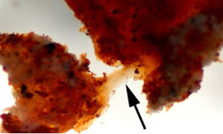
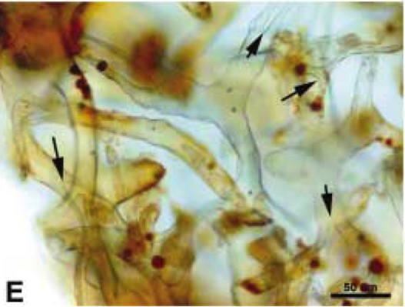
Mary Schweitzer, 2011
Fossils / eggs (Jack Horner).
Blood vessels and red blood cells in ‘68 million year old dinosaur’??
She, an evolutionist, old-earther, fired!

Slide 25
World Book
“Dragons of legend are strangely like actual creatures that have lived in the past. They are much like the great reptiles which inhabited the earth long before man is supposed to have appeared on earth. Dragons were generally evil and destructive. Every country had them in its mythology. Dragons were generally evil and destructive. Every country had them in its mythology.” They are drawn and described with uniformity.

Slide 26
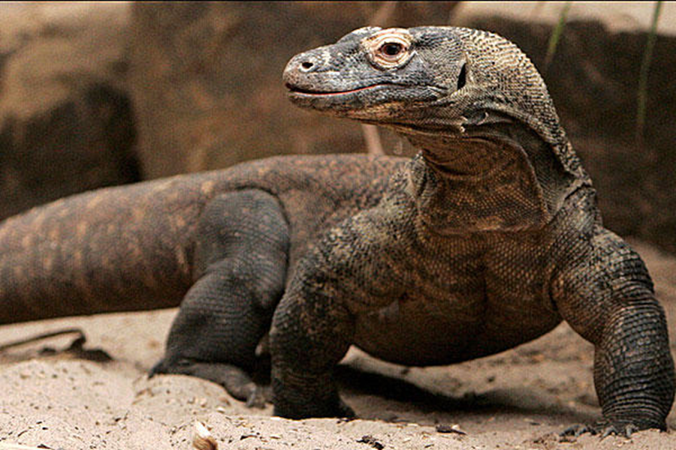
Worldwide Flood
If flood altered earth’s canopy vapor, dinosaurs (and man) may have shrunk in size / longevity.
99% of earth’s species are extinct?
History points to one special cause.
Terrible lizard?

