Slide 2
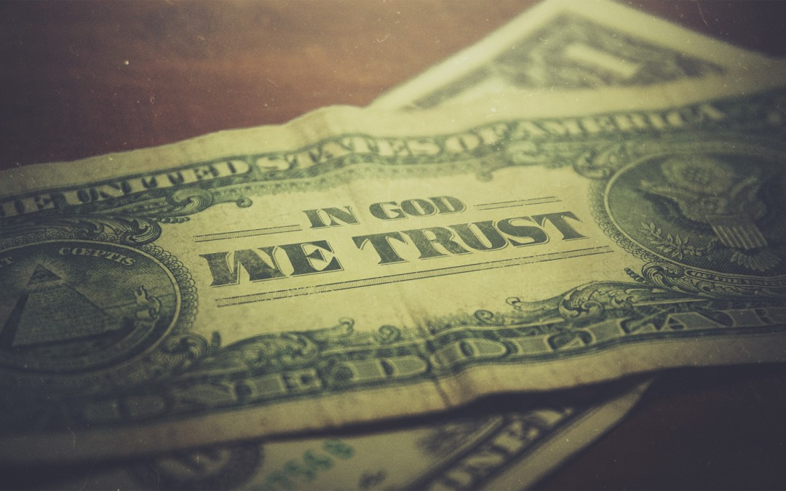
Money, Contentment,
& True Riches
1 Timothy 6

Slide 3

Money – The Blessing and Danger
Money is a Blessing from God
It isn’t money that is being condemned, but the love of money – 1 Timothy 6:10
Money is a gift from God – 1 Timothy 6:17; James 1:17; Deuteronomy 8:11, 17-18
Money is a necessity which God supplies – cf. Matthew 7:9-11
Truly, money is God’s and we are merely stewards – 1 Timothy 6:7; 1 Chronicles 29:10-15; Job 1:21
  It is to be used in ways authorized and commanded by Him – EX: 1 Timothy 5:8; Romans 13:1, 6-7

Slide 4
Money – The Blessing and Danger
Money is a Blessing from God
The Love of Money (v. 10)
God wants our love – Matthew 19:20-22, 23-24, 29; Matthew 6:24
False teachers as an example of the danger – 1 Timothy 6:3-5, 9-10

Slide 5
Contentment – The Proper Perspective
A Spiritual Perspective in a Material World
Came with nothing, leave with nothing – 1 Timothy 6:7
Luke 12:13-21 – learn from the rich fool.
All will be burned up – 2 Peter 3:10

Slide 6
Contentment – The Proper Perspective
A Spiritual Perspective in a Material World
Contentment
Called to godliness and contentment – 1 Timothy 6:6-8 (cf. Matthew 6:33)
Contentment in any circumstance is dependent on a relationship with Christ – Philippians 4:4, 10-13
“great gain” – 1 Timothy 4:8

Slide 7
True Riches – The Christian’s Pursuit
What is Truly Valuable – 1 Timothy 6:17-19; Matthew 6:19-21
The Pursuit of True Riches
Paul’s exhortation to Timothy in contrast to the false teachers – 1 Timothy 6:11-12
Physical riches can and should be used to lay up spiritual riches – 1 Timothy 6:18-19; Luke 16:9-13; 2 Corinthians 9:6-11

Slide 8
Money, Contentment,
& True Riches
1 Timothy 6

