Slide 1
.

Slide 2
The God Who
Is There

Slide 3
God, the Creator
Genesis 1:14-19
Psalm 8:1-4
Daniel 2:28
God
Creator
Majesty
Splendor
Earth
Fingers
Concern for man

Slide 4

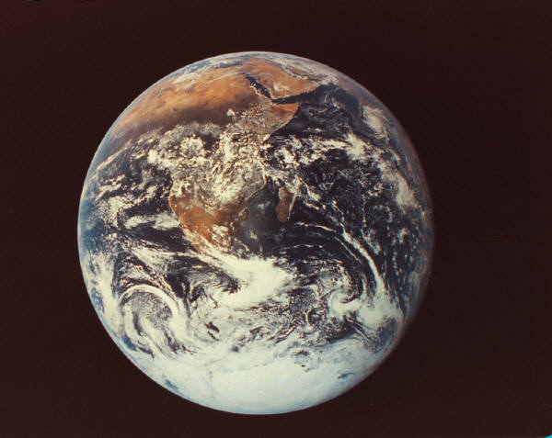

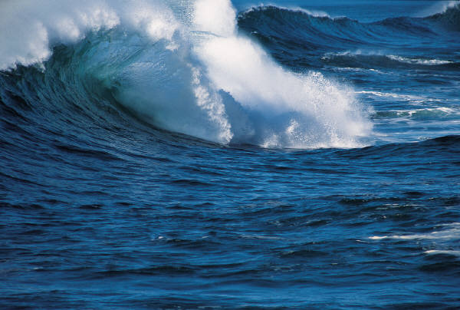
Ancient Earth View

Slide 5


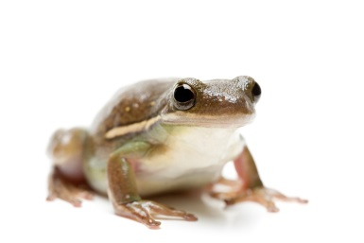

Modern evolution
1. No observers
2. Multiplied millions of years
3. Cannot be repeated
4. Therefore, matter of ‘faith’
?

Slide 6

I. The Problem

Slide 7
Some claim that earth, life, humans came from nothing
“It is not sufficient merely to say, ‘you can’t get something from nothing.’ While everyday experience and common sense seem to support this principle, if there is anything that we have learned from 20th Century physics, it is this: Common sense is often wrong, and our normal experiences are but a tiny fraction of reality”
If true, we cannot know anything!

Slide 8
Did earth, stars, humans come from nothing?
1. Where did matter come from to allow their ‘existence’ in the first place?

Slide 9
Did earth, stars, humans come from nothing?
1. Where did matter come from to allow their ‘existence’ in the first place?
2. Does scientific method observe some-thing coming from nothing?

Slide 10
Scientific method
Start: observe / ask a question
Hypothesize / Predict
Test / Analyze
Examine results

Slide 11
Did earth, stars, humans come from nothing?
1. Where did matter come from to allow their ‘existence’ in the first place?
2. Does scientific method observe some-thing coming from nothing?
3. How do skeptics react to Lord’s miracles?
  “Contrary to our normal experience”
  BUT experience is a “tiny fraction of reality”?

Slide 12
“Normal experiences (a fraction of reality) might produce matter from nothing”
“Don’t believe Lord’s miracles; they are contrary to our experience”

Slide 13


How to explain the house?
1. Illusion? (mirage; medicine)
2. Eternal? (self-existent) Entropy
3. Created itself? (law of non-contradiction)
4. Intelligent designer? (Hb.3:4; 11:3)

Slide 14
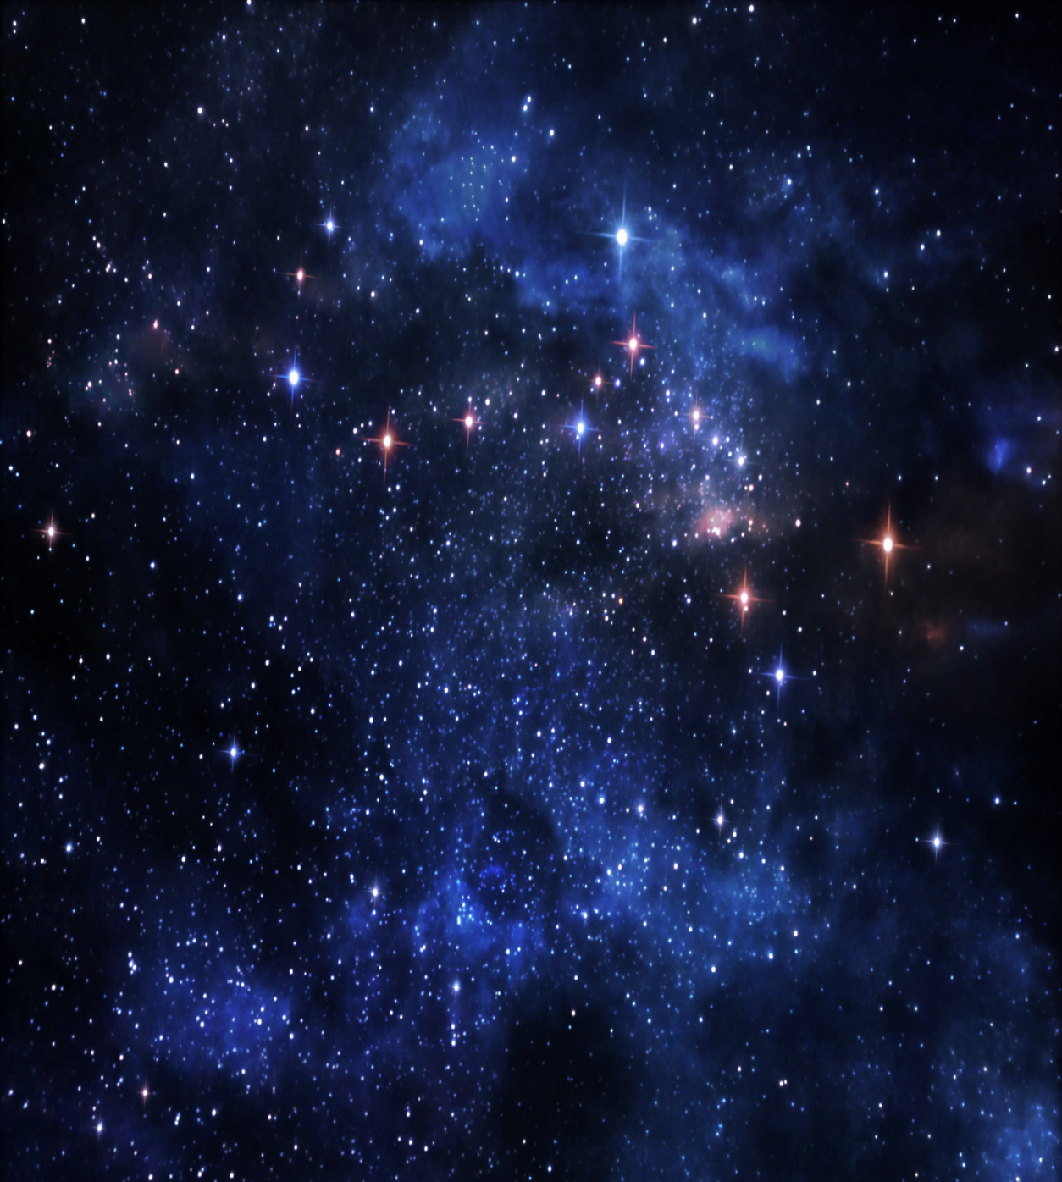
How to explain the stars?
1. Illusion? (mirage; medicine)
2. Eternal? (self-existent) Entropy
3. Created itself? (law of non-contradiction)
4. Intelligent designer? (Hb.3:4; 11:3)

Slide 15
I. The Problem
II. The Proof

Slide 16



God’s design
Job 38
1-4, earth
16, sea
19-21, light
31-33, stars
1. Something either is or it is not. Which?
2. What is, is either created or eternal. Which?

Slide 17
God’s design
Job 38
1-4, earth
16, sea
19-21, light
31-33, stars
1. Something either is or it is not. Which?
2. What is, is either created or eternal. Which?
3. Creator is either intelligent or unintelligent.
  House . . . Universe

Slide 18

Anthropic principle
(Job 38:34…39)
■ Oxygen level
Earth’s atmosphere is 21% oxygen.
25%, fires would erupt spontaneously
15%, people would suffocate

Slide 19
Anthropic principle
■ Oxygen level
■ Atmospheric transparency
Less: not enough solar radiation would reach earth’s surface
More: bombarded with too much solar radiation

Slide 20
Anthropic principle
■ Oxygen level
■ Atmospheric transparency
■ Moon-Earth gravitational interaction
Greater: tidal effects on oceans, atmosphere, and rotational period would be too severe; no life on earth
Less: orbital changes would cause climactic instabilities; no life on earth

Slide 21
Anthropic principle
■ Oxygen level
■ Atmospheric transparency
■ Moon-Earth gravitational interaction
■ Carbon Dioxide level
Higher: runaway greenhouse effect (we burn up)
Lower: plants could not maintain efficient photosynthesis for life
(we suffocate)

Slide 22
Anthropic principle
■ Oxygen level
■ Atmospheric transparency
■ Moon-Earth gravitational interaction
■ Carbon Dioxide level
■ Gravity
If force of gravity were altered by 0.00000000000000000000000000000000000001 % . . . the sun would not exist
(thus, neither would we)

Slide 23
We acknowledge intelligent design every day
Plane with lights . . . and stars
Statue . . . person who posed for it
Camera . . . eye, Pr.20:12
Cochlear implant . . . ear, Pr.20:12
Robotic hand . . . hand, Ps.139:13-16
Computer . . . brain
City water system, cars . . . cell

Slide 24
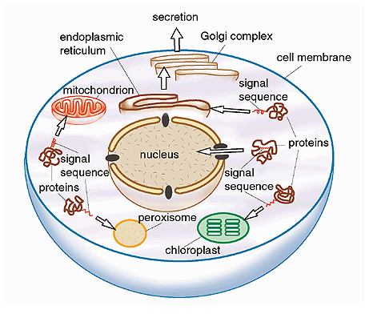
We acknowledge intelligent design every day

Slide 25

Human Body’s systems
Circulatory
Nervous
Respiratory
Reproductive
Skeletal
First man and woman could not live with circula-tory system alone…
All systems had to work together – in two persons at same time.

Slide 26
Creation Reveals Divine Designer
“For since the creation of the world His invisible attributes are clearly seen, being understood by the things that are made, even His eternal power and Godhead, so that they are without excuse” – Ro.1:20

