Slide 1
.

Slide 2
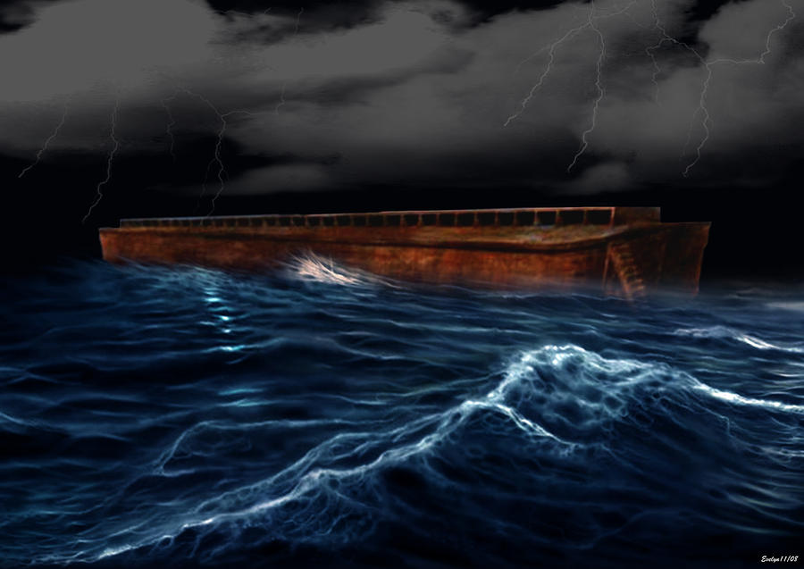
The Water That
Washed The World
(Genesis 6-9)

Slide 3
Genesis – Flood
1. Two chapters reveal Creation, 1-2
2. One chapter records Fall, 3
3. Four chapters relate Great Flood, 6-9

Slide 4
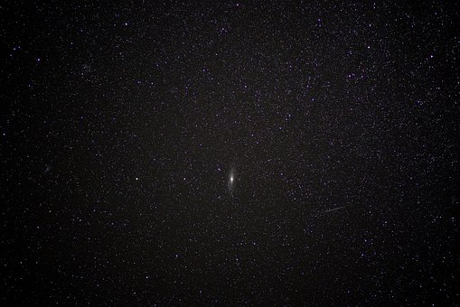
Facts About The Flood
Noah (‘comfort’) Gn.5:29
6:1-2, sons of God – as Dt.14:1
6:3, period of grace, opportunity to repent
6:4, giants. Context: men, not angels
4:16-24, family of Cain
5:1-32, godly men
6: salt is losing its flavor

Slide 5
Gn.6:1-7, people, not angels
Angels cannot marry (Lk.20:34-36)
Evil angels are not sons of God; good angels do not disobey (6:2)
Angels sin – men are punished? (6:3)
“Afterward” – more angels? (6:4)
Wickedness of men; evil hearts (6:5)
God: grieving heart (6:6)
Judgment (flood) (6:7)

Slide 6
Gn.6:8-9, BUT Noah…
Found grace
A contrast: God favored Noah.
Character of Noah: ‘different’
1. Just (righteous)
2. Perfect (consistent)
3. Walked with God (as 5:22)
Wherever God leads, Noah goes
Opposition to sin; stands with God
Righteous life (7:1). Hb.11:7; 2 Pt.2:5

Slide 7
Gn.6:11-22… self-destruction
13: end of grace; judgment would follow
14: ark: boat, basket, chest; floating box. Pitch
15: size
16: window; three decks
17: destroy all flesh
18: covenant with Noah and family
19-20: animal preserve
21: food store
22: Noah’s faith (Hb.11:7)

Slide 9
Gn.7-8, on board ark; exit from ark
7:11, rain + fountains of great deep
8:11, dove…olive leaf
8:17 (= 1:28): fruitful, multiply
8:20-22, worship

Slide 10
I. Many Do Not Believe In Worldwide Flood

Slide 11
People reject Flood because…
1. Does not ‘match science’
a. “Gn.1-11 is poetry”
b. Why stop here?
2. Media
3. Manipulate terms: ‘universal…’
4. Myth view
5. Mini-flood view

Slide 12
I. Many Do Not Believe In Worldwide Flood
II. Why Insist On Worldwide Flood?

Slide 13
1. Directions God gave Noah, 6:1-4
120 years (3): time God gave Noah to finish preparing for Flood (ark; pack; preach…)
If local Flood, why . . .
not relocate Noah? [Sodom…Lot]
gather animals?
build ark?
build such large ark?
1858
Two of every family . . . / species
Average land animal: smaller than sheep
136,560 sheep in ½ its capacity . . .

Slide 14
1. Directions God gave Noah, 6:1-4
2. Dimensions of flood, 6:5
Great wickedness in earth, 5.
Face of earth, 7.
Earth corrupt, filled with violence, 11.
All flesh corrupted, 12.
All flesh, 7:19, 21.

Slide 15
1. Directions God gave Noah, 6:1-4
2. Dimensions of flood, 6:5
3. Design of flood, 6:…13
Destroy sinful ‘man’ with earth.

Slide 16
1. Directions God gave Noah, 6:1-4
2. Dimensions of flood, 6:5
3. Design of flood, 6:…13
4. Description of flood, 7:11
7:11 – reversal of 1:6ff.
1. Below: all fountains of great deep broke up (oceans) [1:2]
2. Above: windows of heaven (firmament, expanse, 1:7)

Slide 17
1. Directions God gave Noah, 6:1-4
2. Dimensions of flood, 6:5
3. Design of flood, 6:…13
4. Description of flood, 7:11
5. Duration of Flood, 7:11; 8:14
One year, ten days, 7:11; 8:14
Peaked in 150 days (8:3-4)

Slide 18
1. Directions God gave Noah, 6:1-4
2. Dimensions of flood, 6:5
3. Design of flood, 6:…13
4. Description of flood, 7:11
5. Duration of flood, 7:11; 8:14
6. Depth of flood, 7:19-20
Waters covered mountains to depth of at least the draft of Noah’s ark

Slide 19
1. Directions God gave Noah, 6:1-4
2. Dimensions of flood, 6:5
3. Design of flood, 6:…13
4. Description of flood, 7:11
5. Duration of flood, 7:11; 8:14
6. Depth of flood, 7:19-20
7. Decree, 9:15
No more universal floods.
If local: decree is proven false every year.
Rainbow would remind us that God lied.

Slide 20
1. Directions God gave Noah, 6:1-4
2. Dimensions of flood, 6:5
3. Design of flood, 6:…13
4. Description of flood, 7:11
5. Duration of flood, 7:11; 8:14
6. Depth of flood, 7:19-20
7. Decree, 9:15
8. Deliverance (type and antitype)
Gn.6:14-16, flood and salvation – faith
Noah: saving faith, Hb.11:7. Great test.
Baptism: 1 Pt.3:20-21
God’s idea: ark / baptism
Voluntary, but exclusive…
Based on grace: had to enter ark
Few were saved. So, today

Slide 21
1. Directions God gave Noah, 6:1-4
2. Dimensions of flood, 6:5
3. Design of flood, 6:…13
4. Description of flood, 7:11
5. Duration of flood, 7:11; 8:14
6. Depth of flood, 7:19-20
7. Decree, 9:15
8. Deliverance (type and antitype)
Gn.10:1…32
Actual characters
Actual events
Universal scope

Slide 22
1. Directions God gave Noah, 6:1-4
2. Dimensions of flood, 6:5
3. Design of flood, 6:…13
4. Description of flood, 7:11
5. Duration of flood, 7:11; 8:14
6. Depth of flood, 7:19-20
7. Decree, 9:15
8. Deliverance (type and antitype)
Mt.24:37-39, flood, judgment, neglect
As days of Noah – so will be… (really?)
Noah entered ark – ‘all’ taken away
Lk.17:27-29, ‘all’; ‘Sodom’
Lk.3:36, Noah – real?
If we can’t trust Jesus on history, can we trust Him on salvation?

Slide 23
1. Directions God gave Noah, 6:1-4
2. Dimensions of flood, 6:5
3. Design of flood, 6:…13
4. Description of flood, 7:11
5. Duration of flood, 7:11; 8:14
6. Depth of flood, 7:19-20
7. Decree, 9:15
8. Deliverance (type and antitype)
Hb.11:7
If not factual, how would it encourage readers?
How many other examples in Hb.11 are ‘good stories’ / ‘mere legends’?

Slide 24
1. Directions God gave Noah, 6:1-4
2. Dimensions of flood, 6:5
3. Design of flood, 6:…13
4. Description of flood, 7:11
5. Duration of flood, 7:11; 8:14
6. Depth of flood, 7:19-20
7. Decree, 9:15
8. Deliverance (type and antitype)
2 Pt.2:5
Flood and universal judgment (9)
Deny Noah = deny our final judgment?

Slide 25
1. Directions God gave Noah, 6:1-4
2. Dimensions of flood, 6:5
3. Design of flood, 6:…13
4. Description of flood, 7:11
5. Duration of flood, 7:11; 8:14
6. Depth of flood, 7:19-20
7. Decree, 9:15
8. Deliverance (type and antitype)
2 Pt.3:5-6, compares miracle of flood and creation and universal judgment of world
6: earth
10-12, if local flood, will final judgment melt only small part of earth with fervent heat?

Slide 26
1. Directions God gave Noah, 6:1-4
2. Dimensions of flood, 6:5
3. Design of flood, 6:…13
4. Description of flood, 7:11
5. Duration of flood, 7:11; 8:14
6. Depth of flood, 7:19-20
7. Decree, 9:15
8. Deliverance (type and antitype)
~250-300 Flood traditions in literature of nations. Babylon
Berosus (275 BC):
‘But of this ship that grounded in Armenia some part still remains in the mountains …and some get pitch from the ship by scraping it off.’

Slide 27
1. Directions God gave Noah, 6:1-4
2. Dimensions of flood, 6:5
3. Design of flood, 6:…13
4. Description of flood, 7:11
5. Duration of flood, 7:11; 8:14
6. Depth of flood, 7:19-20
7. Decree, 9:15
8. Deliverance (type and antitype)
~250-300 Flood traditions in literature of nations.
Josephus
Idea of ‘local Flood’ not found prior to AD 1655.
Fossils of sea creatures found in every continent on mountainous regions…

Slide 28
Genesis 6-9
Multitude of words, phrases, clauses that can be understood only globally
“...we should be careful to read the [Flood] account wholeheartedly in its own terms, which depict a total judgment on the ungodly world already set before us in Genesis—not an event of debatable dimensions in a world we may try to reconstruct. The whole living scene is blotted out, and the New Testament makes us learn from it the greater judgment that awaits not only our entire globe but the universe itself” – Kidner, II Pt.3:5-7 p.95

Slide 29
Genesis 6-9
Multitude of words, phrases, clauses that can be understood only globally
“...we should be careful to read the [Flood] account wholeheartedly in its own terms, which depict a total judgment on the ungodly world already set before us in Genesis—not an event of debatable dimensions in a world we may try to reconstruct. The whole living scene is blotted out, and the New Testament makes us learn from it the greater judgment that awaits not only our entire globe but the universe itself” – Kidner, II Pt.3:5-7 p.95

