Slide 2
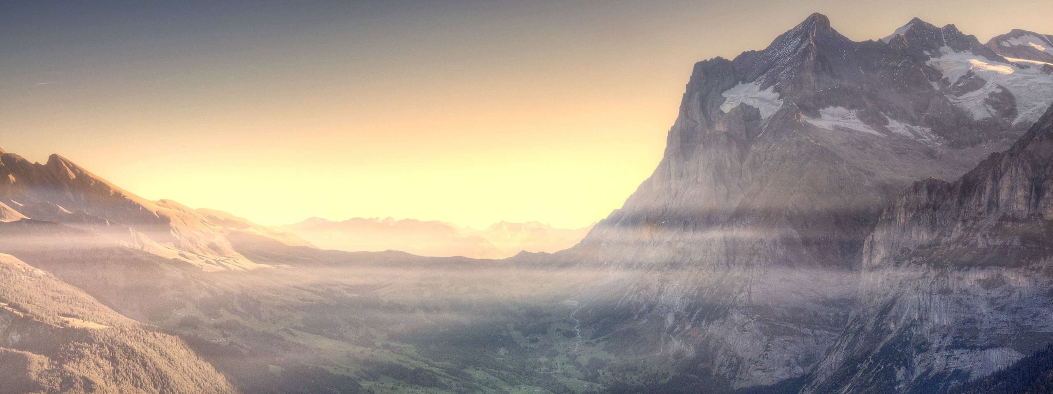
God
Hills
of
the
&
Valleys
1 Kings 20:28

Slide 3
God of the
Hills
God is the Source of Good
James 1:16-17 – everything good comes from Him.
We need to heed the warning given to the Israelites – Deuteronomy 8:11-17
Especially concerning spiritual matters:
Not self-righteous like the Pharisee – Luke 18:9-14
But seeking the righteousness from God by faith – Philippians 3:9
God is to be Praised for His Goodness – 1 Thessalonians 5:16-18; Colossians 3:17

Slide 4
God of the
Valleys
God is the One to Seek as the Solution to All Problems
He does not abandon us in trouble – Matthew 27:45-46; Psalm 22
He is with His people through the hills and the valleys – Psalm 23
He can make the bad work for our good – Romans 8:28 (cf. 5:3-4)
Most importantly, He is the solution to spiritual problems – John 6:66-69

Slide 5
God of the
Valleys
God is the One to Seek as the Solution to All Problems
The Valley of Spiritual Failure
It is important to know that God never separates Himself from us – Isaiah 59:1-2 – our sin separates us from Him.
God pursues us – Isaiah 59:15-21; 1 John 1:5; John 1:4, 9-13
God descends to sinful man to help Him up – 1 Timothy 1:12-16

Slide 6
God of the
Valleys
God is the One to Seek as the Solution to All Problems
The Valley of Spiritual Failure
If we find ourselves in the valley of spiritual failure:
Humble yourself and turn back to God – James 4:4-10; 1 John 2:1-2; 1:9
Consider God’s optimism concerning your growth – Hebrews 6:4-6, 9-12
Show God and others your godly sorrow and repentance – 2 Corinthians 7:8-11

Slide 7
God
Hills
of
the
&
Valleys
1 Kings 20:28

