Slide 2
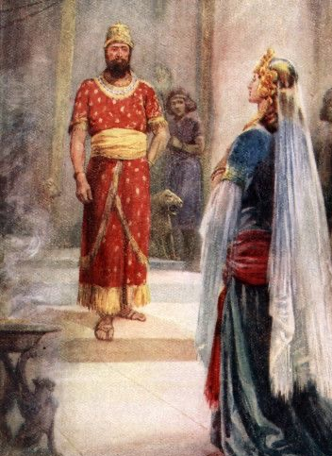
Judgment
from the
Queen
of the South

Slide 3
Eagerness
1 Kings 10:1 – When she heard of Solomon’s wisdom, she was eager to witness it herself. To the extent of traveling a great distance.
Do we hunger and thirst for righteousness? – Matthew 5:6
Are we swift to hear God’s word? – James 1:19
Are we eager like the Psalmist? – Psalm 42:1-2; 63:1-8
Are we eager like the Bereans? – Acts 17:11-12
Are we eager to enter the house of the Lord? – Psalm 122:1

Slide 4
Access
1 Kings 10:1-2 – It was far from convenient for the Queen to visit Solomon.
We do not have to accomplish great feats to know God’s wisdom – Romans 10:6-8
God’s wisdom has been graciously revealed to us – 1 Corinthians 2:9-10
We can know it by simply reading! – Ephesians 3:3-4
We live in the blessed time of God’s full revelation – 1 Corinthians 13:10-12; Jude 3

Slide 5
Thorough Inquiry
1 Kings 10:2 – The Queen did not fail to take full advantage of the wisdom before her by asking anything that was on her heart.
Do we ask God for wisdom often? – James 1:5
Do we seek the deeper things of God’s wisdom, and ask Him to show us? – Psalm 119:17-19
Do we ask our High Priest questions during all our trials? – Hebrews 4:14-16
Do we pour our hearts out to God in Christ to find peace? – Philippians 4:6-7

Slide 6
Acceptance
1 Kings 10:6-9 – Even though the Queen was eager to meet Solomon she had no confirmation of his supposed wisdom beforehand. However, when she spoke with him, she accepted his wisdom without hesitation.
Accept the word like the Thessalonians – 1 Thessalonians 2:13; 5:19-22
Do we accept God’s word with meekness and then obey it? – James 1:19-25

Slide 7
Giving and Praise
1 Kings 10:6-12 – When the Queen knew the wisdom of Solomon to be true, and from the Lord, she acknowledged it, and gave him gifts.
We need to acknowledge God, and praise Him for His vast wisdom – Romans 11:33-36
We always need to be thankful to God for His word – 1 Thessalonians 5:16-18; Colossians 3:17
Do we respond to Jesus as a friend as He has been a friend to us? – John 15:14-15
Do we give our lives to God and Christ in response to His mercy? – Romans 12:1-2

Slide 8
Judgment
from the
Queen
of the South

