Slide 1
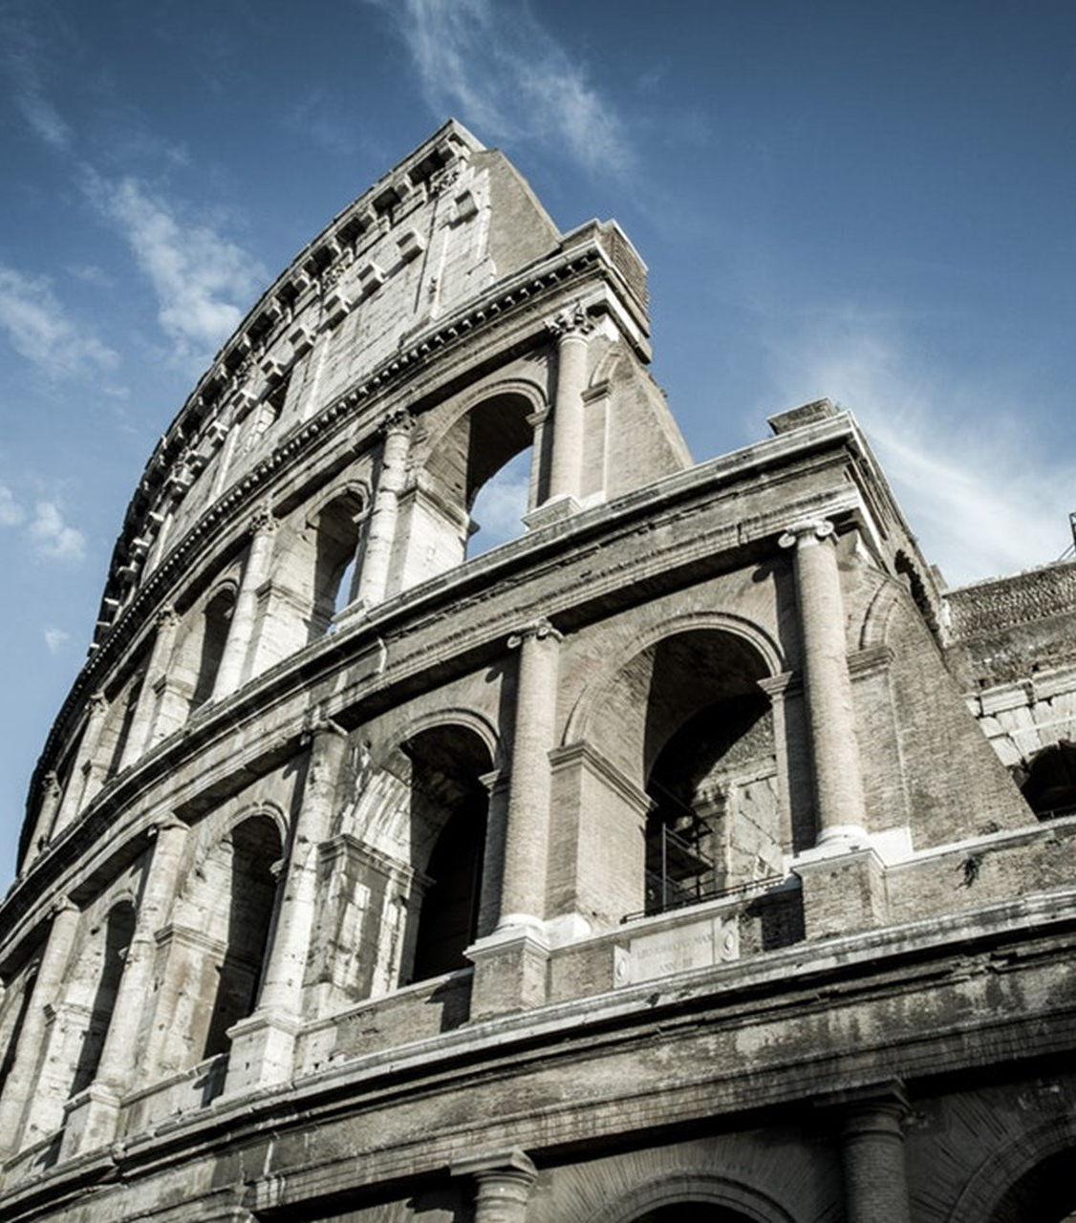
The Epistle to the Romans
Chapter 7

Slide 2
Freedom from the Law and from the Body of Death
Freedom from the Law to Serve Christ (vv. 1-6)
Sin’s Occasion by the Law (vv. 7-12)
The Dominion of Sin Under the Law (vv. 13-25)

Slide 3
Freedom from the Law and from the Body of Death
Freedom from the Law to Serve Christ (vv. 1-6)
The law has dominion over a man as long as he lives. (v. 1)
A woman is bound by the law to her husband as long as he lives. (v. 2a)
If the husband dies, she is released from the law of her husband. (v. 2b)
While her husband lives, if she marries another man, she is an adulteress. (v. 3a)
If her husband dies, she is free from that law, is no adulteress, though she married another man. (v. 3b)
Through Christ you have become dead to the law to be married to Christ and bear fruit to God. (v. 4)
When we were in the flesh, sinful passions were at work to bear fruit to death. (v. 5)
We have been delivered from the law to serve in newness of spirit and not in the oldness of the letter. (v. 6)

Slide 4
Freedom from the Law and from the Body of Death
Sin’s Occasion by the Law (vv. 7-12)
What shall we say then? Is the law sin? (v. 7a)
Certainly not! Sin is not known except through law. (v. 7b)
EX: Covetousness is known because the law said, "You shall not covet." (v. 7c)
Sin took opportunity by the commandment and produced all manner of evil desire. (v. 8a)
Apart from the law sin was dead. (v. 8b)
I was alive once without the law, but when the commandment came, sin revived and I died. (v. 9)
The commandment was to bring life but brought death. (v. 10)
Sin took occasion by the commandment, deceived me, and killed me. (v. 11)
The law is holy, and the commandment holy, just and good. (v. 12)

Slide 5
Freedom from the Law and from the Body of Death
The Dominion of Sin Under the Law (vv. 13-25)
Has then what is good become death to me? (v. 13a)
Certainly not! By using the commandment to kill, sin is shown to be exceedingly sinful. (v. 13b)
The law is spiritual, but I am carnal, sold under sin. (v. 14)
For what I am doing (accomplishing), I do not understand. For what I will to do, that I do not practice; but what I hate, that I do (produce). (v. 15)
If I do what I will not to do, I agree the law is good. (v. 16)
It is not I who do it, but sin that dwells in me. (v. 17)
Nothing good dwells in my flesh; the will to perform good is present, but the knowledge is not. (v. 18)
I do not do the good, but I practice the evil. (v. 19)
It is not I who do it, but sin that dwells in me. (v. 20)

Slide 6
Freedom from the Law and from the Body of Death
The Dominion of Sin Under the Law (vv. 13-25)
I find then a law, that evil is present with me, the one who wills to do good. (v. 21)
My inward man delights in God’s law. (v. 22)
There is another law in my members that is contrary to the law of my mind which brings me under the captivity of sin. (v. 23)
O wretched man that I am! Who will deliver me from this body of death? (v. 24)
I thank God—through Jesus Christ our Lord! (v. 25a)
With the mind I serve the law of God, but with the flesh the law of sin. (v. 25b)

Slide 7
Freedom from the Law and from the Body of Death
Freedom from the Law to Serve Christ (vv. 1-6)
Sin’s Occasion by the Law (vv. 7-12)
The Dominion of Sin Under the Law (vv. 13-25)

