Slide 2
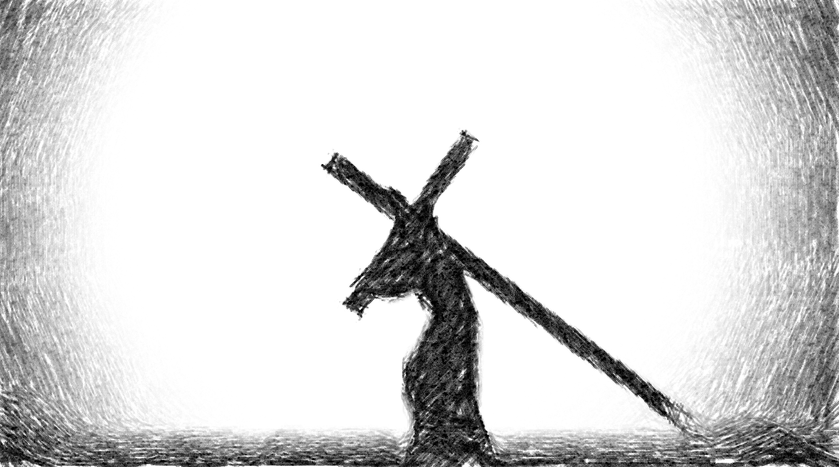
The Way of the Cross Leads Home

Slide 3

When the Path of Least Resistance is Taken
Israelites at Kadesh Barnea
Ten of the spies were greatly intimidated – Numbers 13:26-33 – it seemed they expected the path to be easier than what they saw.
The opposition they would have to face caused their faith to waver – Numbers 14:1-4 – they wanted the path of least resistance.
The consequence of even requesting that path was dire – Hebrews 3:16-19

Slide 4
When the Path of Least Resistance is Taken
Israelites at Kadesh Barnea
The Rich Young Ruler
This man seemed to be devoutly religious and interested in eternal life – Matthew 19:16-20
Jesus’ requirement proved too much – Matthew 19:21-22 – it would be too difficult to go that way.
Keeping the commandments was evidently not too difficult for him, but when something truly difficult was required he rejected it.

Slide 5
The Way of the Cross
Resist Sin
The flesh is referred to as “sinful flesh” and will always manifest passions that must be resisted with the Holy Spirit – Romans 8:3; Galatians 5:16-17
We are called to resist Satan and his temptations to sin – 1 Peter 5:8-9; James 4:7-8
The path of least resistance ends in death – James 1:14-15

Slide 6
The Way of the Cross
Resist Sin, Resist Error
We are called to contend for the faith – Jude 3-4
We must refuse the temptation for neutrality lest we find ourselves against Jesus – Matthew 12:30
Some want to avoid negativity – Isaiah 30:8-11; 2 Timothy 4:3-4
We must preach/teach the whole counsel of God – Acts 20:26-27
The path of least resistance leads to corruption – 1 Corinthians 15:33

Slide 7
The Way of the Cross
Resist Sin, Resist Error, Face the Ridicule of the World
We are called to be different, and are set apart by God’s word – Romans 12:1-2; John 17:14-17
The world will hate us – John 15:18-19
We are to crucify the world to ourselves, but we will be crucified to the world – Galatians 6:14

Slide 8
The Way of the Cross Leads Home

