Slide 1
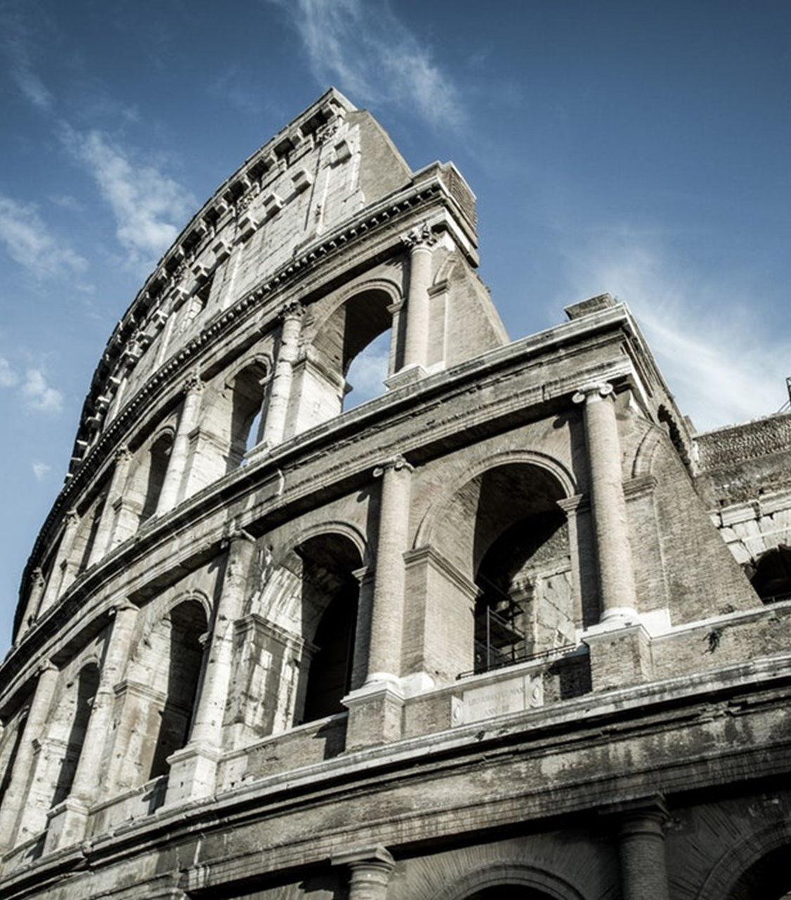
The Epistle to the Romans
Chapter 8

Slide 2
Freedom, Heirship, Hope, and Love in Christ
Freedom in Christ (vv. 1-11)
Heirs with Christ (vv. 12-17)
Hope in Christ (vv. 18-30)
Love of God in Christ (vv. 31-39)

Slide 3
Freedom, Heirship, Hope, and Love in Christ
Freedom in Christ (vv. 1-11)
There is no condemnation to those in Christ (v. 1a)
Who do not walk according to the flesh (v. 1b)
But according to the spirit. (v. 1c)
The law of the Spirit of life frees from the law of sin and death. (v. 2)
What the law could not do due to the weakness of flesh (v. 3a)
God did by sending His Son in the flesh, on account of sin: (v. 3b)
He condemned sin in the flesh (v. 3c)
To fulfill the righteous requirement of the law in those who walk according to the spirit. (v. 4)

Slide 4
Freedom, Heirship, Hope, and Love in Christ
Freedom in Christ (vv. 1-11)
Those who live to the flesh set their minds on the flesh, but those who live to the spirit, the spirit. (v. 5)
Carnal mindedness is death, but spiritual mindedness is life and peace. (v. 6)
The carnal mind is enmity against God (v. 7a)
It is not subject to God’s law, nor can it be. (v. 7b)
Those in the flesh cannot please God. (v. 8)
You are in the spirit if the Spirit of God dwells in you. (v. 9a)
If you do not have the Spirit of Christ, you are not His. (v. 9b)
If Christ is in you (v. 10a)
The body is dead because of sin (v. 10b)
The spirit is life because of righteousness. (v. 10c)
If the Spirit of Him who raised Jesus from the dead is in you He will also give life to your mortal bodies through His Spirit in you. (v. 11)

Slide 5
Freedom, Heirship, Hope, and Love in Christ
Heirs with Christ (vv. 12-17)
We are debtors—not to live to the flesh. (v. 12)
If you live to the flesh you will die (v. 13a)
If by the spirit you put to death the deeds of the body you will live. (v. 13b)
Those led by the Spirit of God are sons of God. (v. 14)
You did not receive the spirit of bondage, but the spirit of adoption. (v. 15)
The Spirit Himself bears witness with our spirit that we are children of God (v. 16)
And heirs of God with Christ (v. 17a)
If we suffer with Him, that we may be glorified together. (v. 17b)

Slide 6
Freedom, Heirship, Hope, and Love in Christ
Hope in Christ (vv. 18-30)
The sufferings of the present are not comparable to the glory to be revealed in us. (v. 18)
The expectation of the creation waits for the revealing of the sons of God. (v. 19)
God subjected the creation to futility in hope. (v. 20)
The creation will be delivered from the bondage of corruption. (v. 21a)
Into the glorious liberty of the children of God. (v. 21b)
The creation groans and labors with birth pangs. (v. 22)
Those who have the firstfruits of the Spirit do the same, waiting for the adoption. (v. 23)
For we were saved in this hope, but hope is not seen. (v. 24)
Hope causes perseverance. (v. 25)

Slide 7
Freedom, Heirship, Hope, and Love in Christ
Hope in Christ (vv. 18-30)
The spirit helps in our weaknesses. (v. 26a)
We do not know what we should pray for. (v. 26b)
The spirit Himself (itself) makes intercession with unutterable groanings. (v. 26c)
He who searches the hearts knows the mind of the spirit. (v. 27a)
He intercedes for the saints according to God’s will. (v. 27b)
All things work together for good to those who love God and are the called according to His purpose. (v. 28)
Whom He foreknew, He predestined to be conformed to the image of His Son. (v. 29)
Whom He predestined, He called (v. 30a)
Whom He called, He justified (v. 30b)
Whom He justified, He glorified. (v. 30c)

Slide 8
Freedom, Heirship, Hope, and Love in Christ
Love of God in Christ (vv. 31-39)
What then shall we say to these things? (v. 31a)
If God is for us, who can be against us? (v. 31b)
He who did not spare His own Son, how shall He not freely give us all things? (v. 32)
Who shall bring a charge against us? God justifies. (v. 33)
Who shall condemn? Christ makes intercession for us. (v. 34)
Who shall separate us from the love of Christ? (v. 35a)
Shall tribulation, distress, persecution, famine, nakedness, peril, sword? (v. 35b)
As it is written: "For Your sake we are killed all day long; We are accounted as sheep for the slaughter." (v. 36)
In all these things we are more than conquerors through Him. (v. 37)
Nothing can separate us from the love of God in Christ. (vv. 38-39)

Slide 9
Freedom, Heirship, Hope, and Love in Christ
Freedom in Christ (vv. 1-11)
Heirs with Christ (vv. 12-17)
Hope in Christ (vv. 18-30)
Love of God in Christ (vv. 31-39)

