Slide 2
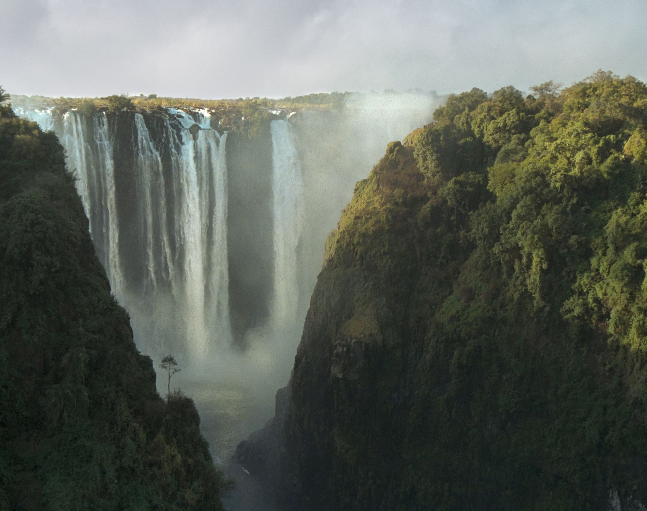
the Omni Attributes of God
Latin – “omnis” – “all” – “all; of all things”

Slide 3
Omnipotent
God is All Powerful
God to Abraham – Genesis 17:1-8, 17-19 (Almighty – el Shaddai); 18:13-14 (of Sarah)
No purpose is withheld from Him – Job 42:2
Seen in creation – Hebrews 3:4; Genesis 1:1; Romans 1:20; Psalm 19:1; Jeremiah 32:27
There should never be surprise about the Lord’s power – Acts 26:4-8

Slide 4
Omnipotent
Before the Omnipotent God
Fearful Obedience – Genesis 17:1; Matthew 10:27-28; Luke 17:31-32
Comfort – Matthew 10:29-31; Psalm 118:6
Unwavering Trust – Romans 4:18-22; Philippians 2:12-13

Slide 5
Omniscient
God is All Knowing
His knowledge is perfect – Job 37:14, 16; 38:1-7; Psalm 147:5; Deuteronomy 29:29
He knows past, present, future – Isaiah 41:21-24; 46:8-11
He knows what is in man – Acts 1:24
His wisdom is greater than man – 1 Corinthians 1:18-25; 2:7-9

Slide 6
Omniscient
Before the Omniscient God
Careful Obedience – 1 John 3:20-21; Psalm 139:1-4; Hebrews 4:11-13
Comfort – Isaiah 40:27-31
Trust in His Wisdom – Romans 1:16-17; Isaiah 55:8-9; James 1:19-25; Proverbs 3:5-8

Slide 7
Omnipresent
God is All Present
His Omnipresence Noted – Psalm 139:7-12; Jeremiah 23:23-24
Omnipresent through Instrumentality – Acts 17:26-28; Genesis 1:1; Colossians 1:16-17; Proverbs 5:21; 15:3

Slide 8
Omnipresent
Before the Omnipresent God
Integrity – Philippians 1:27; 2:12-13; Hebrews 4:13
Comfort – 2 Timothy 4:10, 16-18; John 4:19-24 (worship); Acts 7:44-50; 17:24
Fear of Losing God’s Presence – 2 Thessalonians 1:8-9; Matthew 25:41

Slide 9
the Omni Attributes of God
Latin – “omnis” – “all” – “all; of all things”

