Slide 1
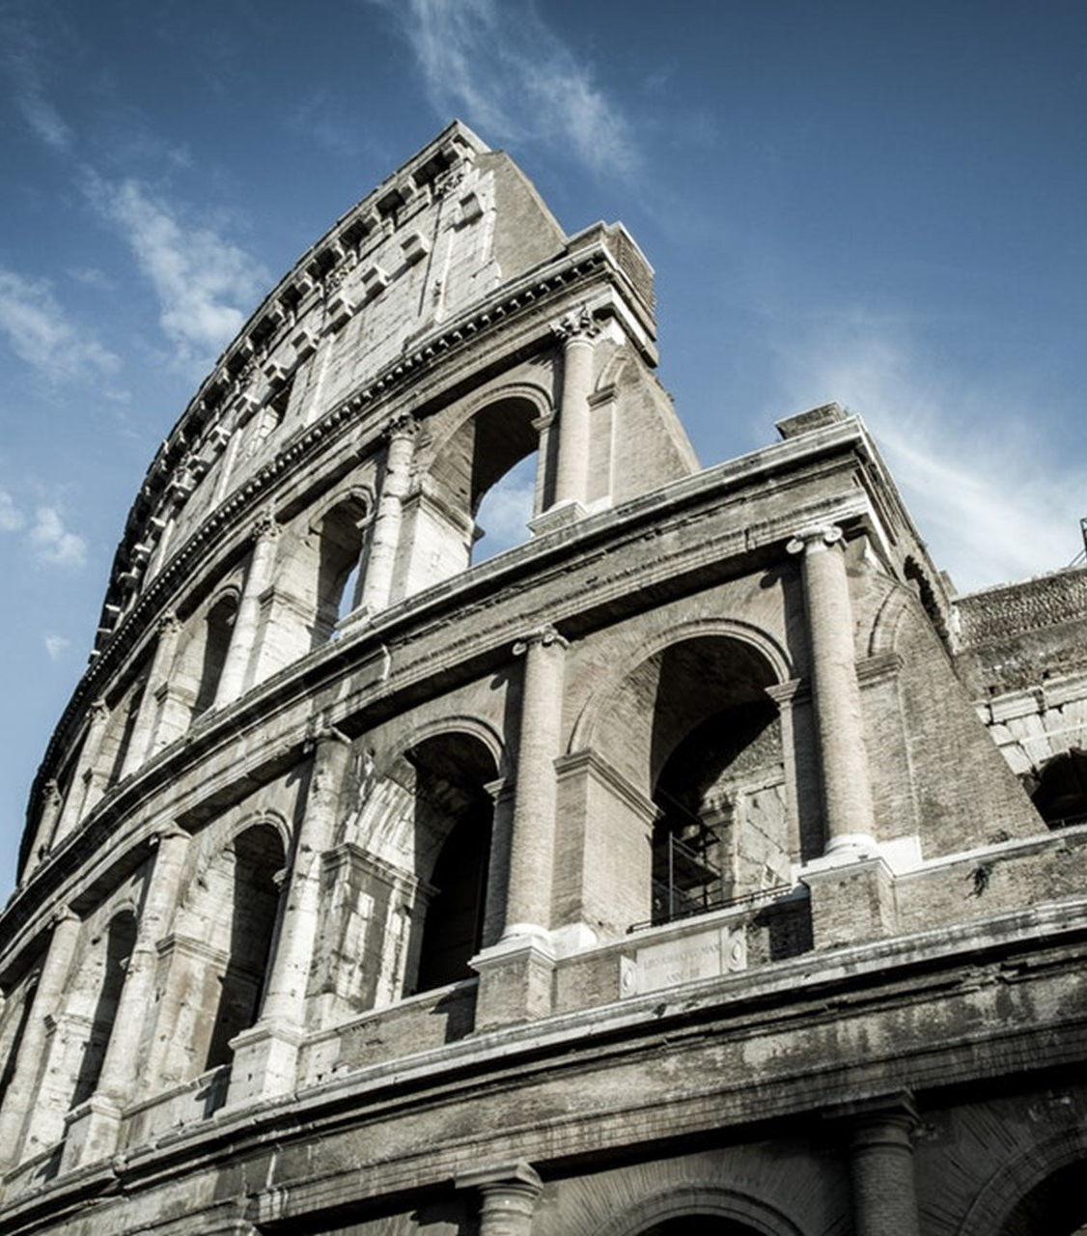
The Epistle to the Romans
Chapter 10

Slide 2
Israel’s Rejection of the Gospel
Israel’s Failure to Submit to the Righteousness of God (vv. 1-4)
The Righteousness of God in the Word of Faith (vv. 5-13)
Israel Rejected What They Heard (vv. 14-21)

Slide 3
Israel’s Rejection of the Gospel
Israel’s Failure to Submit to the Righteousness of God (vv. 1-4)
Paul desires Israel’s salvation. (v. 1)
They have zeal for God, but not according to knowledge. (v. 2)
In ignorance of God's righteousness, they sought to establish their own, and did not submit to the righteousness of God. (v. 3)
Christ is the end of the law for righteousness to everyone who believes. (v. 4)

Slide 4
Israel’s Rejection of the Gospel
The Righteousness of God in the Word of Faith (vv. 5-13)
Moses writes about the righteousness of the law (v. 5a)
"The man who does those things shall live by them." (v. 5b)
The righteousness of faith speaks in this way (v. 6a)
"Do not say in your heart, 'Who will ascend into heaven?'" (that is, to bring Christ down from above) (v. 6b)
"'Who will descend into the abyss?'" (that is, to bring Christ up from the dead). (v. 7)
"The word is near you, in your mouth and in your heart" (the word of faith) (v. 8)
You will be saved if you confess the Lord Jesus and believe God raised Him from the dead. (v. 9)
One believes unto righteousness, and confession is made unto salvation. (v. 10)
The Scripture says, "Whoever believes on Him will not be put to shame." (v. 11)
There is no distinction between Jew and Greek. (v. 12)
"Whoever calls on the name of the Lord shall be saved." (v. 13)

Slide 5
Israel’s Rejection of the Gospel
Israel Rejected What They Heard (vv. 14-21)
How shall they call on Him without belief? (v. 14a)
And how shall they believe without hearing? (v. 14b)
And how shall they hear without a preacher? (v. 14c)
And how shall they preach unless they are sent? (v. 15a)
As it is written: (Isaiah 52:7) (v. 15b)
They have not all obeyed the gospel. (v. 16a)
Isaiah says, "Lord, who has believed our report?" (Isaiah 53:1) (v. 16b)
Faith comes by hearing the word of God. (v. 17)
Have they not heard? Yes indeed. (Psalm 19:4) (v. 18)
Did Israel not know? First Moses says: (Deuteronomy 32:21) (v. 19)
Isaiah is very bold and says: (Isaiah 65:1) (v. 20)
To Israel he says: (Isaiah 65:2) (v. 21)

Slide 6
Israel’s Rejection of the Gospel
Israel’s Failure to Submit to the Righteousness of God (vv. 1-4)
The Righteousness of God in the Word of Faith (vv. 5-13)
Israel Rejected What They Heard (vv. 14-21)

