Slide 1
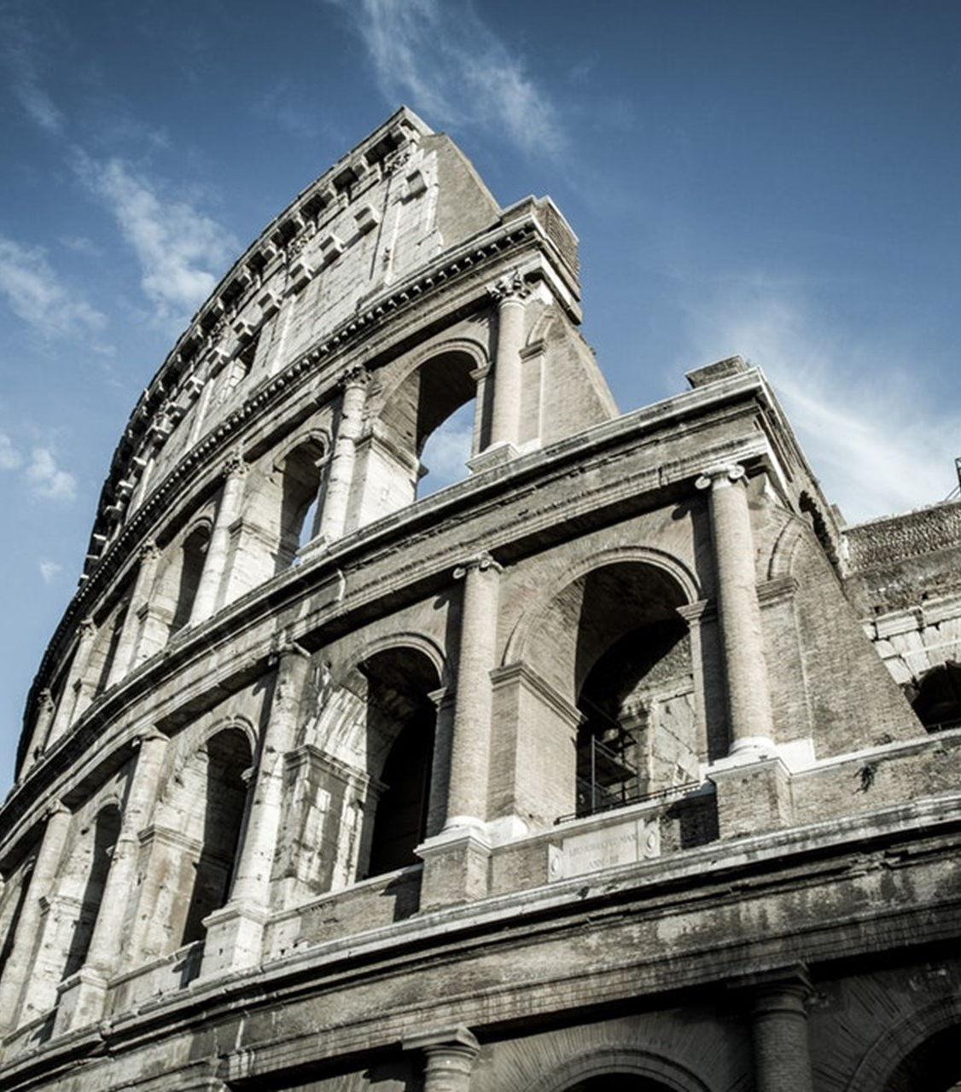
The Epistle to the Romans
Chapter 9

Slide 2
Israel’s Reply and God’s Sovereignty
Paul’s Sorrow for Israel (vv. 1-5)
Israel’s First Objection – God is Unfaithful (vv. 6-13)
Israel’s Second Objection – God is Unrighteous (vv. 14-18)
Israel’s Third Objection – God is Unfair (vv. 19-33)

Slide 3
Israel’s Reply and God’s Sovereignty
Paul’s Sorrow for Israel (vv. 1-5)
Paul has sorrow and grief in his heart. (vv. 1-2)
Paul wishes that he could be accursed from Christ for his physical brethren – Jews. (v. 3)
To physical Israel pertained the various blessings of the Old Covenant. (v. 4)
From physical Israel came the patriarchs, and most importantly, the Christ. (v. 5)

Slide 4
Israel’s Reply and God’s Sovereignty
Israel’s First Objection – God is Unfaithful (vv. 6-13)
It is not that the word of God has taken no effect. (v. 6a)
They are not all Israel who are of Israel (v. 6b)
They are not all children because they are Abraham’s seed. (v. 7a)
The seed is after Isaac. (v. 7b)
The children of God are not of flesh (v. 8a)
The children of the promise are the seed. (v. 8b)
The word of promise spoke of Sarah’s son. (v. 9)
Additionally, Rebecca conceived by Isaac. (v. 10)
God’s choice of which child was not based on anything they had done. (v. 11)
God chose the younger (Jacob), not the older (Esau). (vv. 12-13)

Slide 5
Israel’s Reply and God’s Sovereignty
Israel’s Second Objection – God is Unrighteous (vv. 14-18)
Is there unrighteousness with God? Certainly not! (v. 14)
God told Moses He would have mercy/compassion on whomever He chooses. (v. 15).
Such is not according to any will or action of man, but of God’s choice. (v. 16)
Such is also shown when God told Pharaoh He raised him up to show His power and declare His name in the earth. (v. 17)
God chooses who He shows mercy, and who He hardens. (v. 18)

Slide 6
Israel’s Reply and God’s Sovereignty
Israel’s Third Objection – God is Unfair (vv. 19-33)
Why does He still find fault? For who has resisted His will? (v. 19)
Who are you to reply against God? (v. 20a)
Will the thing formed say to him who formed it, "Why have you made me like this?" (v. 20b)
Doesn’t the potter have the power to make vessels of honor and dishonor from the same lump? (v. 21)
What if God was longsuffering to the vessels of wrath to make His wrath and power known… (v. 22)
…and to make known His glory on the vessels of mercy, of those called, both Jews and Gentiles? (vv. 23-24)?
The prophets testify of this:
As He says also in Hosea. (vv. 25-26)
Isaiah also cries out concerning Israel. (vv. 27-28)
And as Isaiah said before. (v. 29)

Slide 7
Israel’s Reply and God’s Sovereignty
Israel’s Third Objection – God is Unfair (vv. 19-33)
What shall we say then? (v. 30a)
Gentiles, who did not pursue righteousness, have attained to the righteousness of faith. (v. 30b)
Israel, pursuing the law of righteousness, has not attained to the law of righteousness. (v. 31)
Why? Because they sought it by works, not by faith. (v. 32a)
For, as it is written, they stumbled at that stumbling stone, the Messiah. (vv. 32b-33)

Slide 8
Israel’s Reply and God’s Sovereignty
Paul’s Sorrow for Israel (vv. 1-5)
Israel’s First Objection – God is Unfaithful (vv. 6-13)
Israel’s Second Objection – God is Unrighteous (vv. 14-18)
Israel’s Third Objection – God is Unfair (vv. 19-33)

