Slide 1
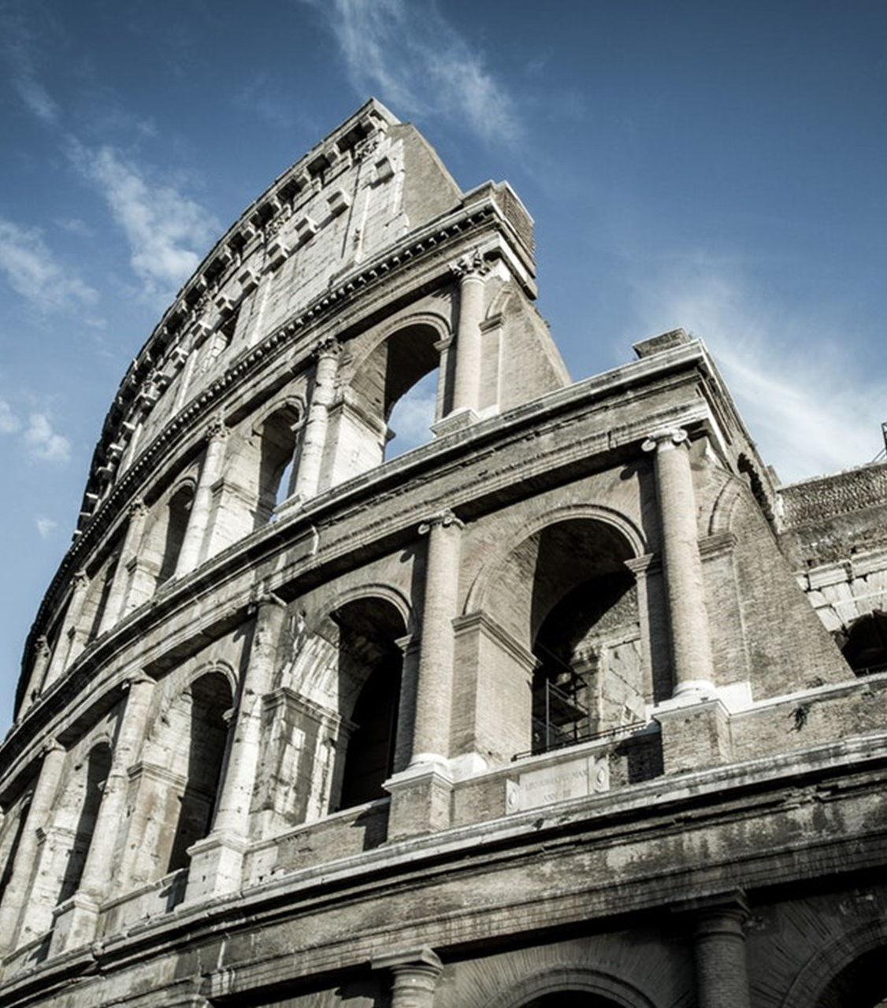
The Epistle to the Romans
Chapter 12

Slide 2
The Christian’s Response to the Mercies of God
A Call to Sacrificial Living (vv. 1-2)
A Call to Humility and Service in the Body (vv. 3-8)
A Call to Behave Like a Christian (vv. 9-21)

Slide 3
The Christian’s Response to the Mercies of God
A Call to Sacrificial Living (vv. 1-2)
Paul, by the mercies of God, calls for the body to be presented as a living sacrifice (v. 1)
Holy
Acceptable to God
Your reasonable service.
Do not be conformed to this world. (v. 2a)
Be transformed by the renewing of your mind. (v. 2b)
To prove what is that good, acceptable, and perfect will of God. (v. 2c)

Slide 4
The Christian’s Response to the Mercies of God
A Call to Humility and Service in the Body (vv. 3-8)
No one should think of himself more highly than he ought to think (v. 3a)
Think soberly. (v. 3b)
God has dealt to each one a measure of faith. (v. 3c)
The body has many members with different functions. (v. 4)
We, being many, are one body in Christ, and individually members of one another. (v. 5)
Having differing gifts, we are to use them (v. 6a)
Prophecy, let us prophesy in proportion to our faith (v. 6b)
Ministry, teaching, exhortation, giving liberally, leading with diligence, showing mercy with cheerfulness. (vv. 7-8)

Slide 5
The Christian’s Response to the Mercies of God
A Call to Behave Like a Christian (vv. 9-21)
Love without hypocrisy. Abhor evil. Cling to good. (v. 9)
Show brotherly love and give preference to one another. (v. 10)
Not lagging in diligence, fervent in spirit, serving the Lord. (v. 11)
Rejoicing in hope, patient in tribulation, continuing steadfastly in prayer. (v. 12)
Distributing to the needs of the saints, given to hospitality. (v. 13)
Bless those who persecute you; bless and do not curse. (v. 14)
Rejoice with those who rejoice, and weep with those who weep. (v. 15)
Be of the same mind toward one another. (v. 16a)
Do not set your mind on high things, but associate with the humble. (v. 16b)
Do not be wise in your own opinion. (v. 16c)

Slide 6
The Christian’s Response to the Mercies of God
A Call to Behave Like a Christian (vv. 9-21)
Repay no one evil for evil. (v. 17a)
Have regard for good things in the sight of all men. (v. 17b)
If possible live peaceably with all men. (v. 18)
Do not avenge self, but give place to wrath. (v. 19a)
It is written, "Vengeance is Mine, I will repay.” (v. 19b)
"If your enemy is hungry, feed him; If he is thirsty, give him a drink; For in so doing you will heap coals of fire on his head." (v. 20)
Do not be overcome by evil, overcome evil with good. (v. 21)

Slide 7
The Christian’s Response to the Mercies of God
A Call to Sacrificial Living (vv. 1-2)
A Call to Humility and Service in the Body (vv. 3-8)
A Call to Behave Like a Christian (vv. 9-21)

