Slide 1
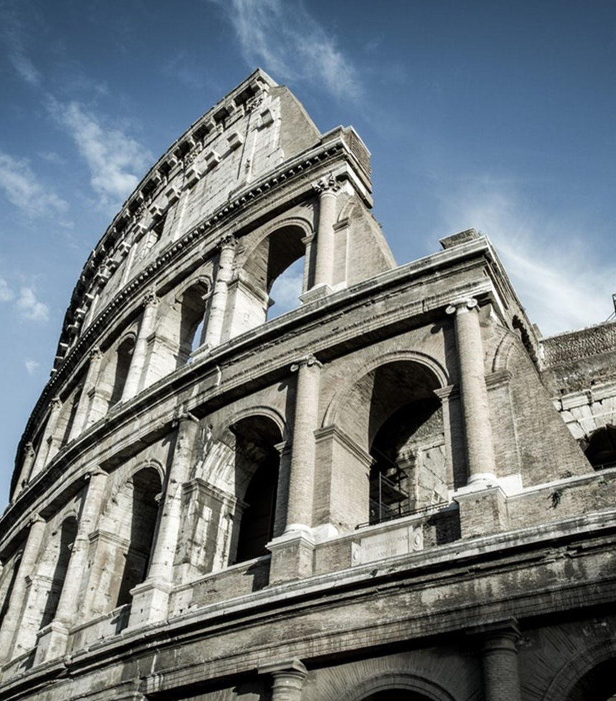
The Epistle to the Romans
Chapter 13

Slide 2
The Christian’s Responsibility to Government, Neighbor, the Time
The Christian’s Responsibility to the Government (vv. 1-7)
The Christian’s Responsibility to His Neighbor (vv. 8-10)
The Christian’s Responsibility Given the Time (vv. 11-14)

Slide 3
The Christian’s Responsibility to Government, Neighbor, the Time
The Christian’s Responsibility to the Government (vv. 1-7)
Be subject to the governing authorities. (v. 1)
There is no authority except from God.
The existing authorities are God appointed.
Whoever resists the authority resists the ordinance of God, and brings judgment on self. (v. 2)
Rulers are not a terror to good works, but to evil. (v. 3a)
Do you want to be unafraid of the authority? (v. 3b)
Do what is good, and you will have praise from the same. (v. 3c)
He is God's minister to you for good. (v. 4a)
If you do evil, be afraid; (v. 4b)
He does not bear the sword in vain; (v. 4c)
He is God's minister to execute wrath on him who practices evil. (v. 4d)
You must be subject because of wrath and for conscience' sake. (v. 5)
Because of this you also pay taxes. (v. 6)
Render therefore to all their due: taxes, customs, fear, honor. (v. 7)

Slide 4
The Christian’s Responsibility to Government, Neighbor, the Time
The Christian’s Responsibility to His Neighbor (vv. 8-10)
Owe no one anything except to love one another, for he who loves another has fulfilled the law. (v. 8)
For the commandments, "You shall not commit adultery," "You shall not murder," "You shall not steal," "You shall not bear false witness," "You shall not covet," and if there is any other commandment, are all summed up in this saying, namely, "You shall love your neighbor as yourself." (v. 9)
Love does no harm to a neighbor; therefore love is the fulfillment of the law. (v. 10)

Slide 5
The Christian’s Responsibility to Government, Neighbor, the Time
The Christian’s Responsibility Given the Time (vv. 11-14)
And do this, knowing the time, that now it is high time to awake out of sleep; (v. 11a)
for now our salvation is nearer than when we first believed. (v. 11b)
The night is far spent, the day is at hand. (v. 12a)
Therefore let us cast off the works of darkness, and let us put on the armor of light. (v. 12b)
Let us walk properly, as in the day, not in revelry and drunkenness, not in lewdness and lust, not in strife and envy. (v. 13)
But put on the Lord Jesus Christ, and make no provision for the flesh, to fulfill its lusts. (v. 14)

Slide 6
The Christian’s Responsibility to Government, Neighbor, the Time
The Christian’s Responsibility to the Government (vv. 1-7)
The Christian’s Responsibility to His Neighbor (vv. 8-10)
The Christian’s Responsibility Given the Time (vv. 11-14)

