Slide 1
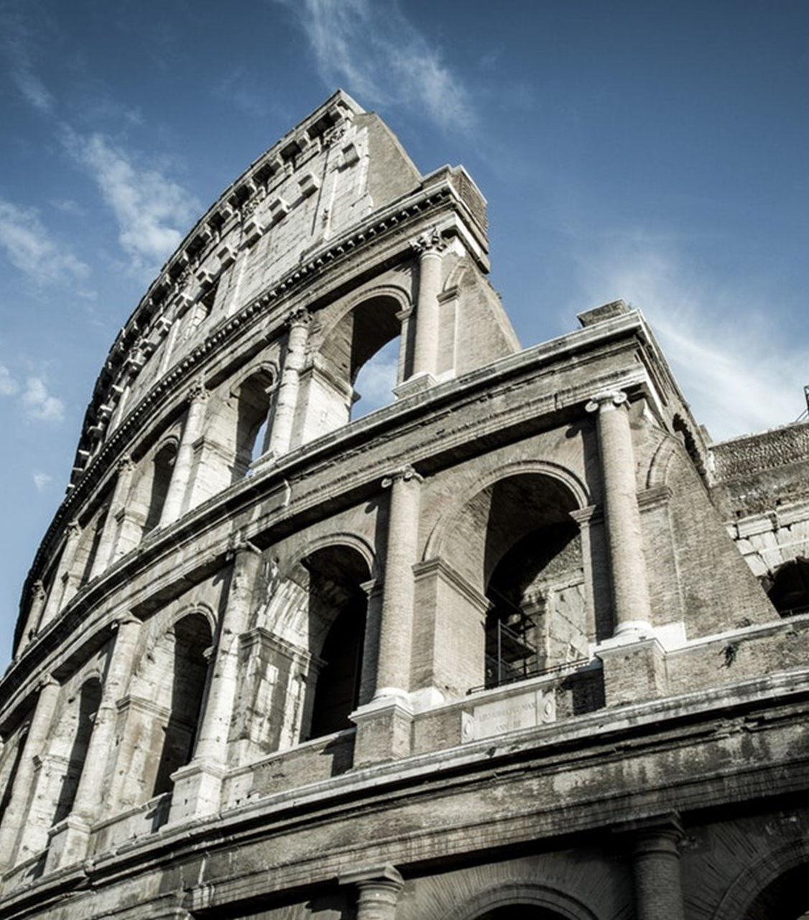
The Epistle to the Romans
Chapter 14

Slide 2
The Regulation of Love in the Exercising of Liberties
Regulations Concerning Liberties (vv. 1-13)
Regulating Liberties with Love for Brethren (vv. 14-23)

Slide 3
The Regulation of Love in the Exercising of Liberties
Regulations Concerning Liberties (vv. 1-13)
Receive the weak in the faith, but not to disputes over doubtful things. (v. 1)
One believes he may eat all things, the weak eats only vegetables. (v. 2)
Him who eats is not to despise him who does not, and him who does not eat is not to judge him who eats; for God has received him. (v. 3)
Who are you to judge another's servant? To his own master he stands or falls. (v. 4a)
He will be made to stand, for God is able to make him stand. (v. 4b)

Slide 4
The Regulation of Love in the Exercising of Liberties
Regulations Concerning Liberties (vv. 1-13)
One person esteems one day above another; another esteems every day alike. Let each be fully convinced. (v. 5)
He who observes the day (or not), observes it (or not) to the Lord (v. 6a)
He who eats (or not), eats (or not) to the Lord, for he gives God thanks (v. 6b)
None of us lives or dies to himself. (v. 7)
If we live or die, we live or die to the Lord (v. 8a)
Whether we live or die, we are the Lord's. (v. 8b)
For Christ died and rose and lived again that He might be Lord of the dead and the living. (v. 9)
Why do you judge? Why do you show contempt? (v. 10a)
We shall all stand before the judgment seat of Christ. (v. 10b)
For it is written: "As I live, says the Lord, Every knee shall bow to Me, And every tongue shall confess to God." (v. 11)
Each of us shall give account of himself to God. (v. 12)
Let us not judge one another, but rather do not put a stumbling block or a cause to fall in our brother's way. (v. 13)

Slide 5
The Regulation of Love in the Exercising of Liberties
Regulating Liberties with Love for Brethren (vv. 14-23)
There is nothing unclean of itself; but if one considers anything to be unclean, to him it is unclean. (v. 14)
If your brother is grieved because of your food, you are no longer walking in love. (v. 15a)
Do not destroy with your food the one for whom Christ died. (v. 15b)
Do not let your good be spoken of as evil; (v. 16)
The kingdom of God is not eating and drinking, but righteousness, peace, joy in the Holy Spirit. (v. 17)
He who serves Christ in these things is acceptable to God and approved by men. (v. 18)

Slide 6
The Regulation of Love in the Exercising of Liberties
Regulating Liberties with Love for Brethren (vv. 14-23)
Pursue things which make for peace and edification. (v. 19)
Do not destroy the work of God for the sake of food. (v. 20a)
All things are pure, but it is evil to eat with offense. (v. 20b)
It is good to not do anything which makes your brother stumble, offended, or weak. (v. 21)
Do you have faith? Have it to yourself before God. (v. 22a)
Happy is he who does not condemn himself in what he approves. (v. 22b)
But he who doubts is condemned if he eats, because he does not eat from faith; for whatever is not from faith is sin. (v. 23)

Slide 7
The Regulation of Love in the Exercising of Liberties
Regulations Concerning Liberties (vv. 1-13)
Regulating Liberties with Love for Brethren (vv. 14-23)

