Slide 1
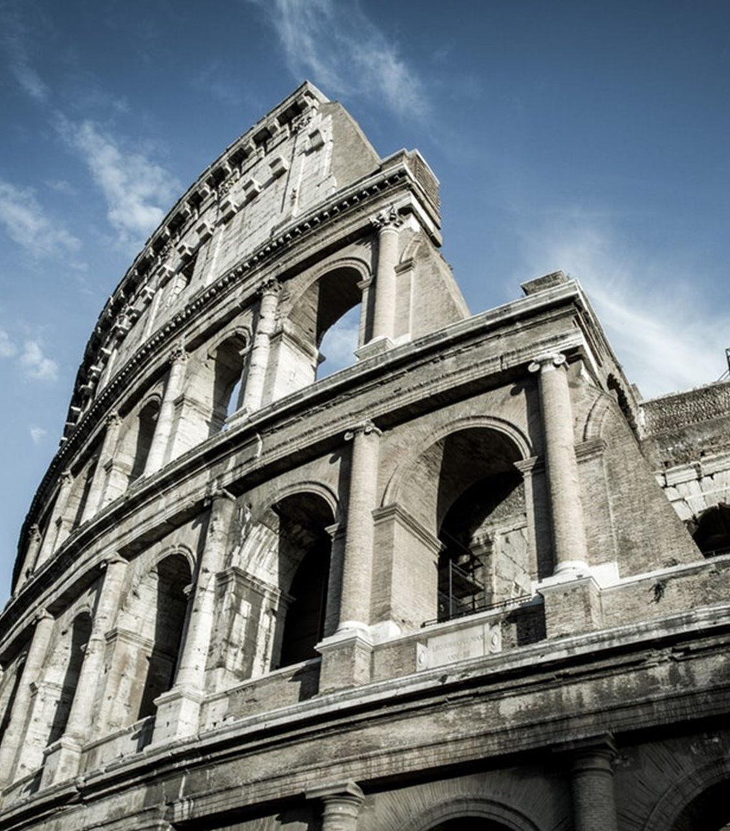
The Epistle to the Romans
Chapter 15

Slide 2
Hope & Unity among Brethren & Paul’s Ministry & Plans
Hope and Unity Among Brethren (vv. 1-13)
Paul’s Ministry to the Gentiles (vv. 14-21)
Paul’s Plan to Visit Rome (vv. 22-33)

Slide 3
Hope & Unity among Brethren & Paul’s Ministry & Plans
Hope and Unity Among Brethren (vv. 1-13)
The strong shouldn’t please self, but rather bear with the weak. (v. 1)
Please your neighbor for his good, to edification. (v. 2)
Christ did not please Himself – Psalm 69:9 (v. 3)
Things written before are for our learning, that we through the patience and comfort of the Scriptures might have hope. (v. 4)
Be like-minded toward one another, to glorify God and Jesus as one. (vv. 5-6)
Receive one another, as Christ also received us, to the glory of God. (v. 7)
Jesus Christ has become a servant to the circumcision. (v. 8)
That the Gentiles might glorify God for His mercy (v. 9)
2 Samuel 22:50; Psalm 18:49 (v. 9)
Deuteronomy 32:43 (v. 10)
Psalm 117:1 (v. 11)
Isaiah 11:1, 10 (v. 12)
Now may the God of hope fill you with all joy and peace in believing, that you may abound in hope by the power of the Holy Spirit. (v. 13)

Slide 4
Hope & Unity among Brethren & Paul’s Ministry & Plans
Paul’s Ministry to the Gentiles (vv. 14-21)
Paul is confident in the Romans being full of goodness, knowledge, and ability to admonish. (v. 14)
He has written to remind them. (v. 15)
He is a minister to the Gentiles in the gospel. (v. 16a)
He desires that the offering of the Gentiles might be acceptable, sanctified by the Holy Spirit. (v. 16b)
He has reason to glory in Christ Jesus in things pertaining to God. (v. 17)
He only will speak of what Christ has accomplished through him toward the Gentile’s obedience. (v. 18)
In mighty signs and wonders (v. 19a)
By the power of the Spirit of God (v. 19b)
From Jerusalem to Illyricum he has fully preached the gospel (v. 19c)
He has made it his aim to preach where Christ is not named to avoid building on another’s foundation. (v. 20)
Isaiah 52:15 (v. 21)

Slide 5
Hope & Unity among Brethren & Paul’s Ministry & Plans
Paul’s Plan to Visit Rome (vv. 22-33)
For this reason he was hindered from coming to Rome. (v. 22)
Whenever he goes to Spain, he will come to Rome. (vv. 23-24a)
He hopes to see them, and to be helped by them, and enjoy their company. (v. 24b)
He is going to Jerusalem to minister to the saints. (v. 25)
Brethren in Macedonia and Achaia made a contribution for the poor saints in Jerusalem. (v. 26)
They are their debtors. (v. 27a)
Gentiles have partaken of their spiritual things, their duty is to minister in material things. (v. 27b)
He will go to them on the way to Spain after this is done. (v. 28)
When he comes, he will come in the fullness of the blessing of the gospel of Christ. (v. 29)
Paul requests their prayers. (v. 30)
To be delivered from unbelievers in Judea. (v. 31a)
That his service for Jerusalem is acceptable. (v. 31b)
That he may come to them and be refreshed (v. 32)
Now the God of peace be with you all. Amen. (v. 33)

Slide 6
Hope & Unity among Brethren & Paul’s Ministry & Plans
Hope and Unity Among Brethren (vv. 1-13)
Paul’s Ministry to the Gentiles (vv. 14-21)
Paul’s Plan to Visit Rome (vv. 22-33)

