Slide 2
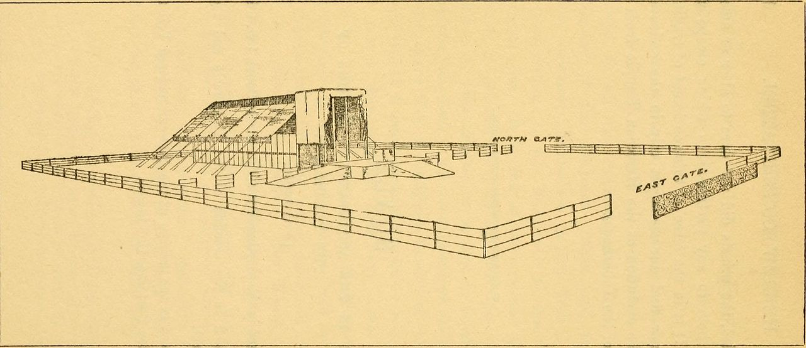
Tabernacled
the Word
among us
John 1:14

Slide 3
Tabernacled Jehovah and the Word
The Tabernacle in the Wilderness
God’s covenant with Israel – Exodus 19:3-6
Sanctuary commanded for God’s dwelling – Exodus 25:8-9; Leviticus 26:11-13; 2 Samuel 7:5-7
The Glory of God
The glory of the Lord with Israel – Exodus 13:21-22; 16:7, 10; 24:16-18
In the tabernacle – Exodus 29:43; 25:9; 40:33-38; Leviticus 9:5-6, 22-24; Exodus 29:45-46

Slide 4
Tabernacled Jehovah and the Word
The Fullness of God in the Incarnate Word
Manifested God’s glory – John 1:14
“as of the only begotten of the Father”
“only begotten” – monogenēs – monos (sole or single) ginomai (to be) – pert. to being the only one of its kind or class, unique (in kind) (BDAG) (cf. John 1:1-3)
Jesus IS the manifestation of the glory of God – Hebrews 1:3; Colossians 1:15; 2:9; John 14:8-9; 12:44-45

Slide 5
The Glory Beheld
God Declared by the Tabernacled Word (John 1:18)
God’s Name Declared by the Tabernacled Word
His work was to reveal the Father’s name – John 17:4-6, 20, 26
Moses’ request to see God’s glory, and God’s reply – Exodus 33:18-19; 34:5-9 – “I will proclaim the name of the Lord before you.”

Slide 6
The Glory Beheld
God Declared by the Tabernacled Word (John 1:18)
God’s Name Declared by the Tabernacled Word
The name of the Lord proclaimed (Exodus 34:6) – “abounding in goodness and truth”
Goodness revealed in the tabernacle – Hebrews 9:6-7
Truth revealed in the tabernacle – Exodus 29:42; 33:7-9

Slide 7
The Glory Beheld
God Declared by the Tabernacled Word (John 1:18)
God’s Name Declared by the Tabernacled Word
The name of the Lord proclaimed (Exodus 34:6) – “abounding in goodness and truth”
The glory of the tabernacled word (as of the only begotten of the Father) (John 1:14) – “full of grace and truth”
Grace revealed in the Word – John 3:13-17; 12:32-33; Hebrews 9:11-12
Truth revealed in the Word – John 1:4-5; 14:6; 18:37

Slide 8
The Glory Shared
The Tabernacle of Prophecy
The tabernacle in the wilderness was a type/shadow – Hebrews 8:3-6
The tabernacle of Messianic prophecy – Ezekiel 37:26-28 – God dwells with us in a relationship through His Son, Jesus Christ, the Word.

Slide 9
The Glory Shared
Fellowship with God Through the Word
Not all experienced the incarnate Word firsthand – John 1:14, 16; 1 John 1:1; 2 Corinthians 5:16
His glory is shared through the word, not by physical senses – 1 John 1:1-4; John 20:29-31
We receive spiritual life and fellowship with God through the knowledge of His Son – 2 Peter 1:2-4
God and Christ dwell in us through obedience to the word – John 14:20-21, 23-24; 17:20-26

Slide 10
Tabernacled
the Word
among us
John 1:14

