Slide 2
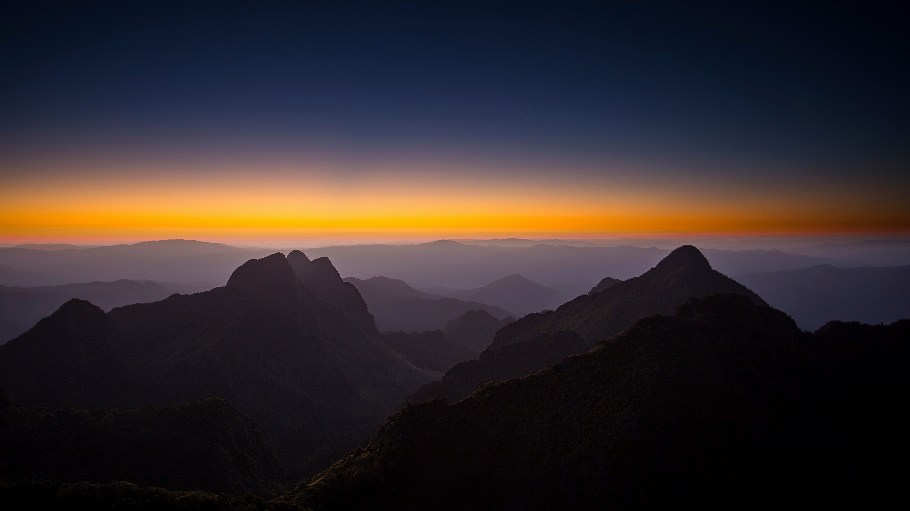
Turning the World
Acts 17:6

Slide 3
Turning the World
Regarding Truth
Regarding our Nature
Regarding Religion

Slide 4
Turning the World
Acts 17:6

