Slide 2
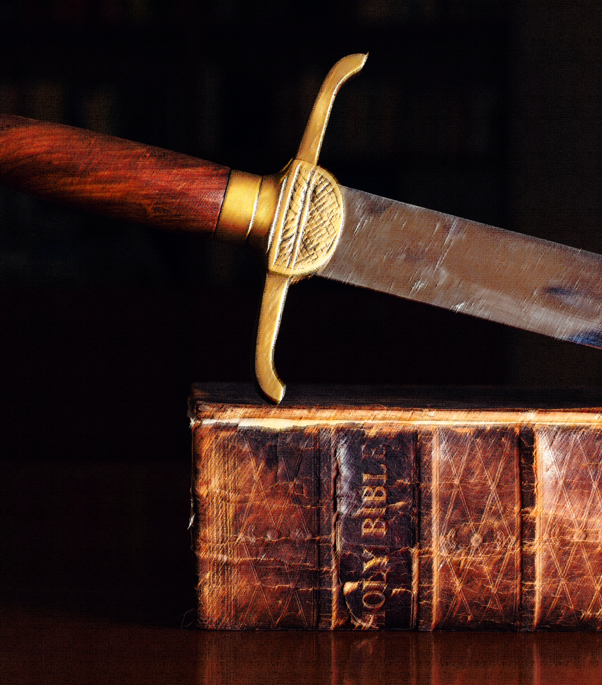
Fearing God’s Word
Proverbs 13:13

Slide 3
Why Many Don’t Fear God’s Word
They Don’t Believe in Inspiration
The scriptures claim to be inspired of God – 2 Timothy 3:16
2 Peter 1:19-20 – not from private origin.
Plenary verbal inspiration – 1 Corinthians 2:13 (NASB); Galatians 3:16

Slide 4
Why Many Don’t Fear God’s Word
They Don’t Believe in Inspiration
They Misunderstand its Author
Is the Bible just a love letter from God to man?
God is love (1 John 4:8), but does that mean scripture is not law?
2 Timothy 3:16 – for teaching and instructing.
1 Corinthians 9:21 – under law toward Christ.
God’s love is unconditional in its provision, but conditional regarding its benefits – John 3:16; 14:21, 23-24; Jude 20-21

Slide 5
Why Many Don’t Fear God’s Word
They Don’t Believe in Inspiration
They Misunderstand its Author
They Misunderstand Christ’s Sacrifice
The gift of Christ frees from death, and places us under grace – Romans 6:23, 14 – but does that nullify obedience?
Romans 10:1-3, 16 – must submit to the gospel.
Romans 6:15-19 – to live without submission is to become a slave of sin again.

Slide 6
Why Many Don’t Fear God’s Word
They Don’t Believe in Inspiration
They Misunderstand its Author
They Misunderstand Christ’s Sacrifice
They Underestimate its Power in Judgment
Will God be lenient in judgment?
Hebrews 9:27 – all will be judged.
John 12:48 – Christ’s word will judge.
Hebrews 4:11-13 – all will be fully exposed by the word.

Slide 7
Why All Should Fear God’s Word
Faithful Men of God Did
Jesus warned about failing to keep the word – Matthew 5:17-20; 7:21
Paul imitated Christ – 1 Corinthians 11:1; Hebrews 5:8-9
1 Corinthians 4:1-5 – He was concerned with being right with God.
Hebrews 11:8 – Abraham obeyed.

Slide 8
Why All Should Fear God’s Word
Faithful Men of God Did
Consistent Punishment of Disobedience is Recorded in History
The example of Israel – Hebrews 3:16-4:2, 11
Hebrews 2:2-4 – how shall we escape?
Hebrews 10:28-31 – how much worse punishment?
Ananias and Sapphira – Acts 5:1-11 (brought fear)
Romans 2:6-11 – God shows no partiality.

Slide 9
Why All Should Fear God’s Word
Faithful Men of God Did
Consistent Punishment of Disobedience is Recorded in History
It is an Immutable Law
Like natural laws, God’s law cannot be changed, and those who challenge it are defeated.
It cannot be broken – John 10:34-35 (EX: Jews – Matthew 21:42-44)
These cannot be broken – Mark 16:15-16; Hebrews 10:36-38

Slide 10
Why All Should Fear God’s Word
Faithful Men of God Did
Consistent Punishment of Disobedience is Recorded in History
It is an Immutable Law
It is the Only Power to Salvation (Romans 1:16)
Many Jews failed to submit and were lost – Romans 9:30-33
Consider the goodness and severity of God! – Romans 11:19-24

Slide 11
Fearing God’s Word
Proverbs 13:13

