Slide 2
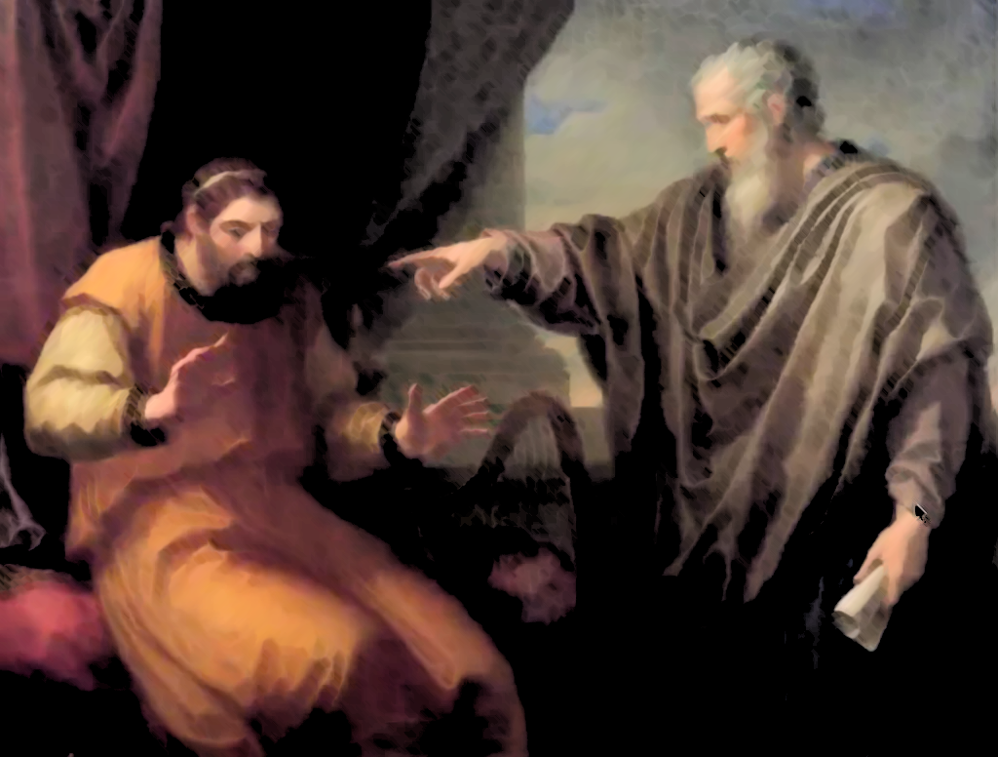
You Man
2 Samuel 12:1-15
are the

Slide 3
We Can be Blind to Our Own Sins
How are we at times blind to our own sins?
Pride – Luke 18:11; 1 Corinthians 10:12-13
Impulse of Self-Justification – Luke 10:25-29
Hypocrisy – Matthew 7:1-5
Self-Deception – Galatians 6:7-8

Slide 4
God’s Word is Meant to Reveal Our Sins to Us
The Purpose of God’s Revealed Law
To show the individual what sin is – Romans 7:7
To convict individual sinners of their sin – 1 Timothy 1:8-11
The Law’s Revelation of Sin is Intended to be Personal
The law speaks to those under it – Romans 3:19
Josiah saw himself and the people in contrast to the law – 2 Kings 22:11-13, 18-19
The people saw themselves in the reading of the law – Nehemiah 8:1-3, 8-9

Slide 5
God’s Unpleasant Rebuke is for Our Forgiveness
Rebuke is a Necessary Stop on the Way to Forgiveness
God does not expose and rebuke sin to condemn – John 3:17; Luke 9:56; 1 Timothy 2:3-4; 2 Peter 3:9
Rebuke is intended as a force to move men to repentance in order to be forgiven – Romans 11:32; Psalm 19:11-12; 2 Corinthians 7:8-10

Slide 6
God’s Unpleasant Rebuke is for Our Forgiveness
Forgiveness Must be Individually Sought
Sin is an individual matter – Ezekiel 18:20 – thus, forgiveness is as well.
God’s offer of forgiveness is universal, but it is given on an individual basis – John 3:14-16
Each individual must seek, request, and access God’s forgiveness themselves – Revelation 22:17

Slide 7
You Man
2 Samuel 12:1-15
are the

