Slide 1
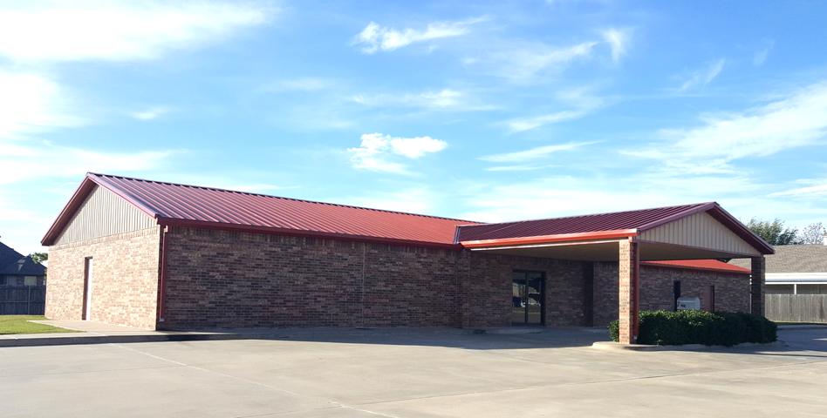
Welcome!
Elm Street church of Christ
December 6, 2020
Notes:
Needed Changes:
Date
Note: Any particular slide can be hid or unhid as needed. Example: If new members, then unhide. Otherwise, keep hidden.

Slide 2
Take Heed how
You Hear
Luke 8:4-18

Slide 3
The Text – Luke 8:4-18
Jesus Explains His Use of Parables (vv. 9-10)
The Parable in Context Serves as an Illustration (vv. 4-8, 11-15)
Jesus Explains the Intention to Reveal, not Conceal (vv. 16-17)
Jesus Explains the Individual Responsibility to Understand (v. 18)

Slide 4
Take Heed How You Hear
Do I have an urgency about knowing the truth, and submitting to it? (Acts 24:24-27)
Do I intend to put forth the necessary effort to ascertain the truth, or am I only desiring truth if it comes easy? (2 Timothy 2:15)
Do I possess the predisposition to accept the truth regardless of its content? (Acts 17:11)
Do I intend to obey the truth? (Luke 6:46; John 7:17)

Slide 5
Take Heed How You Hear
Do I truly wish to follow God, or do I have ulterior motives in my heart? (Ezekiel 14:1-5)
Do I want the truth, or am I seeking validation for settled beliefs? (Luke 10:25-29)
Do I have any reservations before hearing the truth which I have predetermined will take precedence? (Matthew 19:20-22)
Do I intend to follow truth wherever it may take me, even through trial and tribulation? (Mark 8:34-38)

Slide 6
Take Heed how
You Hear
Luke 8:4-18

