Slide 2
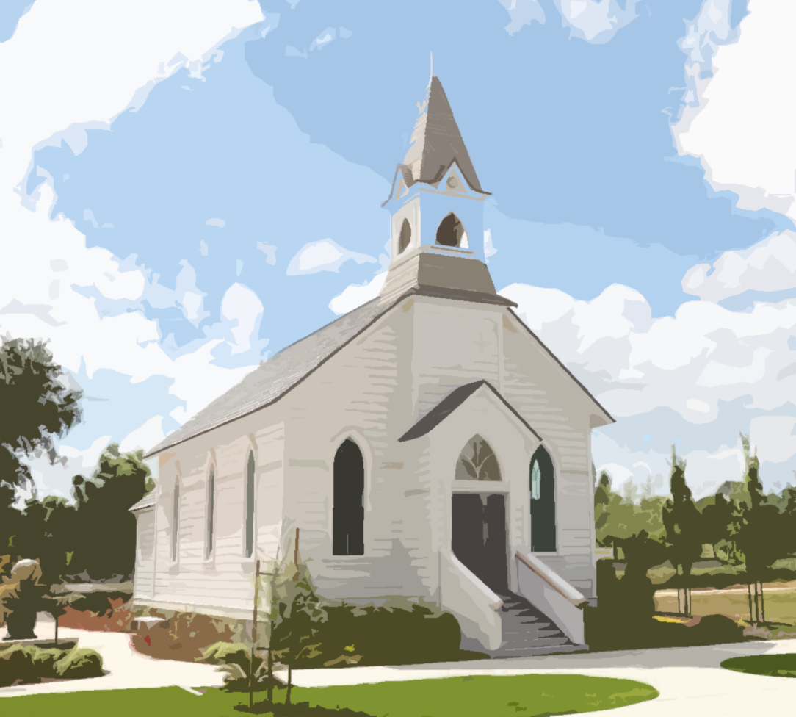
Marks of a Sound Church

Slide 3
What is a “sound” church?
Sound – hygiaino
to have sound health, i.e. be well (in body); figuratively, to be uncorrupt (true in doctrine) (STRONG)
(1) to be in good physical health, be healthy, (2) to be sound or free from error, be correct (BDAG)
Examples: Sound (Revelation 3:7-8, 10); Unsound (1 Corinthians 4:14-21)

Slide 4
Marks of a Sound Church
Distinctive Preaching
Strong Leadership
Faithful Members
The Practice of Discipline

