Slide 2
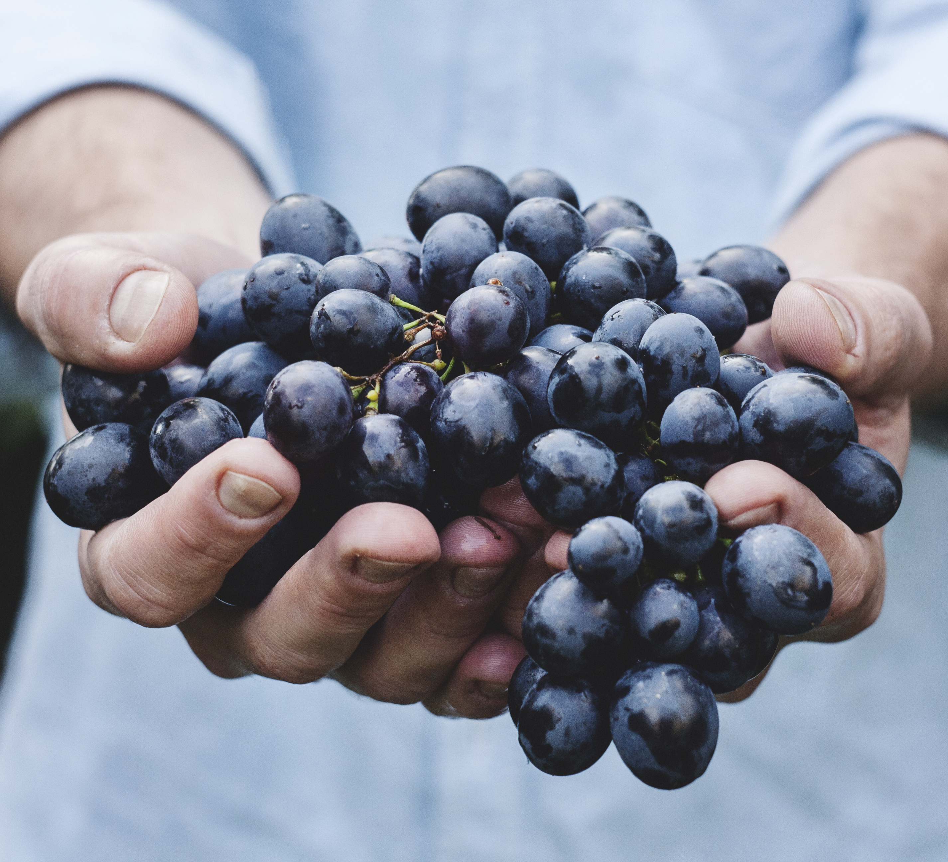
Fruit Righteousness
The
of
James 3:18

Slide 3
The Seed
“And the seed whose fruit is righteousness is sown in peace by those who make peace.” (James 3:18; NASB)
“seeking to establish their own righteousness” – Romans 10:1-4; 1:16-17
Only God’s word produces righteousness – James 3:18; 1:18-21; 1 Peter 1:22-23; 1 John 3:7, 9

Slide 4
The Sowing
“sown in peace by those who make peace” (James 3:18).
Peace with God (James 4:4), and man (James 4:1-3; Ephesians 2:14-16; 4:3)
Not peace for the sake of peace – Romans 12:18; Matthew 10:34; Luke 12:51

Slide 5
The Sowing
“sown in peace” (James 3:18) – Matthew 5:6
Without offense? – Galatians 5:11; 6:12
Sowing in peace? – 1 Timothy 1:8-11; 2 Timothy 4:2

Slide 6
The Pruning
Pruning is needed – John 15:1-3; 2 Timothy 3:16-17
Pruning by chastening – Hebrews 12:5-11; Romans 5:3-5

Slide 7
Fruit Righteousness
The
of
James 3:18

