Slide 2
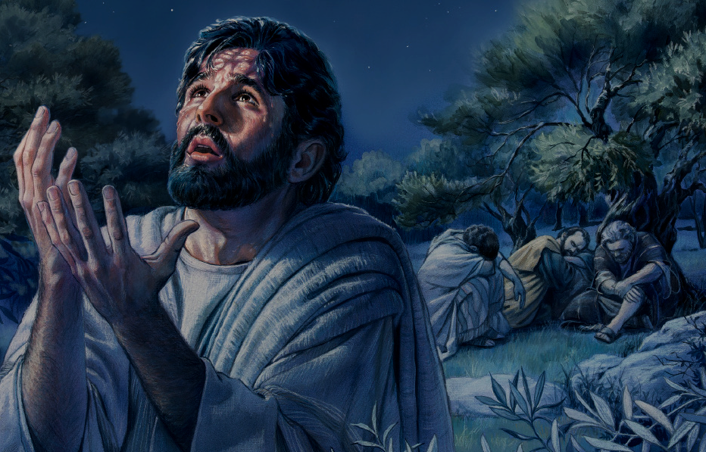
Distance Greater
The
Than a Stone’s Throw
Luke 22:39-46

Slide 3
Greater Distances
Zeal Without Knowledge (Romans 10:2)
Knowledge Without Practical Application (James 1:22-25)
Incomplete Faith (James 2:8-13)
Godliness Rendered Impotent (2 Timothy 3:1-5)

Slide 4
Distance Greater
The
Than a Stone’s Throw
Luke 22:39-46

