Slide 2
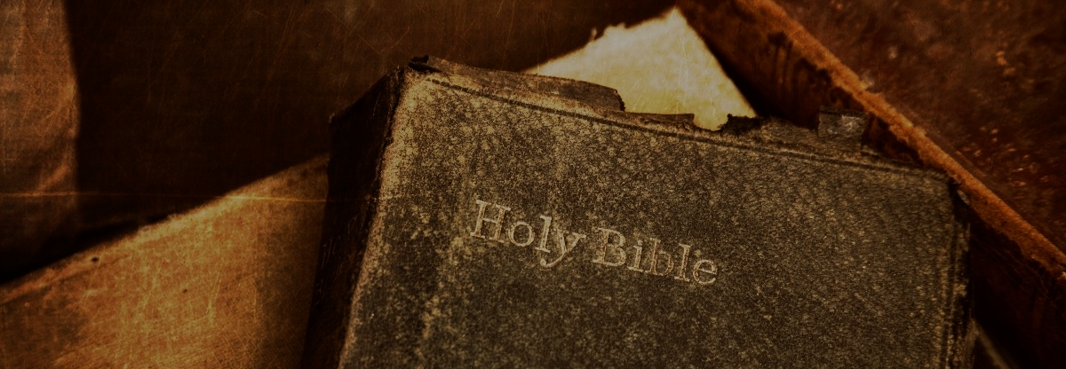
We Believe What the Bible Says

Slide 3
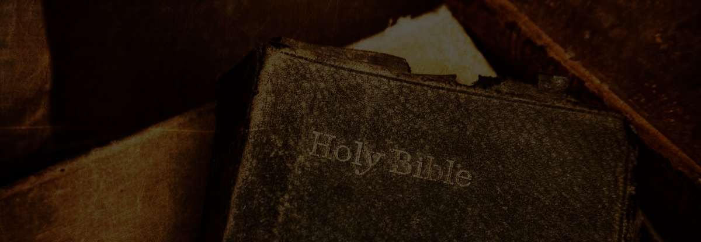
We Believe What the Bible Says
That Sin is a Universal Problem
(Romans 3:23; 6:23; Ezekiel 18:20)

Slide 4
We Believe What the Bible Says
That God Sent His Son to Save All Men
(1 Timothy 2:4; John 3:16; 1 John 4:9-10)

Slide 5
We Believe What the Bible Says
That the Gospel is the Sole Access to the Gift of Jesus’ Sacrifice
(Romans 1:16; 8:2; 5:1-2; 10:17)

Slide 6
We Believe What the Bible Says
That An Obedient Faith is Required by the Gospel for Salvation
(Romans 1:5; 16:26; Mark 16:15-16; Colossians 2:12; Romans 6:4; 17-18)

Slide 7
We Believe What the Bible Says
That There is Only One church Comprised of the Saved
(Acts 2:38, 40-41, 47; Matthew 16:18; Ephesians 1:22-23; 4:4)

Slide 8
We Believe What the Bible Says
That Christ is the Head of the One church
(Colossians 1:18; 3:17; Matthew 28:18; Luke 6:46)

Slide 9
We Believe What the Bible Says
That Christ’s church has Distinct Identifiable Characteristics
(2 Timothy 1:13 – Work, Worship, Organization)

Slide 10
We Believe What the Bible Says
That Christ’s church is Eternal
(Matthew 16:18-19; Daniel 2:44; Hebrews 1:8)

Slide 11
We Believe What the Bible Says
That Christ Will Return to Judge the World
(Hebrews 9:27; John 5:28-29; Ecclesiastes 12:13-14; John 12:48)

Slide 12
We Believe What the Bible Says
That Each Individual Will Spend Eternity in One of Two Places
(Galatians 6:7-8; Matthew 25:34, 41, 46; 7:13-14)

Slide 13
We Believe What the Bible Says

