Slide 2
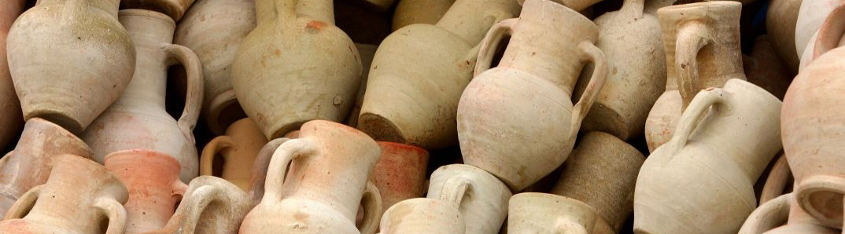
The Gospel in earthen Vessels
“we have this treasure in earthen vessels”
(2 Corinthians 4:7)

Slide 3
We Have This Treasure
The Gospel is a Treasure
The context is considering the gospel – 2 Corinthians 3:14, 17 (knowledge, word), 3 (ministry by Spirit); 4:1-6 (ministry of the gospel)
Not a treasure to many – 2 Cor. 2:15-16; 1 Corinthians 1:23

Slide 4
We Have This Treasure
Do We Value It as Such?
Psalmist saw its value – Psalm 19:10
Paul saw its value – 2 Cor. 4:7-15 – lived accordingly.
Conduct corresponding to value exhorted – Matthew 13:44-46

Slide 5
In Earthen Vessels
Earthen Vessel?
The Body – 1 Peter 3:7; 1 Thessalonians 4:3-4
Paul – Acts 9:10-16
God’s plan is for His glorious message to be carried forth in the earthen vessel of man.

Slide 6
In Earthen Vessels
By God’s Choice
Scripture is sufficient in itself – 2 Timothy 3:16-17
Message preached – 1 Corinthians 1:21; Romans 10:13-15
Not Jesus, but Ananias (Acts 9:6; 22:16); Not an angel, but Philip (Acts 8:26, 35); Not an angel, but Peter (Acts 10:3-6)

Slide 7
In Earthen Vessels
Entrusted with a Stewardship
God’s communication before – Hebrews 1:1
God’s communication now – Hebrews 1:2; John 9:5; 12:35-36; 2 Corinthians 5:16; 4:6; Matthew 5:14; 28:18-20

Slide 8
In Earthen Vessels
“that the excellence of the power may be of God and not of us”
Not by craftiness or handling word with deceit (2 Cor. 4:2).
Not preaching self, but Christ (2 Cor. 4:5).
Manifestation of the truth (2 Cor. 4:2).
Shining the light of the knowledge of the glory of God in the face of Jesus Christ (2 Cor. 4:4, 6).

Slide 9
The Gospel in earthen Vessels
“we have this treasure in earthen vessels”
(2 Corinthians 4:7)

