Slide 2
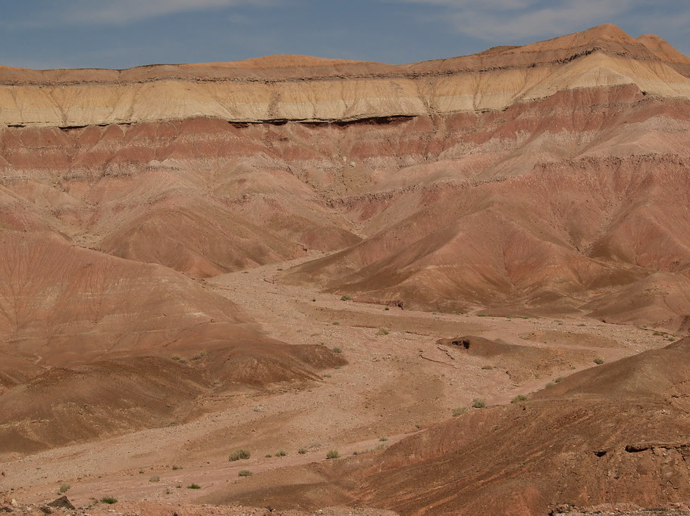

Slide 3
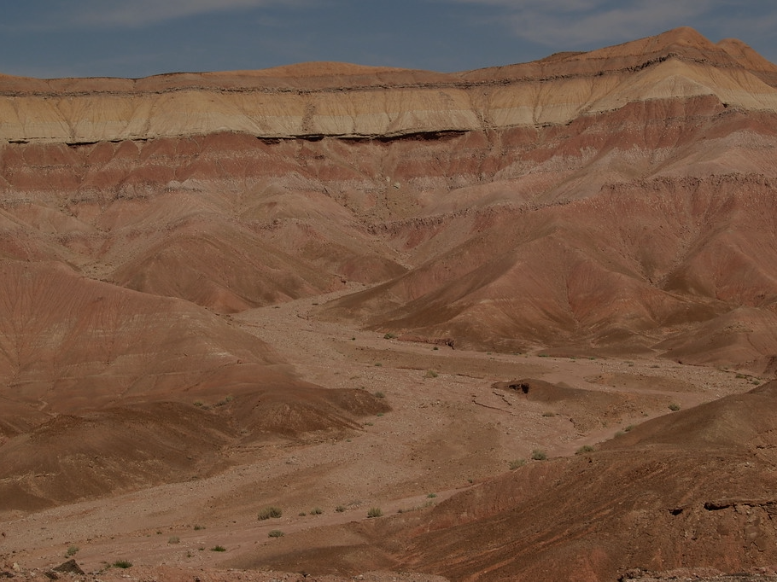
God allows us to be tempted – James 1:13; 1 Corinthians 10:13
The tempter is real – Job 1:7; 1 Peter 5:8; 2 Corinthians 2:11
Jesus can truly sympathize with us – Hebrews 2:18; 4:15-16
There is always more at stake than what we might think.

Slide 4
The temptations of Jesus take place after His baptism, and God’s words of acknowledgment and approval – Matthew 3:13-17
It was the Father’s will that Jesus’ ministry be prefaced by a victory over Satan in immense temptation – Matthew 4:1; Mark 1:12
Jesus had been intensely focused on the Father’s will, fasting for 40 days – Matthew 4:2

Slide 5
Purpose
“If you are the Son of God”
Combining a need with the reality of Jesus’ ability to miraculously provide.
He did not come to be served – Mark 10:45; John 2:4, 11
Satan wants us to forget our purpose and validate our venturing away from it.

Slide 6
Submission
Hunger – a legitimate need which seems reasonable to fulfill. (cf. 1 Corinthians 6:12-13)
Is He in absolute submission to God? – Matthew 4:4; Deuteronomy 8:1-3
Deuteronomy 8:3 – “that is, by every means which God may appoint.” (McGarvey, J.W.)
Satan wants us to fail to see the true heart of submission to God.

Slide 7
Trust
“If you are the Son of God” – Why are you hungry? Won’t He take care of you? Does He desire your well-being?
God desires our well-being, but we must trust He truly knows it better than we do.
Matthew 4:4 – God, His word, and the spiritual life He offers is sufficient. (cf. Daniel 3:17-18)
Satan wants us to think we know better, and we can handle it on our own.

Slide 8
Jesus’ reply – Deuteronomy 8:1-18

Slide 9
The 1st questioned His trust, the 2nd sought to exploit it.
Take heed lest you fall – 1 Corinthians 10:12
True faith does not create its own problems, but fully relies on God when they arise – 2 Corinthians 12:9-10

Slide 10
Satan’s Quotation – Psalm 91:11-12
“To keep you in all your ways” (Psalm 91:11b)
Protection for those abiding in God’s presence:
(vv. 1-2) – abiding in God’s presence, trusting.
(vv. 3-8) – protection described.
(vv. 9-13) – reason: you have made the Lord your dwelling place.
(vv. 14-16) – he has loved God.
Text without a context is a pretext – 2 Peter 3:16

Slide 11
Jesus’ Reply – Deuteronomy 6:16
Scripture itself explains and guards the promises and commands of God that it provides.
(v. 3) – observe the law and it will be well.
(vv. 10-15) – remember it is from God – full dependence and fidelity.
(vv. 16-19) – do not tempt (test) Him, but trust and obey. (Massah – Exodus 17:7)
Satan wants us to presumptuously extend God’s word and goodness beyond its self-defined limits.

Slide 12
Jesus came into the world – John 8:23 (cf. 1 John 2:16; Romans 8:3)
He came into the world to establish a kingdom not of this world, but of eternal spiritual truth – John 18:36-37
Purpose, priority, and position are again at stake in the greatest test yet.
Jesus’ brothers – John 7:2-5
Jesus – Luke 2:49; Matthew 4:17; Hebrews 12:2; John 17:5

Slide 13
Jesus’ Reply – Deuteronomy 6:13
Context – (vv. 10-15) – remember who gave it and give Him your all in reverent service.
Satan – Luke 4:6-7 (cf. Job 1:12; 2:6)
Would not the One who allowed Satan such control be able to offer something greater?
Would not the fact of allowing Satan control exhibit the lacking value of the object(s) put in his control?
Would not these truths lend to the demand to withhold such reverent worship from him and give it to the One truly deserving?

Slide 14
A way to the crown without the cross? – impossible – Philippians 2:8-11
Satan wants us to believe what he offers is the greatest so that we might turn our worship and service to him. (cf. 2 Corinthians 4:3-4; 2 Timothy 2:26)
Aftermath – Matthew 4:11, 17; James 4:7

Slide 15
Beware of your vulnerabilities.
Beware of your strengths.
Be watchful at all points of your life – highs, lows, in between.
Know God’s word.
Always realize true fulfillment comes with resisting Satan and submitting to God.
Have faith that temptation can always be resisted by God’s grace and look to Jesus for help.

