Slide 2
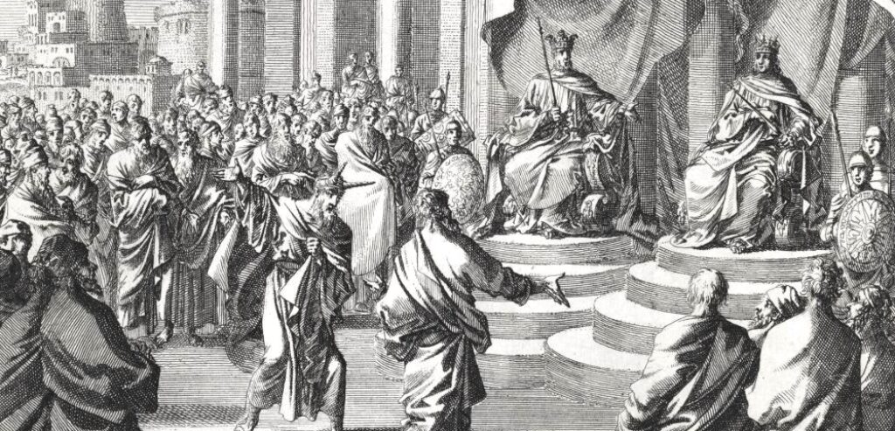
Ahab & Micaiah
1 Kings 22
Anatomy of the Rejection of Truth

Slide 3
Anatomy of the Rejection of Truth
Present Actions Can Make Us Vulnerable to Future Rejection of Truth (1 Kings 20:34, 42; 22:3)
Psalm 1:1; Romans 6:19
Mere Appearance of Love for Truth Can Lead to the Rejection of Truth (1 Kings 22:4-8, 13)
2 Timothy 3:1-5; 2 Thessalonians 2:9-12

Slide 4
Anatomy of the Rejection of Truth
Outward Circumstances Can Alter Our Discernment and Lead to the Rejection of Truth (2 Chron. 18:1-3)
Matthew 10:34-37; Proverbs 13:20; Matthew 15:14; 13:22
Subjective Foundations of Inquiry Can Lead to the Rejection of Truth (1 Kings 22:3-5)
Luke 10:29; James 1:6-8

Slide 5
Anatomy of the Rejection of Truth
A Prejudiced View of a Messenger Can Lead to the Rejection of Truth (1 Kings 22:8)
Matthew 11:16-19; Mark 6:1-6
Misuse of the Truth Can Lead to the Rejection of Truth (1 Kings 22:11-12; Deuteronomy 33:17)
Matthew 4:5-7; 2 Timothy 2:15; 2 Peter 3:16

Slide 6
Anatomy of the Rejection of Truth
Wanting to Believe a Lie Will Lead to the Rejection of Truth (1 Kings 22:19-23)
Isaiah 19:13-14; 29:9-10; Ezekiel 14:4-5; 2 Thessalonians 2:11; Romans 1:24, 26, 28
Resentment Instead of Humility Can Lead to the Rejection of Truth (1 Kings 22:24-25)
John 9:39-41; Galatians 6:1, 6; Acts 18:24-28

Slide 7
Anatomy of the Rejection of Truth
Believing God’s Truth Can be Cheated Will Lead to the Rejection of Truth (1 Kings 22:30, 34)
Ezekiel 3:18-19; Matthew 23:31-36; Galatians 6:7-9; Hebrews 4:11-13

Slide 8
Ahab & Micaiah
1 Kings 22
Anatomy of the Rejection of Truth

