Slide 3
Inspiration Claim Places God as Author
Omnipotent – Romans 1:20; Genesis 17:1
No contradiction or corruption.
Omniscient – Psalm 147:5; Isaiah 40:28
Factual and consistent.

Slide 4
Supposed Contradictions
“In the testimony of witnesses before a court, nothing is more common than for apparent contradictions to arise between credible witnesses or between different statements off the same witness. In all such cases, it is considered entirely logical and legitimate for counsel to show that on some reasonable hypothesis the statements can be harmonized.” (McGgarvey, J.W., Short Essays in Biblical Criticism, 303)
“A mere difference does not a contradiction make!”

Slide 5
Supposed Contradictions
Time of Jesus’ trial and death:
Mark 15:25 – crucified 3rd hour.
John 19:14 – being tried at the 6th hour.
Contradiction? – NO! – Mark (Jewish time – first hour starting at 6AM); John (Roman time – first hour starting at 12AM)

Slide 6
Supposed Contradictions
Contradiction and supplementation are not the same.
Healing of the blind men – Matthew 20:29-34; Mark 10:46-52; Luke 18:35-43
Matthew says 2 men, Mark mentions a name – not a contradiction, but supplementation.
Going out of Jericho or coming near? – 2 Jerichos (antiquity and Herodian)

Slide 7
Uniformity
Bible composition:
Time – 1,600 years, 40 generations, 40 different authors
3 continents – Asia, Africa, Europe
3 languages – Hebrew, Aramaic, Greek
Authors of different occupations – shepherd, military leader, king, herdsman, statesman, priest, cupbearer, scribe, physician, tax collector, fisherman, Rabbi/theologian.
Genres – Law, poetry, history, narrative, biography, prophecy, apocalyptic, personal letters.

Slide 8
Uniformity
Unity of purpose – Luke 24:27, 44; John 5:39-40
“For all that, the Bible is not simply an anthology. There is a unity which binds the whole together. An anthology is compiled by an anthologist, but no anthologist compiled the Bible. Somehow or other it grew in the course of these many centuries until at length it attained full stature as the Bible which we know. And it grew under the hand of him who makes all living things grow, ‘the Holy Spirit, the Lord and giver of life, who spake by the prophets.’” (Bruce, F.F., Books and the Parchments: The Original languages, Canon, Transmission, and How We Got Our English Bible, e-book, Kingsley Books)

Slide 9
Candor
Entirety is truth – Psalm 119:160
Psalm 19:7-9; Galatians 5:23 – Perfection, righteousness, high standards of morality throughout.
The author is no respecter of persons – Romans 2:11
Consistency of criticism – David (Acts 13:22; 2 Sam. 12:9), Israel (Rom. 3:9-20), Peter (1 Pet. 5:1; Gal. 2:11-14), Congregations (1 Cor. 5:1-2), etc.

Slide 10
Scientific Accuracy
Bible author claims to be the wisdom and power behind the cosmos – Psalm 19:1; Romans 1:20; Hebrews 3:4; Acts 17:24, 28
Evidence of such knowledge of the universe?

Slide 11
Scientific Accuracy
Law of Biogenesis – life only comes from life of the same kind – Matthew 7:16-18; Genesis 1:11, 24
Spherical Earth – Job 26:10
Suspended Earth – Job 26:7
Water Cycle – Job 36:27-28; Ecclesiastes 1:7
Life is in the Blood – Leviticus 17:11

Slide 12
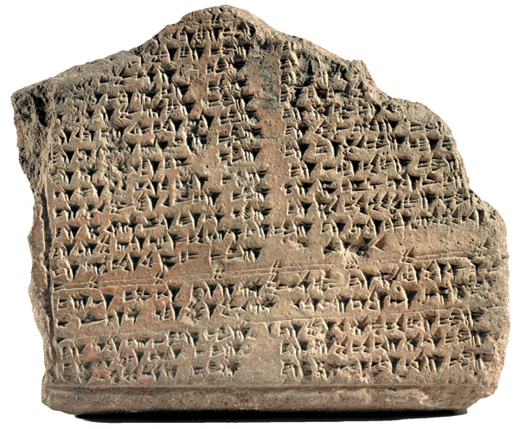
Historical Accuracy
Hittite civilization – Joshua 11:3-4; 2 Samuel 11:3; 12:9
Unknown outside the Bible until 1906 – Hugo Winckler found over 10,000 clay tablets with Hittite and Akkadian texts.

Slide 13
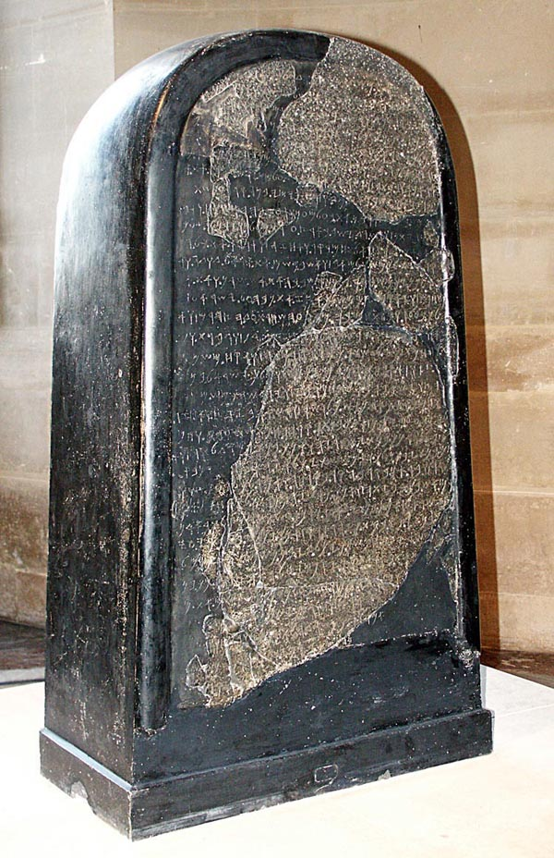
Historical Accuracy
Moabite Stone – Discovered in 1868 by a missionary named Klein.
Mentions Omri as king of Israel – 1 Kings 16:21-28
In close connection with Moab – 2 Kings 3:4-5

Slide 14
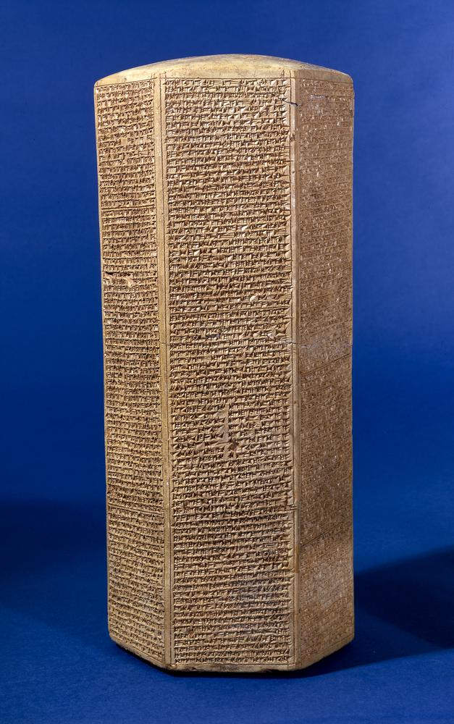
Historical Accuracy
Sennacherib’s Prism – Found by R. Taylor in 1830.
Sennacherib – Assyrian king (704-681 B.C.) – 2 Kings 18-19; 2 Chron. 32; Isa. 36-37
1 Kings 18:13 – detailed on prism.

Slide 15
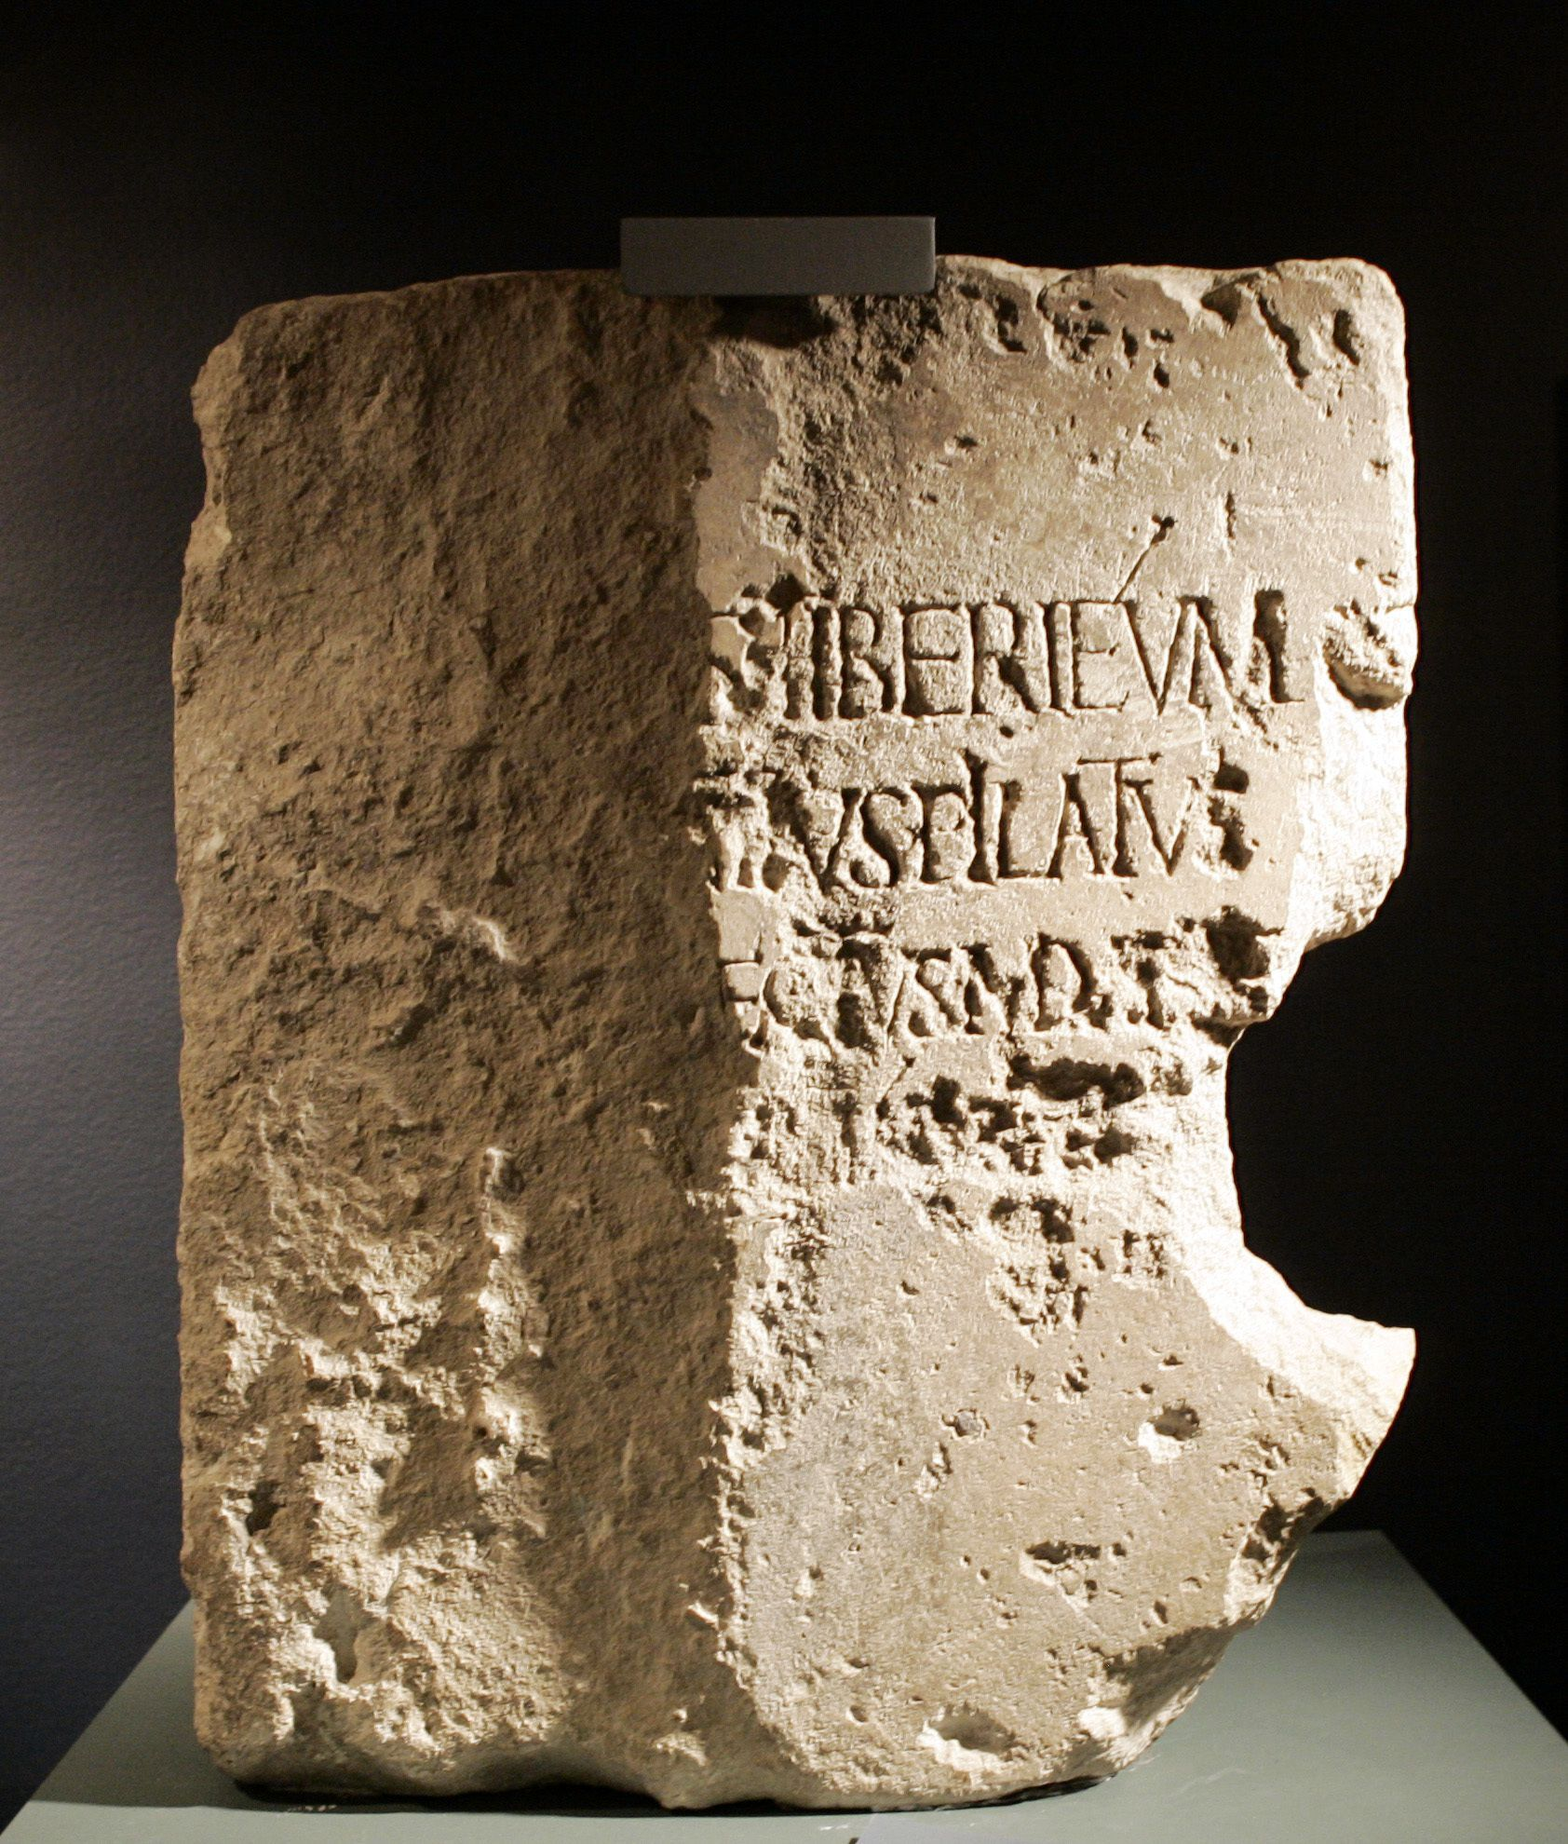
Historical Accuracy
Pilate Inscription – Pilate in Bible not found among archaeological evidence until inscription found in 1961.

Slide 16
Prophetic Accuracy
God’s claim – Isaiah 41:21-24; 46:8-10
If He inspired the Bible, then all prophecies will prove true.
The test of prophecy – Ezekiel 2:5; 33:33; Jeremiah 28:9; Deuteronomy 18:21-22
Prophetic perfect – EX: Isaiah 21:9
If they do not, then the Bible is a charade.

Slide 17
Prophetic Accuracy
Daniel’s interpretation of Nebuchadnezzar’s dream – Daniel 2:31-45
Daniel's time – Daniel 1:1, 21 – 605-538 B.C.
Head of gold (Babylon); Chest/arms of silver (Medo-Persia); Belly/Thighs of bronze (Greece); Legs/feet of iron/clay (Rome)
Medo-Persia take over – Daniel 5:30-31 (539 B.C.)

Slide 18
Prophetic Accuracy
Medo-Persia and Greece specified – Daniel 8 – Goat attacking Ram.
Time of vision – (v. 1) – aprox. 550 B.C.
Initial vision – (vv. 3-14)
Interpretation – (vv. 20-26)

Slide 19
Prophetic Accuracy
Medo-Persia and Greece specified – Daniel 8 – Goat attacking Ram.
(v. 20) – Ram – Media and Persia
“one [horn] was higher than the other, and the higher one came up last” (v. 3).
Herodotus: “On the present occasion the Persians under Cyrus rose against the Medes and from then onwards were masters of Asia.”

Slide 20
Prophetic Accuracy
Medo-Persia and Greece specified – Daniel 8 – Goat attacking Ram.
(v. 21) – Male goat – Greece
“Large horn…is the first king” – Alexander the Great
(v. 7) – Greece defeating Medo-Persia – 330 B.C. (prophecy – 550 B.C.) – Battle of the Persian Gates.

Slide 21
Prophetic Accuracy
Medo-Persia and Greece specified – Daniel 8 – Goat attacking Ram.
(v. 22) – broken horn, 4 horns in place = 4 kingdoms.
Divided among 4 generals after Alexander’s death.
“[T]he Macedonian Empire split into four main kingdoms—the one of Seleucus (Asia), Ptolemy (Egypt), Lysimachus (Thrace), and Antipater’s son Cassander (Macedonia, including Greece)” (http://www.historyofmacedonia.org/AncientMacedonia/AlexandertheGreat.html)

Slide 22
Prophetic Accuracy
Medo-Persia and Greece specified – Daniel 8 – Goat attacking Ram.
(vv. 9, 23-26) – little horn (king) out of one of the 4.
“The little horn (v. 9), which arose out of the four, is generally agreed to mean Antiochus Epiphanes (175-163 B.C.), of the Syrian branch of the Greek Empire, who made a determined effort to stamp out the Jewish religion” (Halley’s Bible Handbook, 440).

Slide 23
Prophetic Accuracy
Medo-Persia and Greece specified – Daniel 8 – Goat attacking Ram.
(vv. 9, 23-26) – little horn (king) out of one of the 4.
Antiochus Epiphanes: Exalted self – (vv. 11, 25)

Slide 24
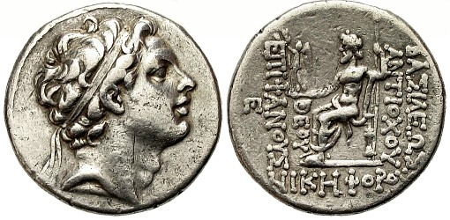
“Tetradrachma of the Seleucid Empire of Antiochus IV Epiphanes…This coin portrays Zeus enthroned; the obverse bears the portrait of Antiochus IV with the inscription ‘of King Antiochus God Manifest’” (Archer, Gleason L., A Survey of Old Testament Introduction, 439)

Slide 25
Prophetic Accuracy
Medo-Persia and Greece specified – Daniel 8 – Goat attacking Ram.
(vv. 9, 23-26) – little horn (king) out of one of the 4.
Antiochus Epiphanes: “grew exceedingly great toward…the Glorious land” (v. 9); “and by him the daily sacrifices were taken away” (v. 11)

Slide 26
“And Antiochus, after he had smitten Egypt, returned in the hundred and forty and third year and went up against Israel and Jerusalem with a heavy multitude and entered into the sanctuary in pride…And when he had taken all, he went away into his own land. And he made a great slaughter, and spoke with great pride.” (1 Maccabees 1:20-24; Bibliotheca, The Apocrypha, 390)
“grew exceedingly great toward…the Glorious land” (Daniel 8:9)

Slide 27
“And the king [Antiochus Epiphanes] sent letters by the hand of messengers to Jerusalem and the cities of Judah, that they should follow laws strange to the land, and should forbid whole burnt offerings and sacrifice and drink offerings in the sanctuary, and should profane the sabbaths and feasts, and pollute the sanctuary and holy ones.” (1 Maccabees 1:44-46; Bibliotheca, The Apocrypha, 392)
“and by him the daily sacrifices were taken away” (Daniel 8:11)

Slide 28
Prophetic Accuracy
Medo-Persia and Greece specified – Daniel 8 – Goat attacking Ram.
(vv. 9, 23-26) – little horn (king) out of one of the 4.
Antiochus Epiphanes: “But he shall be broken without human means” (v. 25)

Slide 29
Died because of a distemper, or fever – “he was confounded, and by the anxiety he was in fell into a distemper, which, as it lasted a great while, and as his pains increased upon him, so he at length perceived he should die in a little time; so he called his friends to him, and told them that his distemper was severe upon him; and confessed withal, that this calamity was sent upon him for the miseries he had brought upon the Jewish nation, while he plundered their temple, and contemned their God; and when he had said this, he gave up the ghost.” (Josephus, Antiquity of the Jews, 12:9:1)

Slide 30
Prophetic Accuracy
Head of gold (Babylon); Chest/arms of silver (Medo-Persia); Belly/Thighs of bronze (Greece); Legs/feet of iron/clay (Rome) (cf. Daniel 2)
Medo-Persia take over – Daniel 5:30-31 (539 B.C.)
Greece take over – Daniel 8 – Goat attacking Ram. (330 B.C.)
Greece followed by Rome (146 B.C.)
“in the days of these kings…” – Daniel 2:44-45 – God’s eternal kingdom.

Slide 31
Prophetic Accuracy
“in the days of these kings…” – Daniel 2:44-45 – God’s eternal kingdom.
Mark 9:1 – within the generation of those Jesus spoke to Himself.
“According to The Skeptics Annotated Bible, in Mark 9:1, ‘Jesus falsely prophesies that the end of the world will come within his listeners’ lifetimes.’” (https://apologeticspress.org/a-failed-prophecy-of-christ-5956/)
Spiritual (cf. John 18:36) – Acts 1:5-8; 2 (30 A.D.) (Church)

Slide 32
Prophetic Accuracy
Critics baselessly argue that Daniel could not have been written during the time it claims.
Argument made simply based on the sheer accuracy of the prophecies. Claim vaticinia ex eventu (predictions from the event).
Jesus referred to Daniel as the work of Daniel the prophet (605-538 B.C.) – Matthew 24:15

Slide 33
Prophetic Accuracy
Cyrus Named:
Isaiah – 740-700 B.C.
Babylon prophesied to fall to the Medes – Isaiah 13:17-10; 21:9
Babylon’s rise – 605 B.C.; Fall – 539 B.C.
Name of the man to lead the Medes specified – Isaiah 44:28; 45:1-7 – 150 years before Cyrus was born.

Slide 34
Prophetic Accuracy
Messianic Prophecy (Over 300 prophecies):
Birthplace – Micah 5:2 (735-700 B.C.); Matthew 2:3-5
Death with wicked – Isaiah 53:8-9 (740-700 B.C.); Luke 23:32-33
Death, hands/feet pierced – Psalm 22:16 (1010-970 B.C.); Matthew 27:35; John 20:24-28
Could not have been contrived by Jesus. Done to Him.

Slide 35
“no prophecy of Scripture is of any private interpretation, for prophecy never came by the will of man, but holy men of God spoke as they were moved by the Holy Spirit.”
(2 Peter 1:20-21)

