Slide 3
Inspiration Claim Places God as Author
Omnipotent – Romans 1:20; Genesis 17:1
No contradiction or corruption.
Omniscient – Psalm 147:5; Isaiah 40:28
Factual and consistent.

Slide 4
Supposed Contradictions
“In the testimony of witnesses before a court, nothing is more common than for apparent contradictions to arise between credible witnesses or between different statements off the same witness. In all such cases, it is considered entirely logical and legitimate for counsel to show that on some reasonable hypothesis the statements can be harmonized.” (McGgarvey, J.W., Short Essays in Biblical Criticism, 303)
“A mere difference does not a contradiction make!”

Slide 5
Supposed Contradictions
Time of Jesus’ trial and death:
Mark 15:25 – crucified 3rd hour.
John 19:14 – being tried at the 6th hour.
Contradiction? – NO! – Mark (Jewish time – first hour starting at 6AM); John (Roman time – first hour starting at 12AM)

Slide 6
Supposed Contradictions
Contradiction and supplementation are not the same.
Healing of the blind men – Matthew 20:29-34; Mark 10:46-52; Luke 18:35-43
Matthew says 2 men, Mark mentions a name – not a contradiction, but supplementation.
Going out of Jericho or coming near? – 2 Jerichos (antiquity and Herodian)

Slide 7
Uniformity
Bible composition:
Time – 1,600 years, 40 generations, 40 different authors
3 continents – Asia, Africa, Europe
3 languages – Hebrew, Aramaic, Greek
Authors of different occupations – shepherd, military leader, king, herdsman, statesman, priest, cupbearer, scribe, physician, tax collector, fisherman, Rabbi/theologian.
Genres – Law, poetry, history, narrative, biography, prophecy, apocalyptic, personal letters.

Slide 8
Uniformity
Unity of purpose – Luke 24:27, 44; John 5:39-40
“For all that, the Bible is not simply an anthology. There is a unity which binds the whole together. An anthology is compiled by an anthologist, but no anthologist compiled the Bible. Somehow or other it grew in the course of these many centuries until at length it attained full stature as the Bible which we know. And it grew under the hand of him who makes all living things grow, ‘the Holy Spirit, the Lord and giver of life, who spake by the prophets.’” (Bruce, F.F., Books and the Parchments: The Original languages, Canon, Transmission, and How We Got Our English Bible, e-book, Kingsley Books)

Slide 9
Candor
Entirety is truth – Psalm 119:160
Psalm 19:7-9; Galatians 5:23 – Perfection, righteousness, high standards of morality throughout.
The author is no respecter of persons – Romans 2:11
Consistency of criticism – David (Acts 13:22; 2 Sam. 12:9), Israel (Rom. 3:9-20), Peter (1 Pet. 5:1; Gal. 2:11-14), Congregations (1 Cor. 5:1-2), etc.

Slide 10
Scientific Accuracy
Bible author claims to be the wisdom and power behind the cosmos – Psalm 19:1; Romans 1:20; Hebrews 3:4; Acts 17:24, 28
Evidence of such knowledge of the universe?

Slide 11
Scientific Accuracy
Law of Biogenesis – life only comes from life of the same kind – Matthew 7:16-18; Genesis 1:11, 24
Spherical Earth – Job 26:10
Suspended Earth – Job 26:7
Water Cycle – Job 36:27-28; Ecclesiastes 1:7
Life is in the Blood – Leviticus 17:11

Slide 12
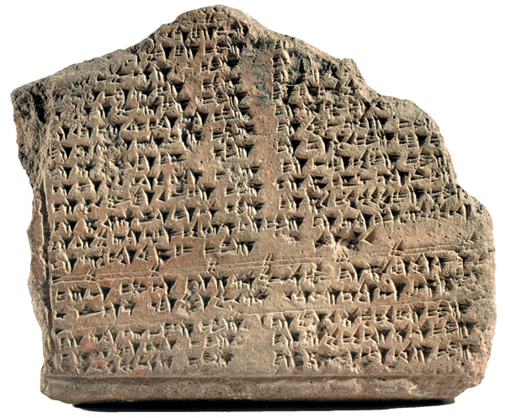
Historical Accuracy
Hittite civilization – Joshua 11:3-4; 2 Samuel 11:3; 12:9
Unknown outside the Bible until 1906 – Hugo Winckler found over 10,000 clay tablets with Hittite and Akkadian texts.

Slide 13
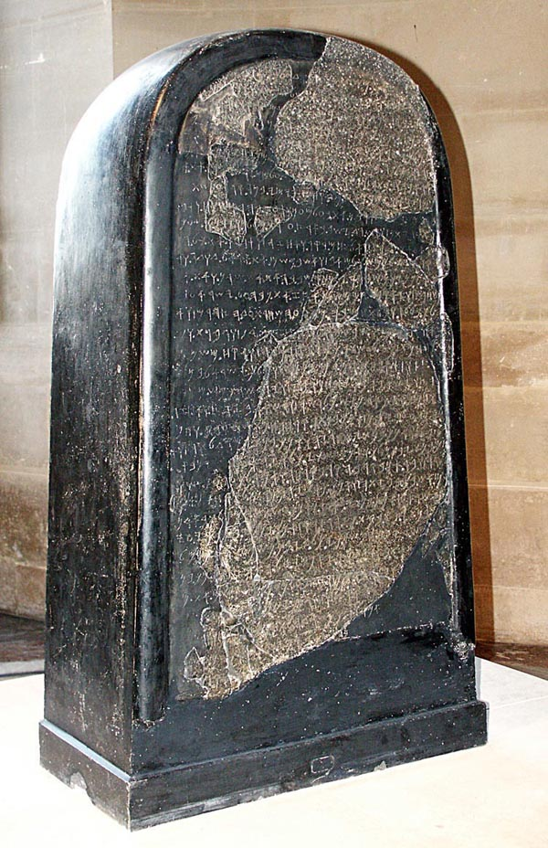
Historical Accuracy
Moabite Stone – Discovered in 1868 by a missionary named Klein.
Mentions Omri as king of Israel – 1 Kings 16:21-28
In close connection with Moab – 2 Kings 3:4-5

Slide 14
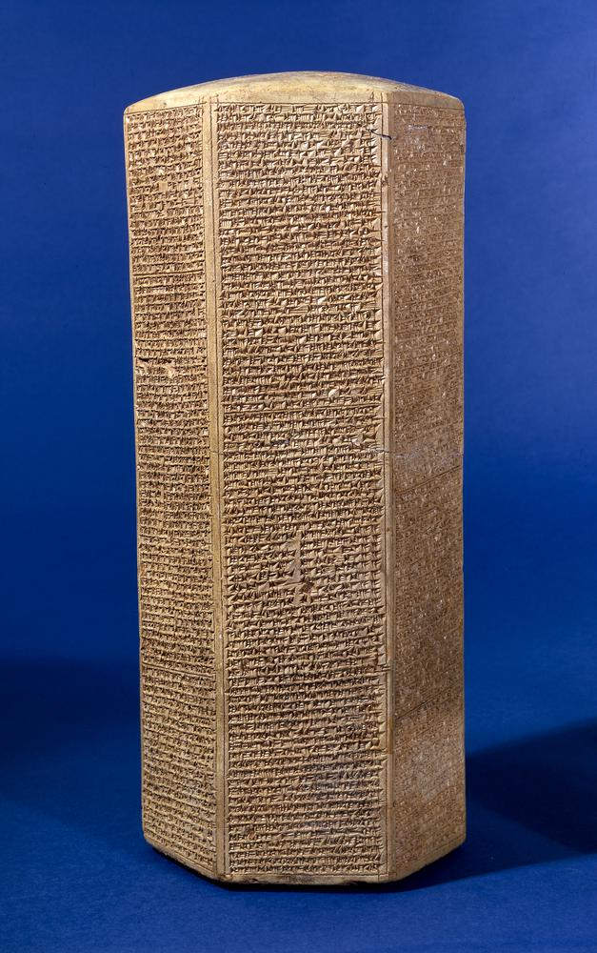
Historical Accuracy
Sennacherib’s Prism – Found by R. Taylor in 1830.
Sennacherib – Assyrian king (704-681 B.C.) – 2 Kings 18-19; 2 Chron. 32; Isa. 36-37
1 Kings 18:13 – detailed on prism.

Slide 15
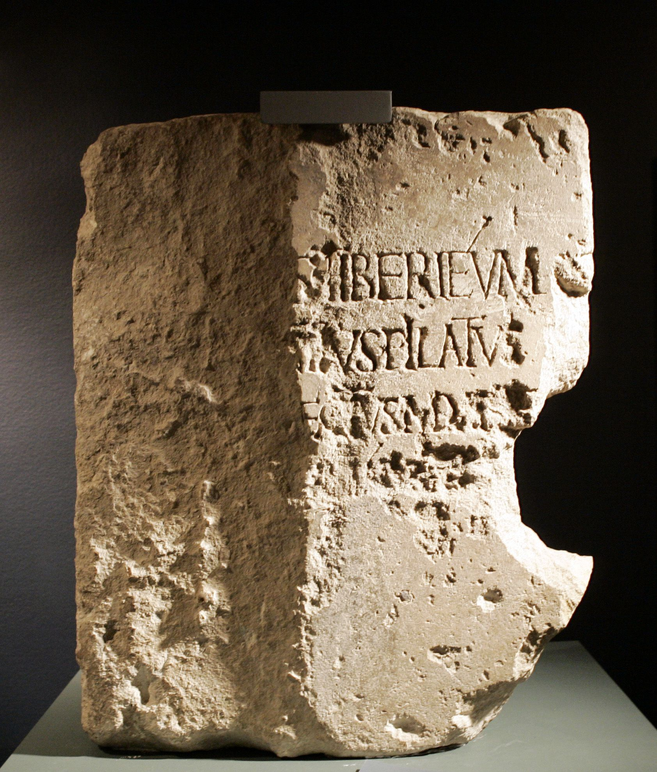
Historical Accuracy
Pilate Inscription – Pilate in Bible not found among archaeological evidence until inscription found in 1961.

Slide 16
Prophetic Accuracy
God’s claim – Isaiah 41:21-24; 46:8-10
If He inspired the Bible, then all prophecies will prove true.
If they do not, then the Bible is a charade.

Slide 17
Prophetic Accuracy
Daniel’s interpretation of Nebuchadnezzar’s dream – Daniel 2:31-45
Daniel's time – Daniel 1:1, 21 – 605-530 B.C.
Head of gold (Babylon); Chest/arms of silver (Medo-Persia); Belly/Thighs of bronze (Greece); Legs/feet of iron/clay (Rome)

Slide 18
Prophetic Accuracy
Daniel's time – Daniel 1:1, 21 – 605-530 B.C.
Head of gold (Babylon); Chest/arms of silver (Medo-Persia); Belly/Thighs of bronze (Greece); Legs/feet of iron/clay (Rome)
Medo-Persia take over – Daniel 5:30-31 (539 B.C.)
Medo-Persia and Greece specified – Daniel 8 – Goat (Greece) attacking Ram (Medo-Persia) – 330 B.C.

Slide 19
Prophetic Accuracy
Daniel's time – Daniel 1:1, 21 – 605-530 B.C.
Head of gold (Babylon); Chest/arms of silver (Medo-Persia); Belly/Thighs of bronze (Greece); Legs/feet of iron/clay (Rome)
Kingdom of Greece divided four ways – Daniel 8:22
Divided after Alexander the Great’s death – Asia, Egypt, Thrace, Macedonia and Greece.

Slide 20
Prophetic Accuracy
Daniel's time – Daniel 1:1, 21 – 605-530 B.C.
Head of gold (Babylon); Chest/arms of silver (Medo-Persia); Belly/Thighs of bronze (Greece); Legs/feet of iron/clay (Rome)
Greece (330 B.C.) followed by Rome (146 B.C.)
Kingdom of Christ/God established 30 A.D. – Mark 9:1; Acts 2 – spiritual (cf. John 18:36), the church.

Slide 21
Prophetic Accuracy
Cyrus Named:
Isaiah – 740-700 B.C.
Babylon prophesied to fall to the Medes – Isaiah 13:17-10; 21:9
Babylon’s rise – 605 B.C.; Fall – 539 B.C.
Name of the man to lead the Medes specified – Isaiah 44:28; 45:1-7 – 150 years before Cyrus was born.

Slide 22
Prophetic Accuracy
Messianic Prophecy (Over 300 prophecies):
Birthplace – Micah 5:2 (735-700 B.C.); Matthew 2:3-5
Death with wicked – Isaiah 53:8-9 (740-700 B.C.); Luke 23:32-33
Death, hands/feet pierced – Psalm 22:16 (1010-970 B.C.); Matthew 27:35; John 20:24-28
Could not have been contrived by Jesus. Done to Him.

