Slide 2
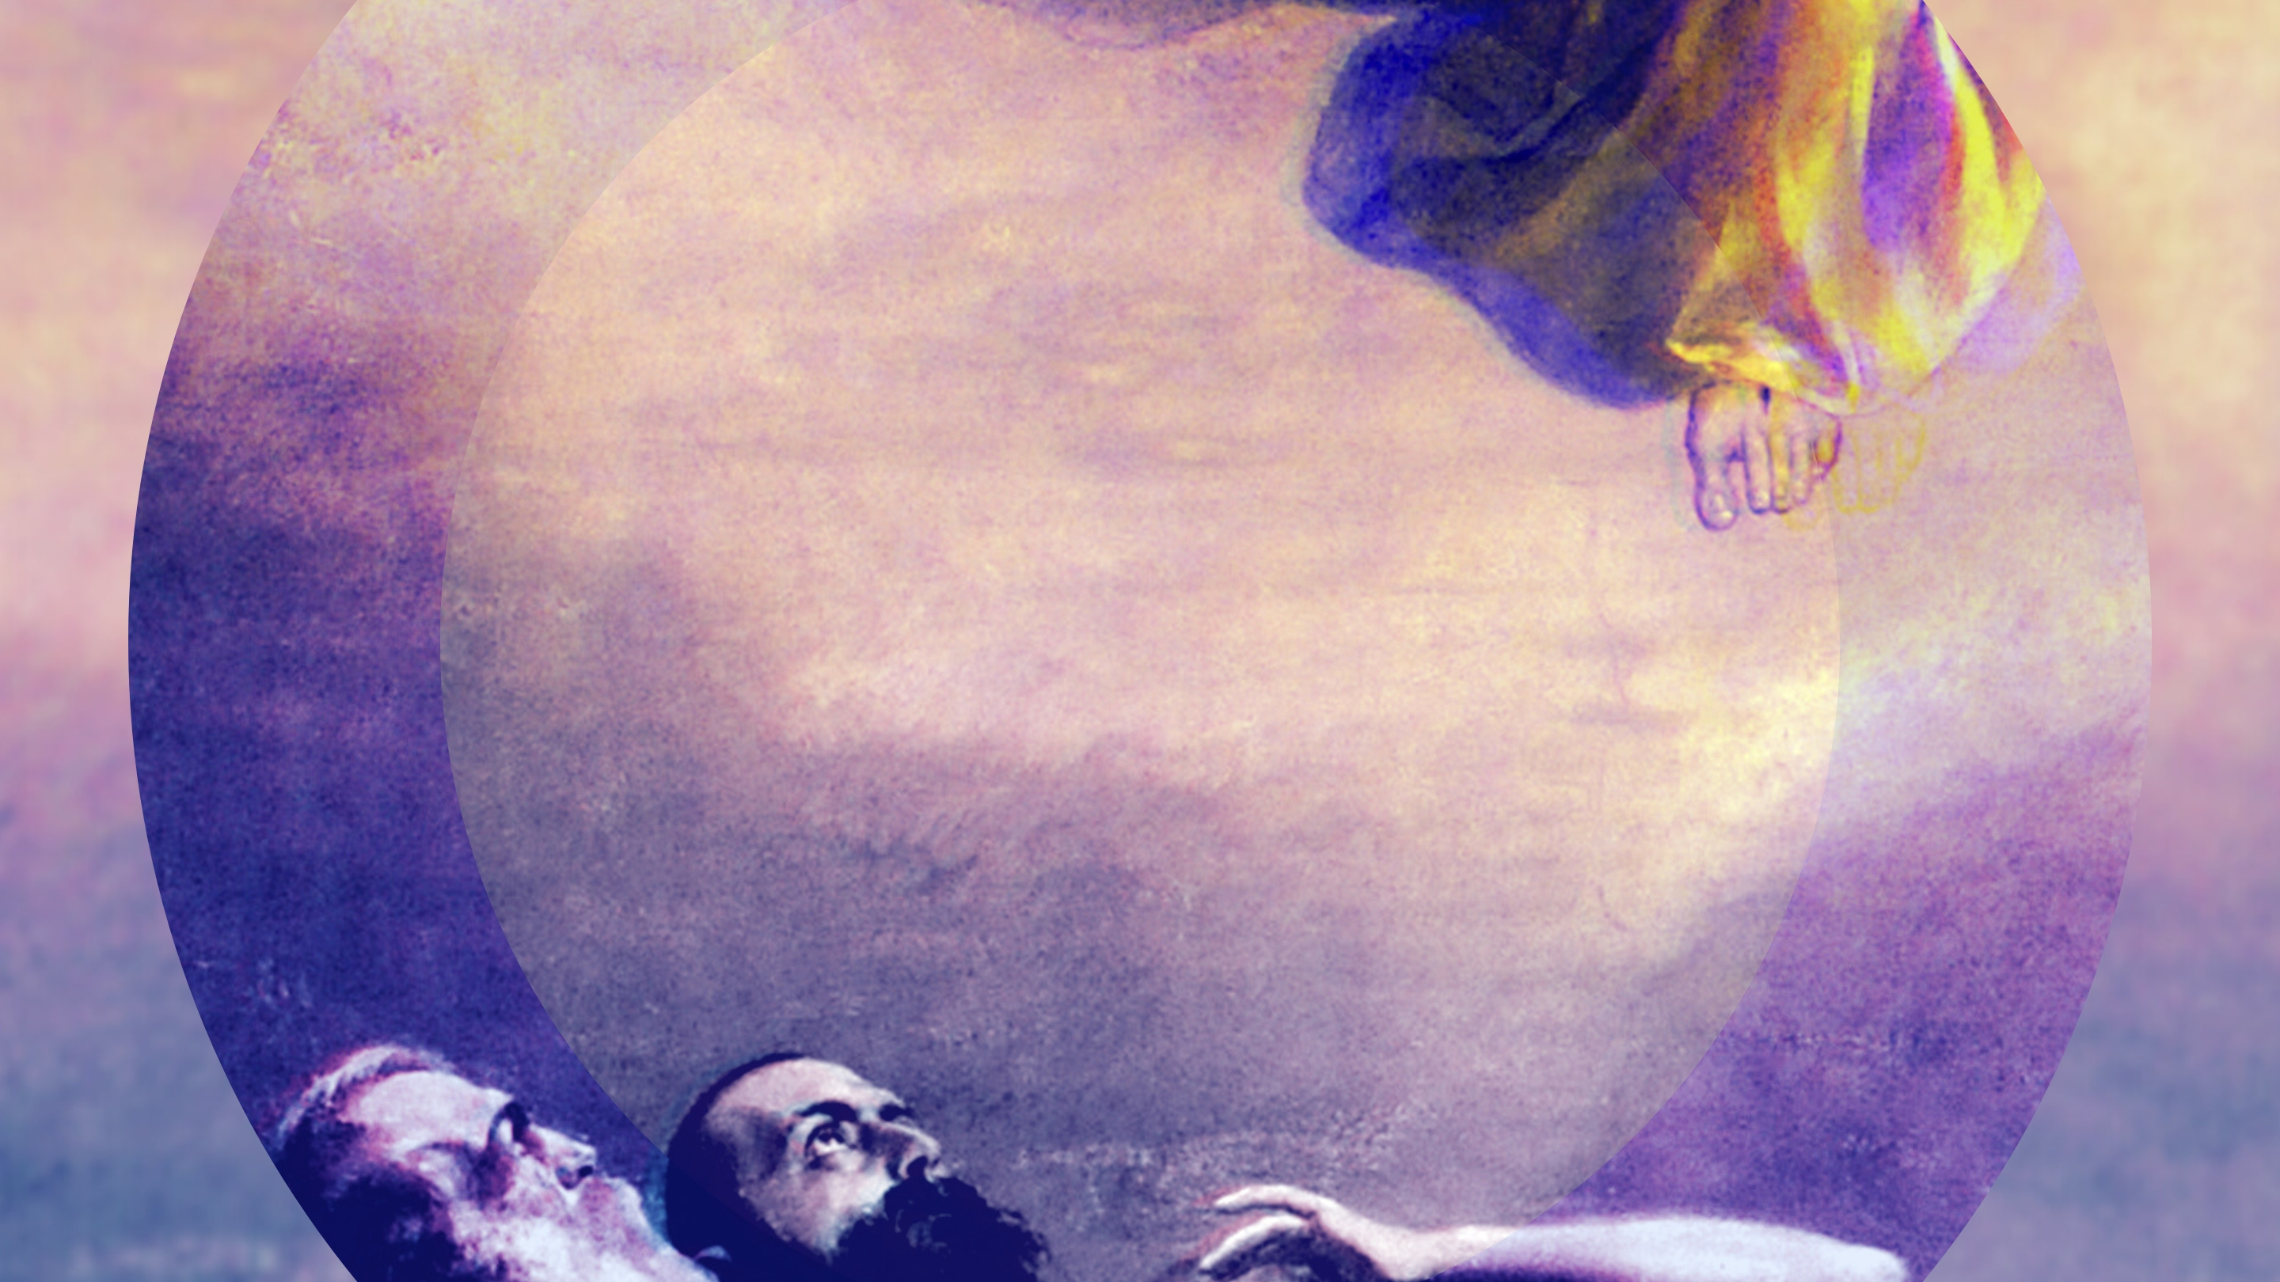

Slide 3
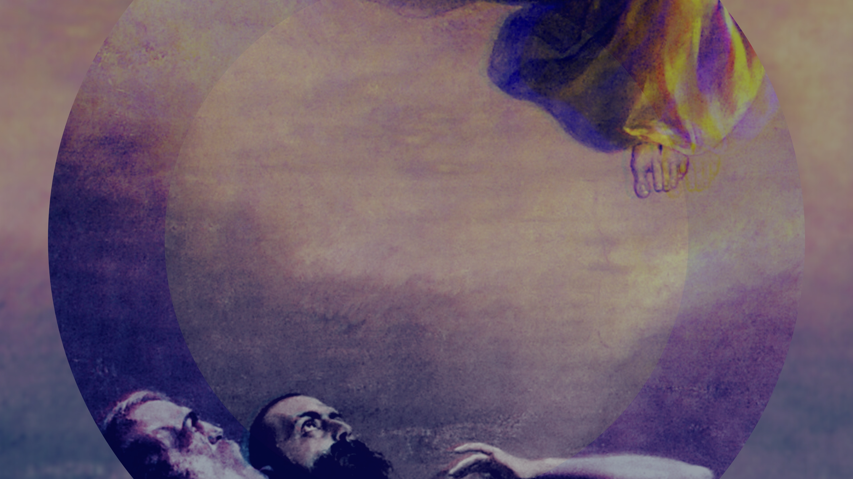
Jesus will return, but we do not watch for Him with our eyes. (vv. 9-11)
Disciples of Jesus are with one accord. (vv. 12-14)
The resurrection of Jesus is life changing. (v. 14)
We decide which place we go to. (vv. 15-26)

