Slide 2
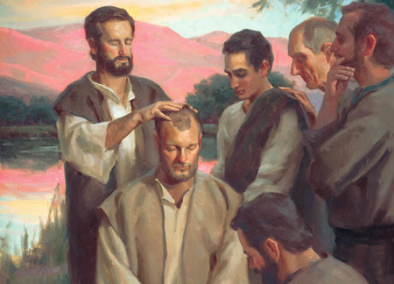
“Of The Laying On Of Hands”
Hebrews 6:2

Slide 3
The Act of the Laying on of Hands
It is a symbolic gesture.
The Offerings Given to the Lord – Leviticus 3:1-2; 4:4
The Bestowal of a Blessing – Genesis 48:14-15
The Consecration of Individuals to a Work – Numbers 8:10-15; 27:15-23; Acts 13:1-3
The Miraculous Healing of People – Mark 6:5; Acts 9:12, 17; 28:8
The Imparting of Spiritual Gifts – Acts 8:14-17; 19:5-7; Romans 1:11-12

Slide 4
What Simon Saw, and its Place in the New Testament
The Case in Samaria (Acts 8)
Philip preached, and many believed – (vv. 5-8, 13)
News reached Jerusalem, sent Peter and John to give the Holy Spirit – (vv. 14-17)
Simon saw that the Spirit was given through the laying on of the apostles’ hands – (vv. 18-19)
Implications – urgency, exclusivity.

Slide 5
What Simon Saw, and its Place in the New Testament
The Remote Context
Urgency explained in infancy of the church – 1 Corinthians 13:8-12
For edification – 1 Corinthians 14:1-4, 12
In Acts – Acts 6:8; 8:4-8; 11:27; 13:1; 15:12, 32; 21:9-14
Exclusivity leads to the necessary conclusion that spiritual gifts have ceased – Acts 8:18; 1 Corinthians 13:10-11

Slide 6
The Determination in Context
Hebrews 6:2 – for the imparting of spiritual gifts.
Acts 6:6 – 7 appointed to the daily distribution.
1 Timothy 5:22 – warning about hastiness in church discipline concerning elders.
1 Timothy 4:14; 2 Timothy 1:6 – Timothy’s gift (Spiritual? Ministry/ability?)

Slide 7
“Of The Laying On Of Hands”
Hebrews 6:2

