Slide 2
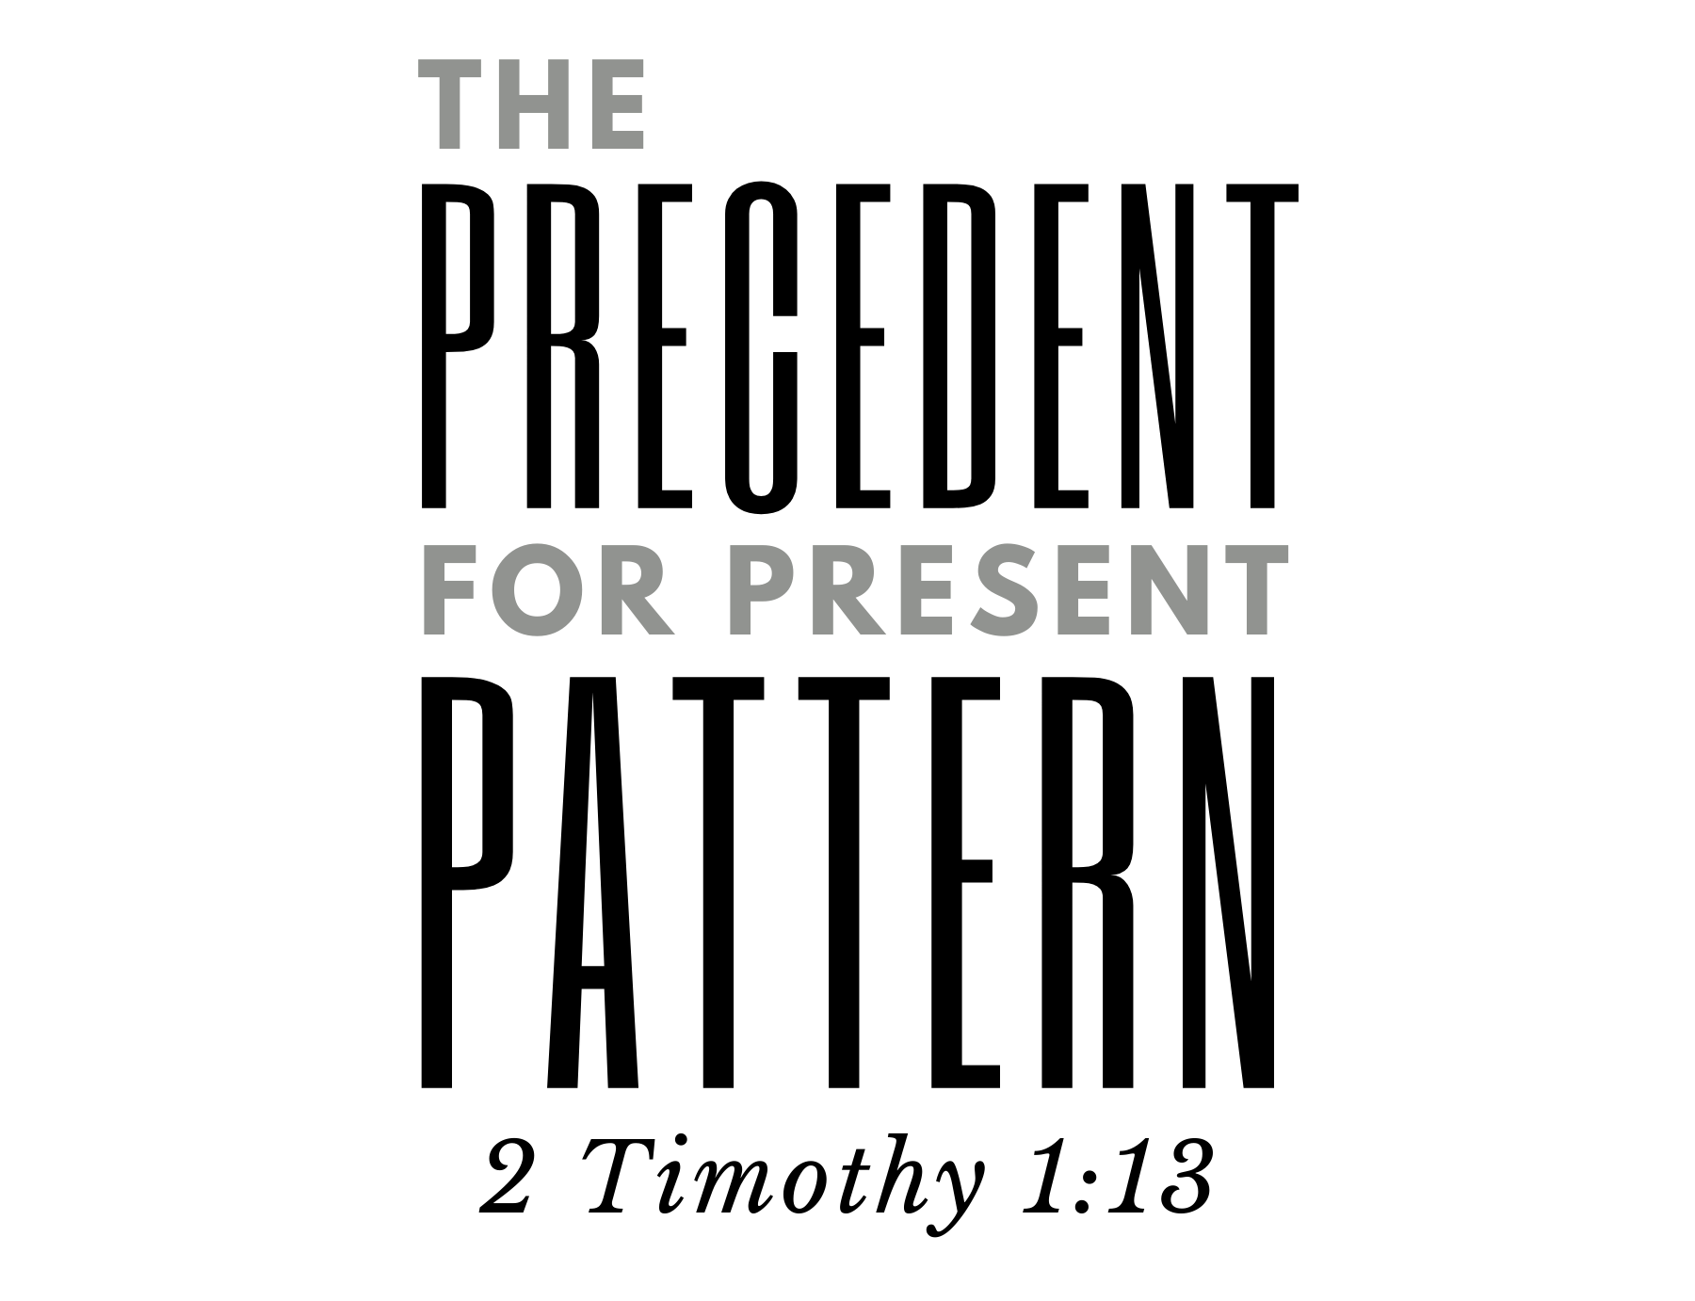

Slide 3
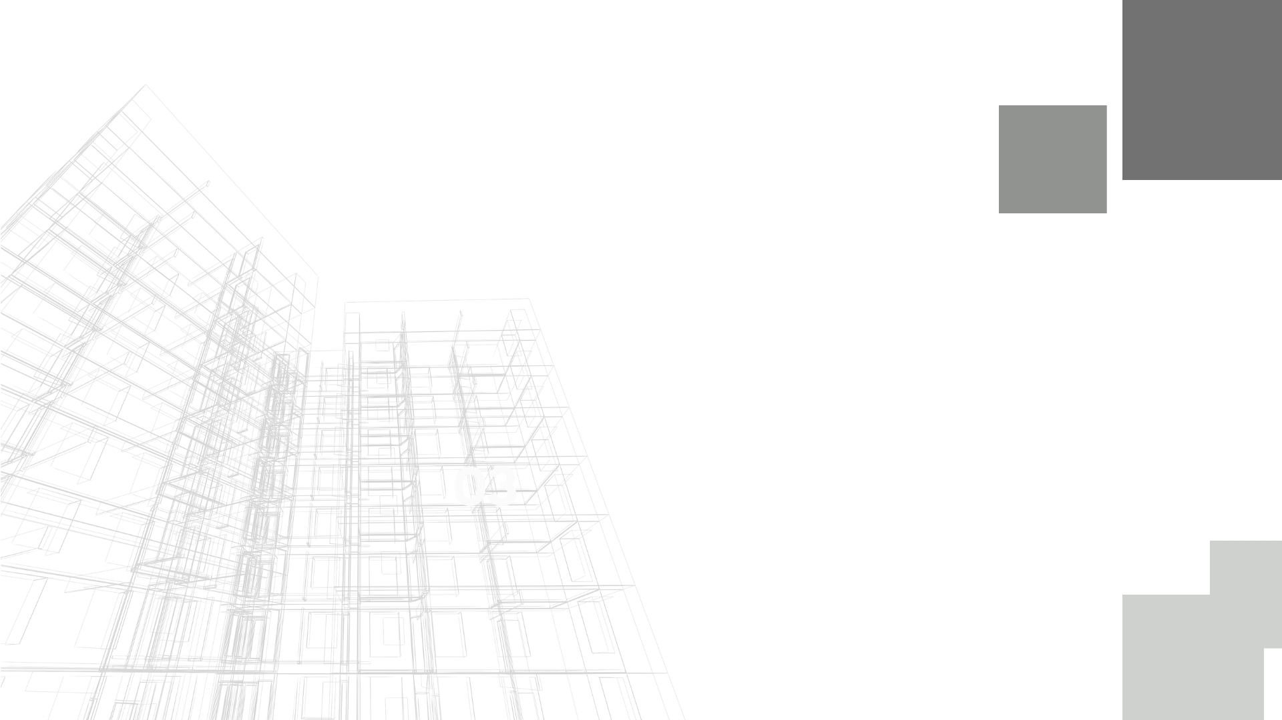
The Nature of God – 1 Corinthians 14:33 – “not characterized by disorder” (NET)
akatastasia – “opposition to established authority, disorder, unruliness” (BDAG) (cf. James 3:16)
Our Responsibility – 1 Corinthians 14:20, 26-38 – “in understanding be mature”
The Effect – “peace” (v. 33) – the product of divine pattern.

Slide 4
Creation Issued from Wisdom – Psalm 104:24; 148:1-6
A product/reflection God’s mind (cf. 1 Corinthians 14:33).
Creation Manifests Order and Pattern
From chaos to order – Genesis 1:1-5
Order and pattern can be observed in creation.
“And God saw that it was good” – an exact product of eternal design.

Slide 5
Creation is the Precedent for All Pattern (spiritual)
Chaos – Genesis 1:2; Isaiah 34:11 – in opposition to God’s word.
Order issued forth from God’s word – Genesis 1:3; Psalm 119:105; John 1:4-5
Chaos comes from rebellion against God’s law/pattern – Romans 5:12
Salvation comes from God’s pattern – Genesis 3:15

Slide 6
The Significance of the Priesthood
Blood atonement and priesthood – Leviticus 17:11; Hebrews 9:22; 7:27; 8:3; 9:6-7
Pattern – Hebrews 7:11 – “for under [the Levitical priesthood] the people received the law”
The Superiority of Christ’s Priesthood – Hebrews 7:11, 19-28; 10:11-14

Slide 7
The Pattern of Christ’s Priesthood
Order of Melchizedek, not Aaron – Hebrews 5:9-10; 7:11
Christ’s High Priesthood is superior to Aaron’s because it is patterned after one superior to Aaron (7:1, 3, 4, 7, 9, 10)
Necessary change of law – Hebrews 7:11-19 – the very blessings of God’s grace and mercy in Christ’s service as High Priest are inseparable from His implementation of pattern.

Slide 8
God’s Desire for Fellowship – Exodus 19:3-6; Isaiah 65:2-5
God’s Arrangement for Fellowship – Exodus 25:8; 29:43-46; Ezekiel 37:26-28
The Tabernacle Demonstrates Heavenly Communication and Fellowship Through Pattern – Exodus 25:8-9; 39:32; 40:34

Slide 9
The Tabernacle and Today
Hebrews 8:4-6 – the pattern typified heavenly things.
To truly represent the heavenly, we must adhere to God’s pattern – Hebrews 9:1, 6, 11, 23; 1 Peter 2:5
There is a Pattern, and We Must Hold it Fast – 2 Timothy 1:13; 2 Thessalonians 2:15; 2 John 9-11

