Slide 2
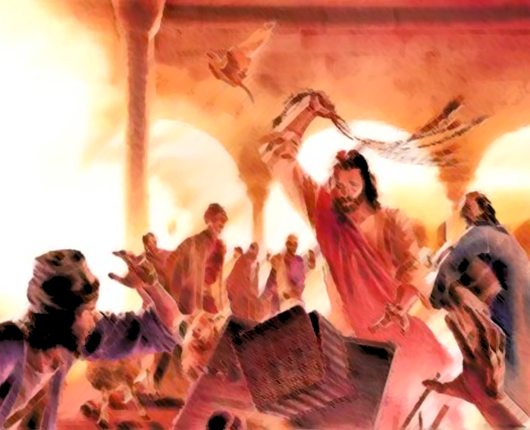
John 2:13-17

Slide 3
Work?
Work is a good thing from God, and commanded – 2 Thessalonians 3:6-12; 1 Timothy 5:8; Ecclesiastes 5:18-20
However, work should not consume us – Ecclesiastes 2:17-23; James 4:13-17

Slide 4
Work? Education?
Education, wisdom, and knowledge have value – Ecclesiastes 2:13; 7:11-12; 9:16-18
However, it is also vain – Ecclesiastes 2:12-16; 12:12

Slide 5
Work? Education? Worry?
There are many things to worry about – Matthew 6:25, 31
Worry is overwhelming – Matthew 6:34
Worry accomplishes nothing – Matthew 6:27

Slide 6
Work? Education? Worry? Liberties/Opinions/Indifferent Matter?
Liberties should not become our master – 1 Corinthians 6:12; Hebrews 12:1
These matters have nothing to do with pleasing God – Romans 14:1-4, 17; 1 Corinthians 8:8; Galatians 6:15
Being consumed by these matters leads to contention – James 4:11-12

Slide 7
Zeal for God’s Will
Jesus’ consuming zeal was for His Father’s will – John 2:16-17; Matthew 21:13
From early on to the end of His life – Luke 2:49; Matthew 26:39

Slide 8
Zeal for God’s Will
God’s house now – 1 Timothy 3:15 – church of God, pillar and ground of the truth.
Zeal for matters pertaining to the church – Romans 12:4-6, 11
Zeal for matters pertaining to the truth – Psalm 119:97 (meditation); 2 Timothy 2:15 (study); Jude 3 (defending); Matthew 28:18-20 (evangelizing/teaching)

Slide 9
The nature of this consuming zeal (cf. John 2:13-17): Informed
Jesus’ zeal came from a knowledge of God’s will – John 2:16; Matthew 21:13
It starts with the content of the heart – Proverbs 4:23; Mark 7:20-23
Zeal for good things – Galatians 4:17-20
Zeal without knowledge is destructive – Romans 10:2

Slide 10
The nature of this consuming zeal (cf. John 2:13-17): Informed, Controlled
Jesus’ actions were deliberate and justified – John 2:14-17
Consuming zeal without an infallible standard will be out of line – John 16:2-3
Consuming zeal for the things of God will cause us to alter our decisions accordingly – 1 Corinthians 8:9-13; 9:19-23; 2 Corinthians 5:14

Slide 11
The nature of this consuming zeal (cf. John 2:13-17): Informed, Controlled, Active
Jesus did not ignore irreverence, but addressed it – John 2:14-17
His time, resources, and energy were taken by this zeal – John 9:4-5
Such zeal is circumspect, and takes advantage of opportunities to further God’s will – Ephesians 5:15-17

Slide 12
The nature of this consuming zeal (cf. John 2:13-17): Informed, Controlled, Active, Persistent
Jesus cleansed the temple more than once – Matthew 21:12-13; Mark 11:15-19; Luke 19:45-46 – at beginning and end of ministry.
Some are initially zealous, but fade due to adversity – Matthew 13:20-21
Some have their zeal until the world entices them – 2 Timothy 4:10
Some let the fire die out over time – Revelation 2:2-5

Slide 13
John 2:13-17

