Slide 3
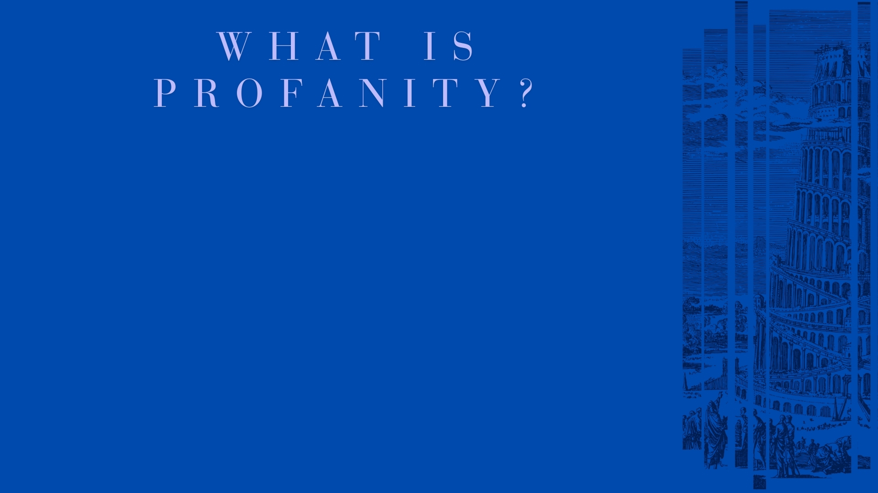
Etymology – “from late Latin profanitas, from Latin profanus ‘not sacred’” (New Oxford American Dictionary)
Definition – “blasphemous or obscene language”
Profanity – “profane language” (Merriam-Webster)

Slide 4
Profane (Adjective) – “(1) not concerned with religion or religious purposes (2) not holy because unconsecrated, impure, or defiled (3) serving to debase or defile what is holy” (Merriam-Webster)
Profane (Verb) – “(1) to treat (something sacred) with abuse, irreverence, or contempt (2) to debase by a wrong, unworthy, or vulgar use” (ibid.)
Language that is not treated as sacred, manifesting in the use of blasphemy, irreverence, obscenity, impurity, vulgarity, and abuse.

Slide 5
The Holiness of Language
Used by God to create – Genesis 1:1, 3; John 1:1, 3
Words are the vehicle to convey intelligence – 1 Cor. 2:11-13; Psalm 33:8-9; 19:1-4
Ability to communicate is a holy purpose – Genesis 1:26; Ecc. 12:13-14; Matt. 12:36-37
As language and speech are consecrated to the service of God’s will, profane speech is simply any unauthorized speech before God.

Slide 6
The Profanation of Speech (Gen. 11:1-9)
The Unity of Language and Speech (vv. 1-2)
The Unity of Pride and Rebellion (vv. 3-4)
The Assessment of the Damage, and Prospective Damage by the Profanation of Speech (vv. 5-6)
The Divine Judgment (vv. 7-9)

Slide 7
Profane Speech:
Uses the instrument for righteousness as an instrument for unrighteousness.
Exalts self against God, whether with intent or in outcome of self-centered expression.
Degrades others, whether directly, or in the negative influence that leads away from God’s will.
Betrays created purpose from God, which includes the use of the tongue.
“And the tongue is a fire, a world of iniquity.” (James 3:6)

Slide 8
Profanity – Blasphemy (Exodus 20:7); Profanity (Ephesians 5:3-5; Matthew 15:18-20; Hebrews 5:14; Romans 12:2)
Abusive Language – Reviler (1 Corinthians 5:11; 6:10); Ephesians 4:29, 31; James 3:9; Colossians 3:8; Proverbs 6:12-19
Lying – Colossians 3:9-10 (cf. John 14:6; 18:37); Ephesians 4:25

