Slide 3
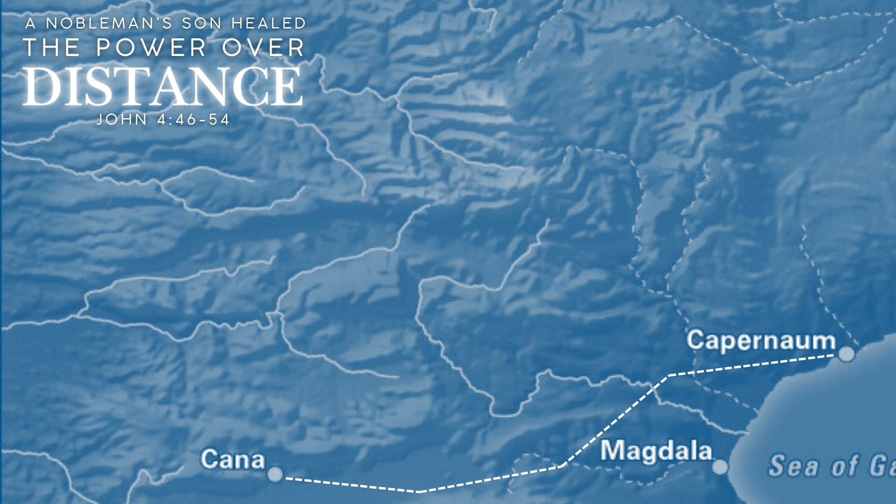
The Miracle
The Desperation (vv. 46-47)
The Insight (vv. 48-49)
Jesus sees where the man is spiritually (v. 48).
He provides for his needs, not his wants (v. 49).
The Sign (vv. 50-54)
What he heard, not saw, produced faith (v. 50)
(cf. Matt. 7:28-29; 8:8-9)
His belief was strengthened (vv. 47, 50, 53)

Slide 4
Jesus is the Lord of Space and Matter
As Creator, Jesus is Not Limited by Creation
Genesis 1:1 (John 1:1-3) – beginning (time), heavens (space), earth (matter)
He is not subject to creation – Revelation 1:8; Psalm 139:7-10; Matthew 3:9
Physical Distance Illustrates Spiritual Distance Which Jesus Vanquishes (John 1:47-51; 14:6)

Slide 5
Jesus Has Power Over Distance
The Distance Between the Gospel and the World – 1 Cor. 2:9-10; Rom. 10:6-8; Mark 16:15; Col. 1:5-6; Heb. 1:1-3; Matt. 7:7-8
The Distance Between Belief and Unbelief – John 4:46-54; 1 Cor. 1:26; Acts 22:3; Phil. 3:4-7; John 19:38-42; 20:25-31

Slide 6
Jesus Has Power Over Distance
The Distance Between God and Sinners – Isaiah 59; Rom. 3:23; 6:23; Matt. 19:23-26; Luke 5:31-32; 19:10
The Distance that Makes No Difference – 2 Cor. 5:6-8; Matt. 28:18-20; 2 Tim. 4:16-17; Heb. 13:5-6; Rom. 8:35, 38-39

