Slide 3
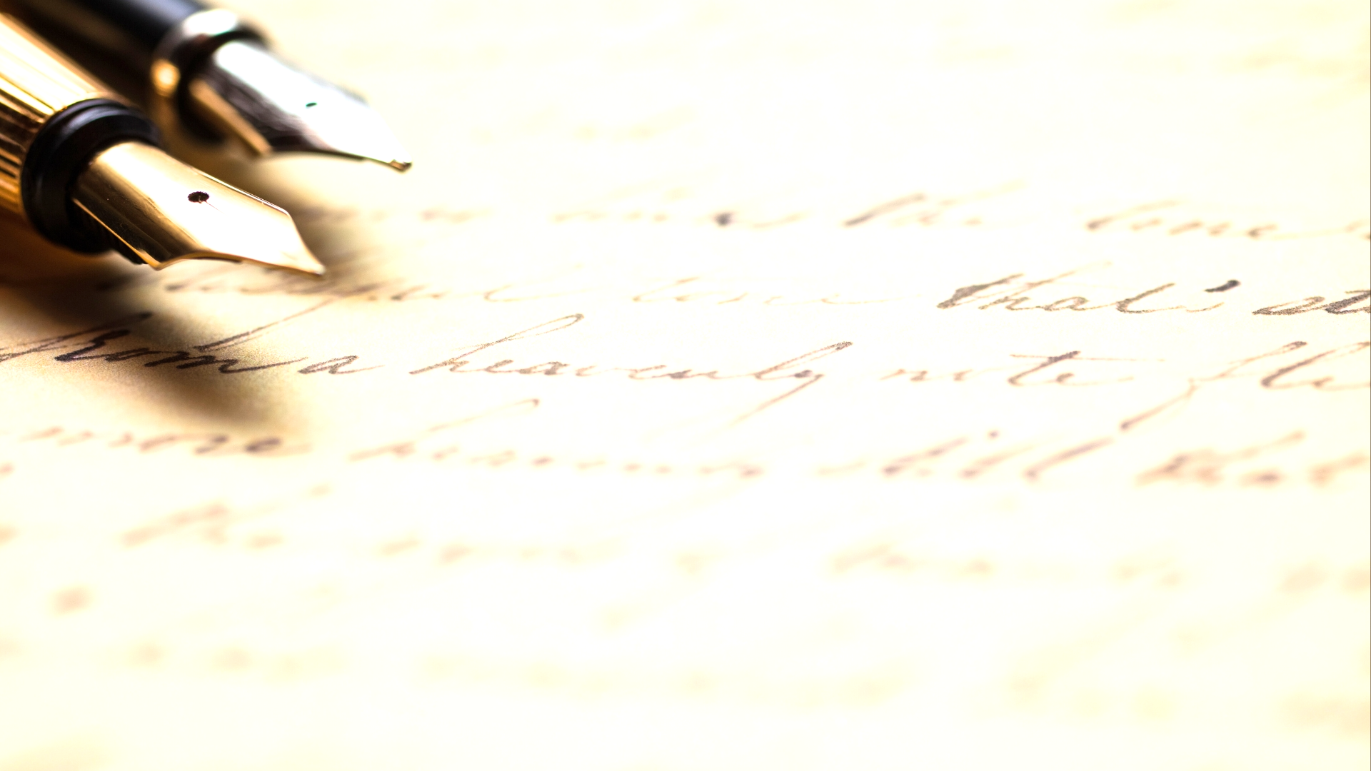
Their Anticipation of the Day of the Lord (vv. 1-2)
The Times and Seasons (vv. 1-3)
(vv. 1-2) – they know that the day is unknown. (cf. Acts 1:6-7)
(v. 3) – contrasted with “they” – the world.

Slide 4
Their Anticipation of the Day of the Lord (vv. 1-2)
Their Relation to the Light (vv. 4-11)
(vv. 4-5) – Christians are characterized by light, not darkness. (cf. 2 Cor. 4:6; Hebrews 6:4; John 3:21; 2 Peter 1:19-21)
(vv. 6-7) – warning – Christians can relapse into darkness.
(v. 8) – exhortation – proper activity of those in the light. (cf. Eph. 6:11; Romans 13:12)
(vv. 9-11) – purpose of activity in the light.

Slide 5
Their Preparation for the Day of the Lord (vv. 12-22)
In Relation to Their Leaders (vv. 12-13) (cf. Hebrews 13:7, 17)
In Relation to Their Brethren (vv. 14-15) (cf. Romans 12:5)
In Relation to Their God (vv. 16-22) (cf. Phil. 4:4; Heb. 4:16; Col. 3:16; Phil. 2:14-16)

Slide 6
Their Confidence at the Day of the Lord (vv. 12-22)
The Sanctification by God (vv. 23-24)
The Fellowship of the Saints (vv. 25-26)
The Decrees of the Lord (v. 27) (cf. 1 Corinthians 14:37; 2 Peter 3:15-16; Colossians 4:16)
The Grace of Jesus (v. 28) (cf. 2 Peter 3:18)

