Slide 2
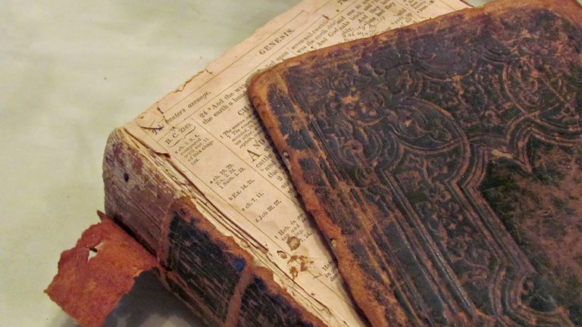

Slide 3
Inspiration of Scripture (2 Timothy 3:16)
Inerrancy of Scripture (Psalm 19:7-9)
Relevance of Scripture (Isaiah 40:6-8)

Slide 4
Faith (Romans 10:17)
Obedience (Romans 6:17-18)

Slide 5
The Scripture Fulfills What God Intends for It (Isaiah 40:6-8; 55:6-13; 1 Peter 1:3-5, 22-25)
The Scripture Destroys Those Who Challenge It (Psalm 118:22-24; 1 Peter 2:6-8; Matthew 21:40-44)

