Slide 2
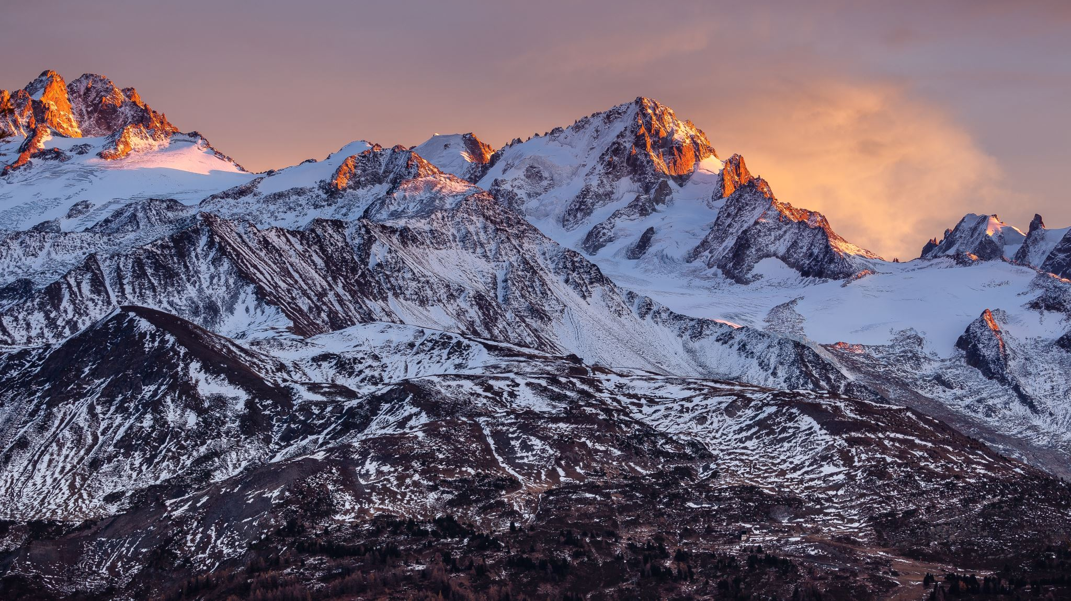
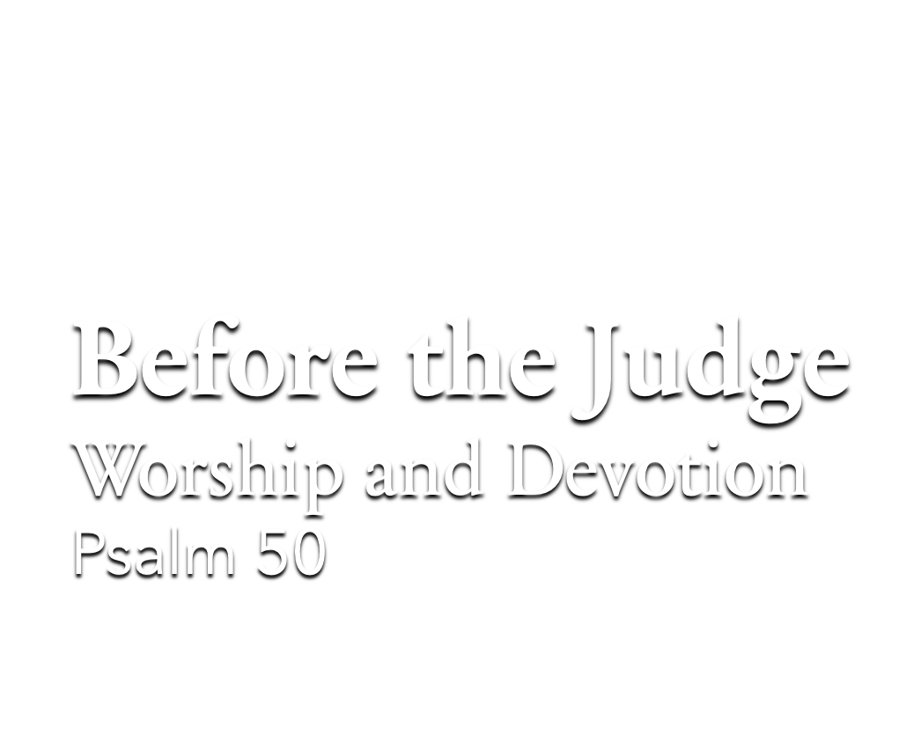

Slide 3

The Nature of the Judge (vv. 1-3)
1 John 1:5 – Light, no darkness.
2 Peter 3:9; Hebrews 12:29 – Is coming and is a consuming fire.
The Nature of His Judgment (vv. 4-6)
Deuteronomy 30:11-20 – Judgment is just. There are witnesses.
(v. 5) – Covenant made!

Slide 4

Regarding True Worship (vv. 7-15)
Prayer – Colossians 4:2
Singing – Ephesians 5:17-19
Lord’s Supper – 1 Corinthians 11:27-29
Giving – 2 Corinthians 9:7; 8:3-5
Preaching – Acts 20:7; 2:42

Slide 5
Regarding True Worship (vv. 7-15)
Regarding True Devotion (vv. 16-21)
Romans 2:17-24 – Do we obey what we know?
Jeremiah 7:1-4, 8-11 – Worship covers sin?
His Final Warning and Plea (vv. 22-23)

