Slide 2
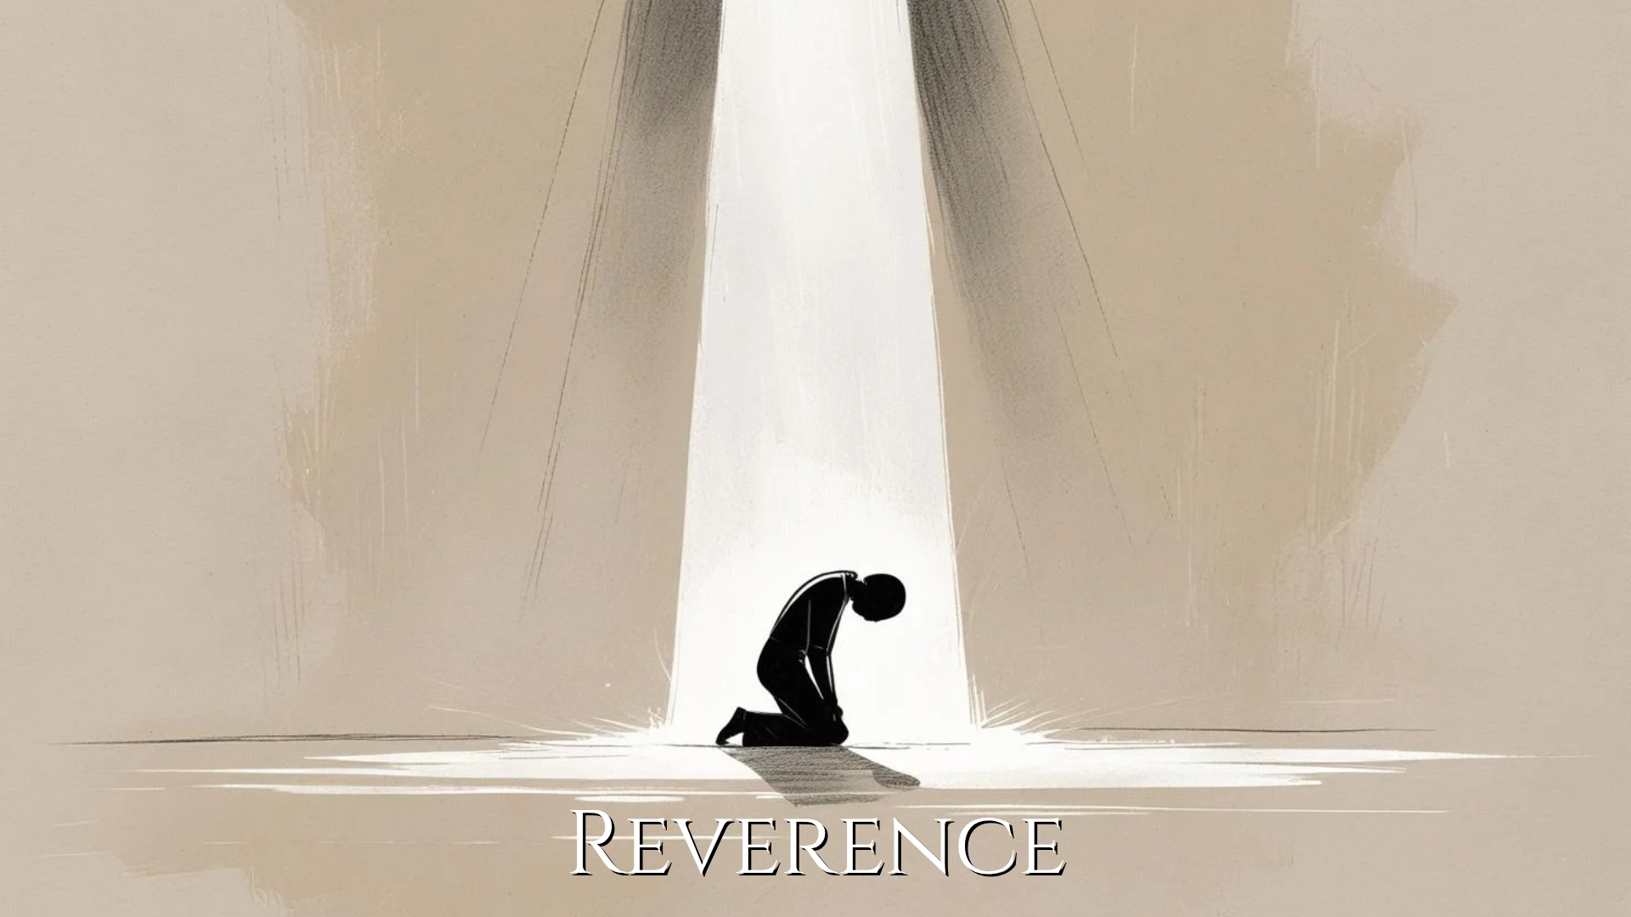

Slide 3
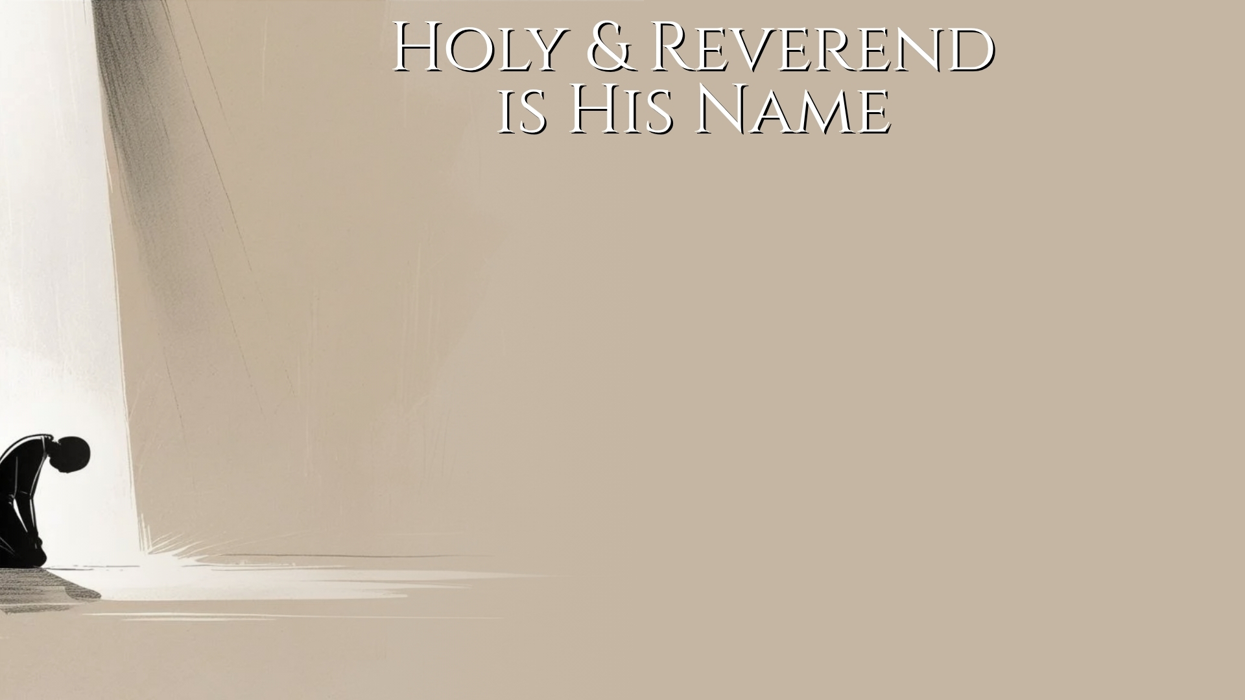
His Name and Work Inspire Reverence (Psalm 111)
Psalm of praise in connection with reverence (vv. 1, 10).
His activity in redeeming His people (vv. 2-6) (cf. Psalm 8; 139; Exodus 3:14-17; 34:5-7)
His activity in sanctifying and sustaining His people, and the proper response by His people (vv. 7-10) (cf. Psalm 19:7-11; Jonah 1:5, 9, 10, 16)

Slide 4
His Nature and Work Require Reverence (Heb. 12)
The terror of Sinai (vv. 18-21).
The joy of Zion (vv. 22-24).
The warning (v. 25).
The requirement (vv. 28-29) – gratitude, reverence and godly fear.

Slide 5
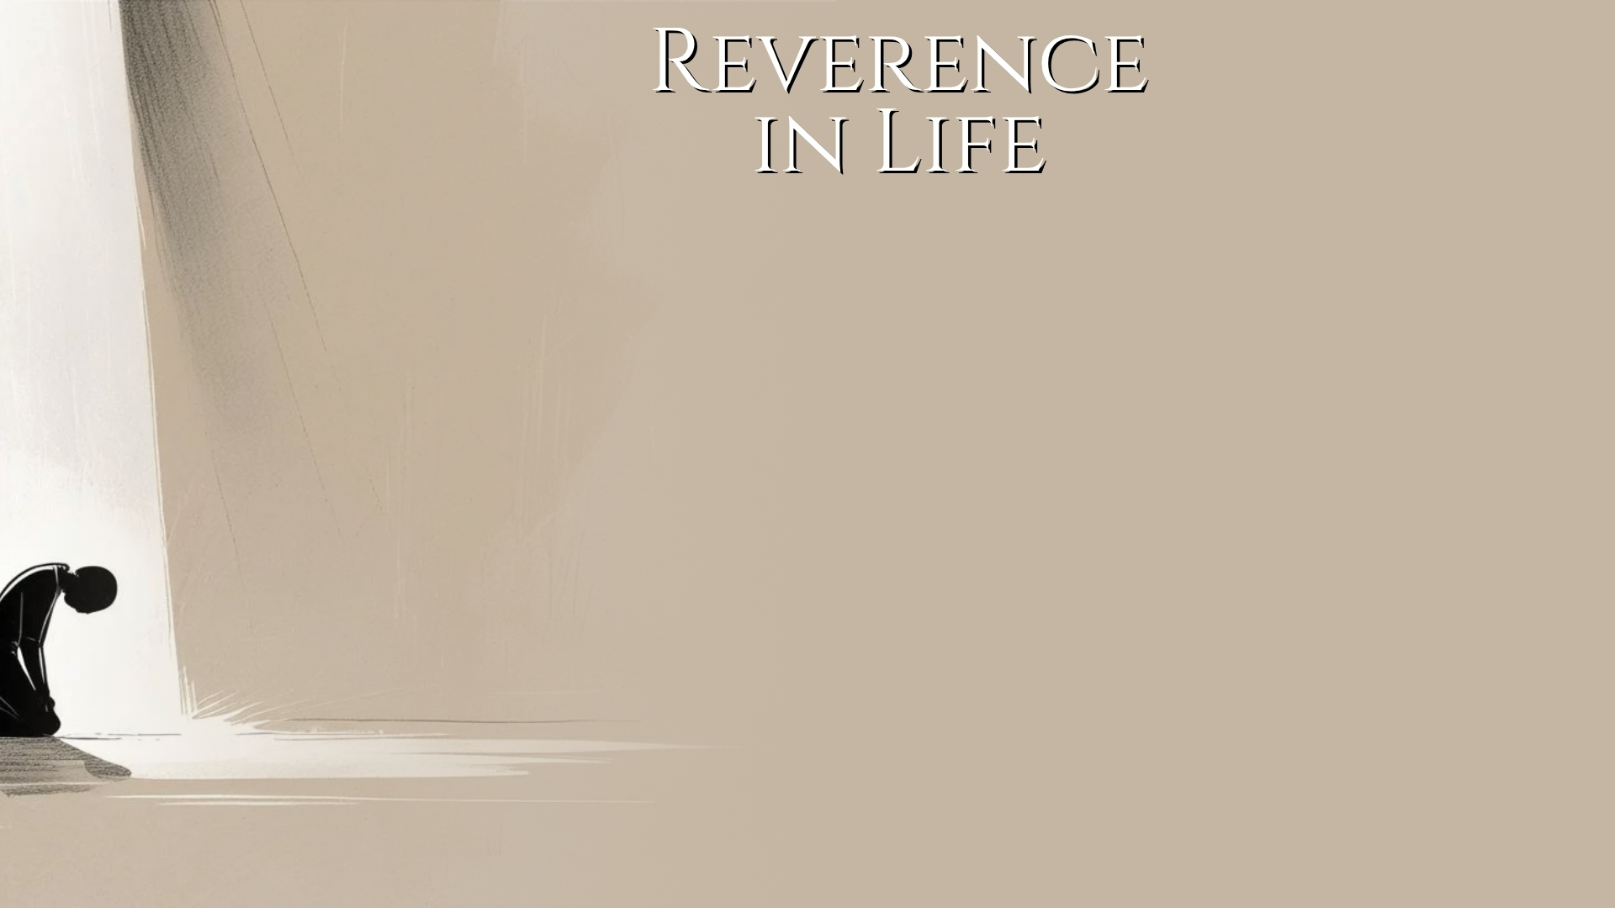
God’s Omnipresence Demands Constant Reverence (Exodus 3:2, 4-6; Psalm 139:7-12)
Reverence Taught by Grace (Titus 2:11-15)
Grace teaches (v. 11) (cf. John 1:14; Hebrews 5:7-8)
Sobriety (cf. Luke 16:1-13)
Righteousness (cf. Psalm 111:10; 1 Corinthians 15:29-34)
Godliness (cf. 1 Corinthians 4:2-5; Galatians 1:10)

Slide 6
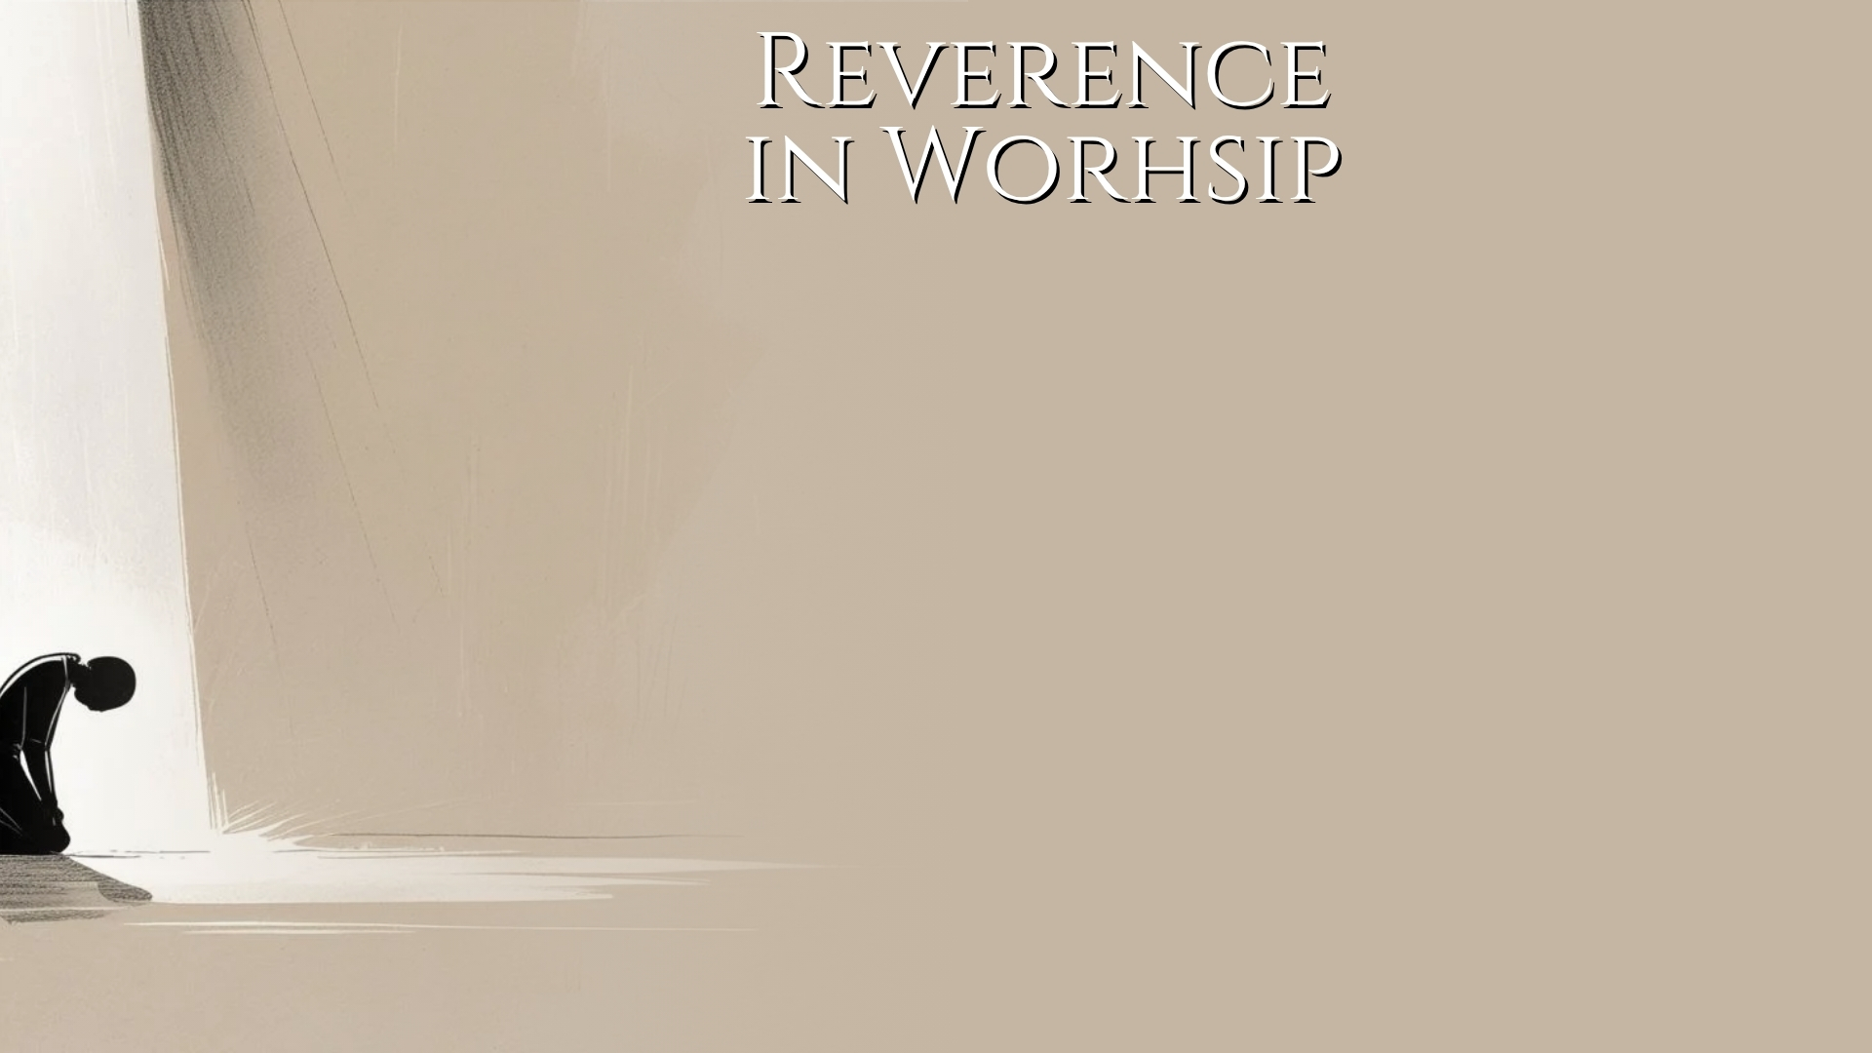
A Picture of Reverence in Worship (Nehemiah 8)
Worship that is Decent and in Order (1 Cor. 14)
Decently and in order (v. 40).
  Decently – euschēmonōs – “pert. to being appropriate, correctly” (BDAG) (cf. Hebrews 10:19, 22, 24-25)
  Order – taxis – “as a characteristic of well-regulated conduct good order, orderliness” (ALGNT) (cf. 2 Timothy 2:13; 1 Corinthians 11:22; 14:37)

Slide 7
A Picture of Reverence in Worship (Nehemiah 8)
Worship that is Decent and in Order (1 Cor. 14)
Promoting edification (v. 12).
Worshiping with understanding (vv. 15, 19).
Providing what is honorable in the sight of men/visitors (vv. 22-25).
Reverent orderliness throughout worship (vv. 26-33)

