Slide 2
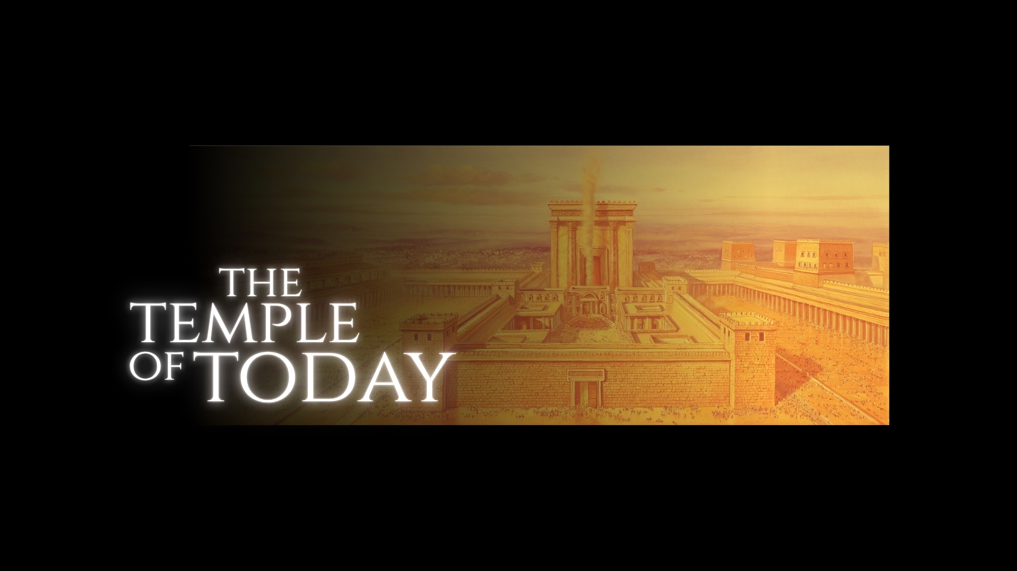

Slide 3

The Temple of Yesterday
The Garden of Eden
(Genesis 2:8; 3:8, 23-24; 13:10)
Abraham
(Genesis 3:15; 12:1-3, 6-8; 13:3-4, 18; 22:2, 9, 13-14; 15:9-21)
Tabernacle
(Exodus 19:3-6; 25:8-9; 40:36-38)
Temple
(2 Samuel 7:1-2, 10, 12-13; 2 Chronicles 3:1; 5:13-6:2; 7:1-2)
Second Temple
(Isaiah 44:26-28; Ezra 1:1-3; Haggai 2:3, 6-9)

Slide 4
The Temple in Transition
God Tabernacled with Man
(John 1:14; Matthew 1:22-23)
God Died for Man
(John 2:18-22; Acts 6:13-15; 7:44-53)
The Temple Destroyed
(Matthew 24:1-2; Ezekiel 37:24-28)

Slide 5
The Church
God’s glory:
Tabernacle (Exodus 40:34); Temple (2 Chronicles 7:1-2); Christ (John 1:14, 16, 18; Colossians 2:9); The Church (Ephesians 1:22-23)
The plan of God in Christ concerning the church – Ephesians 1-3 – “a holy temple in the Lord” (2:21)
God’s tabernacle (cf. Revelation 13:6-8; 2 Corinthians 6:14-18).

Slide 6
The Individual Christian
Individuals comprising the church that is God’s temple – Ephesians 2:19, 21; 4:16
God dwells in individuals – John 14:19-24 – fellowship.
The individual Christian is a temple of God – 1 Corinthians 6:18-20 (cf. Galatians 5:16-17, 24-25; Exodus 25:8-9; Ezekiel 36:26-28)

