Slide 2


Slide 3
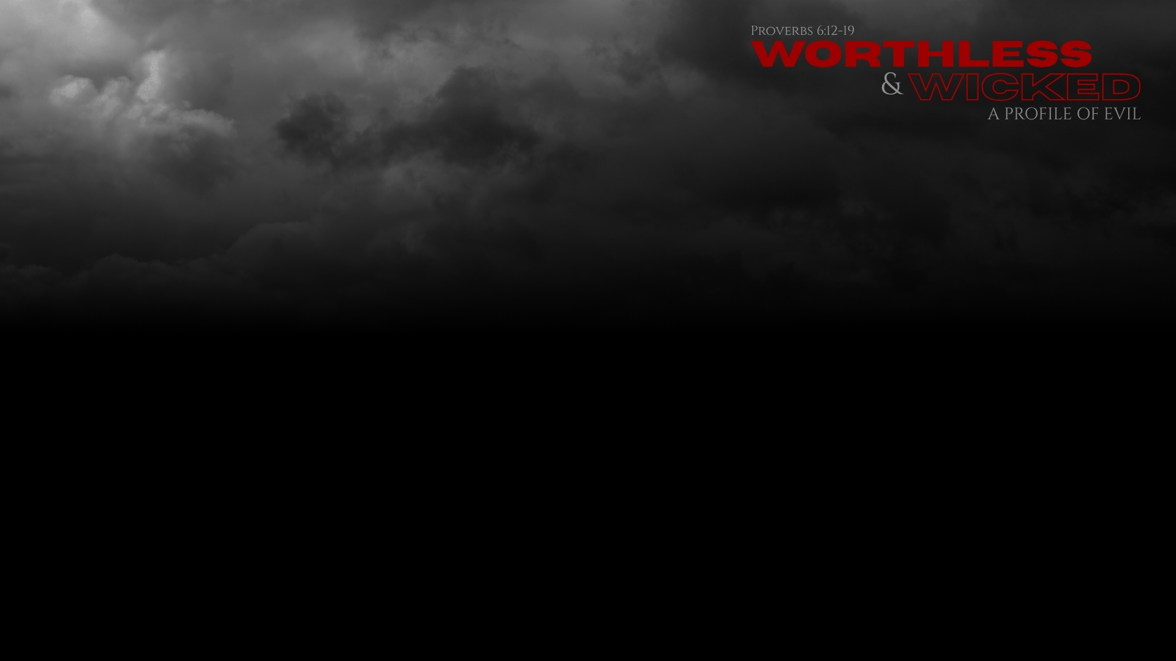
A Profile of Evil
Opposed to God (Proverbs 6:12a, 16a)
“worthless” – ḇelîya‘al – “worthlessness” (BDB); “worthlessness (ḇelîya‘al), derives from bal(i) yaʿl(ê), meaning ‘(a place from which) none arises,’ and is thus a euphemism for Sheol…[or]…it comes from בָּלַע‎ ‘to swallow’ and thus should be understood as ‘the swallower’” (NIDOTTE) (Proverbs 1:10, 12, 18-19)
“This word occurs 27× in the OT and generally refers to a person who has become so wicked and corrupt that he/she is a detriment to society.” (ibid.) (Deuteronomy 13:12-15; 1 Samuel 2:12, 24 - children/sons of Belial)

Slide 4
A Profile of Evil
Opposed to God (Proverbs 6:12a, 16a)
“worthless” – ḇelîya‘al
Against God (1 Samuel 12:12), justice (Proverbs 19:28), community (Deuteronomy 15:9), propriety (1 Samuel 1:16), life (2 Samuel 22:5)
“And what accord has Christ with Belial?” (2 Corinthians 6:15)

Slide 5
A Profile of Evil
Opposed to God (Proverbs 6:12a, 16a)
“wicked” – ’âwen – “(1) disaster; (2) (looming) disaster; (3) sin, injustice; (4) deception, nothingness; (5) false, idolatrous cult” (HALOT)
“occurs predominantly in poetic passages and most often has the worshipers (or worship) of Yahweh as its backdrop. The doer of אָוֶן‎ seeks to unsettle or even kill any faithful member of the covenant community, esp. the less fortunate individuals.” (NIDOTTE) (cf. Psalm 28:3; 59:1-5)
“it appears to derive from the same parent root as אוֹן‎ (ʾôn) (power). Consequently, אָוֶן‎ could highlight a negative aspect of power, i.e., the abuse of power that brings harm and destruction (TDOT 1:141–42).” (ibid.)

Slide 6
A Profile of Evil
Opposed to God (Proverbs 6:12a, 16a)
“the Lord hates” (v. 16) (Exodus 34:6-7; Micah 6:8)

Slide 7
A Profile of Evil
Heart Set on Evil (Proverbs 6:12b, 14a, 18a)
Perverse mouth and heart (vv. 12b, 14a) (Proverbs 4:23; Matthew 12:34-35; 15:18-19; James 3:14-16)
Heart that devises wicked plans (v. 18a) (Psalm 10:1-11)

Slide 8
A Profile of Evil
Calculated Evil
“devises evil continually” (v. 14b)
“sows discord” (vv. 14c, 19)
The whole body used for evil (v. 13) (Proverbs 16:27-30; Isaiah 58:3-4, 9)
Pride, lying, killing (vv. 17-19) (Isaiah 2:12, 17-18; Psalm 120:2; Matthew 15:19; 1 John 3:15)

Slide 9
A Profile of Evil
Deeds with Destructive Destiny (Proverbs 6:15)
“Therefore” connects his behavior with his end.
Proverbs 1:17-19 – backfires.
Isaiah 1:21-23, 31 – their actions set their own lives on fire.
Proverbs 6:15-16 – eternal judgment of the Lord (Psalm 1, 11)

Slide 10
What am I to do?
Flee from Every Trait
None of these are to be minimized (Romans 1:21-23, 28-32; James 2:10-11)
To partake in one is to start a decline in the heart (Hebrews 3:13; Ephesians 4:17-19; 1 Timothy 4:1-2; 2 Timothy 3:13)
Abstain, flee, pursue (1 Thessalonians 5:19-22; 1 Timothy 6:11) (Matthew 12:30; 22:37-40; James 1:27; 2:1, 8-9, 13; 4:17; Matthew 5:48; 1 John 4:17-19)

Slide 11
What am I to do?
Beware of These in Others
Perilous times (2 Timothy 3:1-9)
Strike the balance of optimism and pragmatism, selfless compassion and self-preservation:
Love (1 Corinthians 13:4-7)
Soul saving includes your own (Matthew 10:11-20; Ezekiel 14:12-20)

Slide 12
What am I to do?
Do Not Be Complicit
“Now Saul was consenting to his death” (Acts 8:1) (cf. Acts 22:19)
Standing on the other side, as one of them (Obadiah 10-11)
Thoughtful about the situation, avoiding wrong or harm (Proverbs 3:27-30)
Avoid being an ear that is persuaded by the wicked (Proverbs 6:14, 17, 19; 18:1, 2, 5, 8, 9, 13, 15, 17, 21)

Slide 13
What am I to do?
Oppose the Wicked
“The only thing necessary for the triumph of evil is for good men to do nothing.” (cf. Matthew 12:30)
Expose darkness (Ephesians 5:8-13)
Cut off opportunity from those who seek to harm, or are the cause harm (Romans 16:17-20; 2 Timothy 3:5)
Pursue the heart of God in our relationships with fellow men (Isaiah 1:16-17, 21-23; Job 29:1-17)
Overcome evil with good (Romans 12:21)

