Slide 2
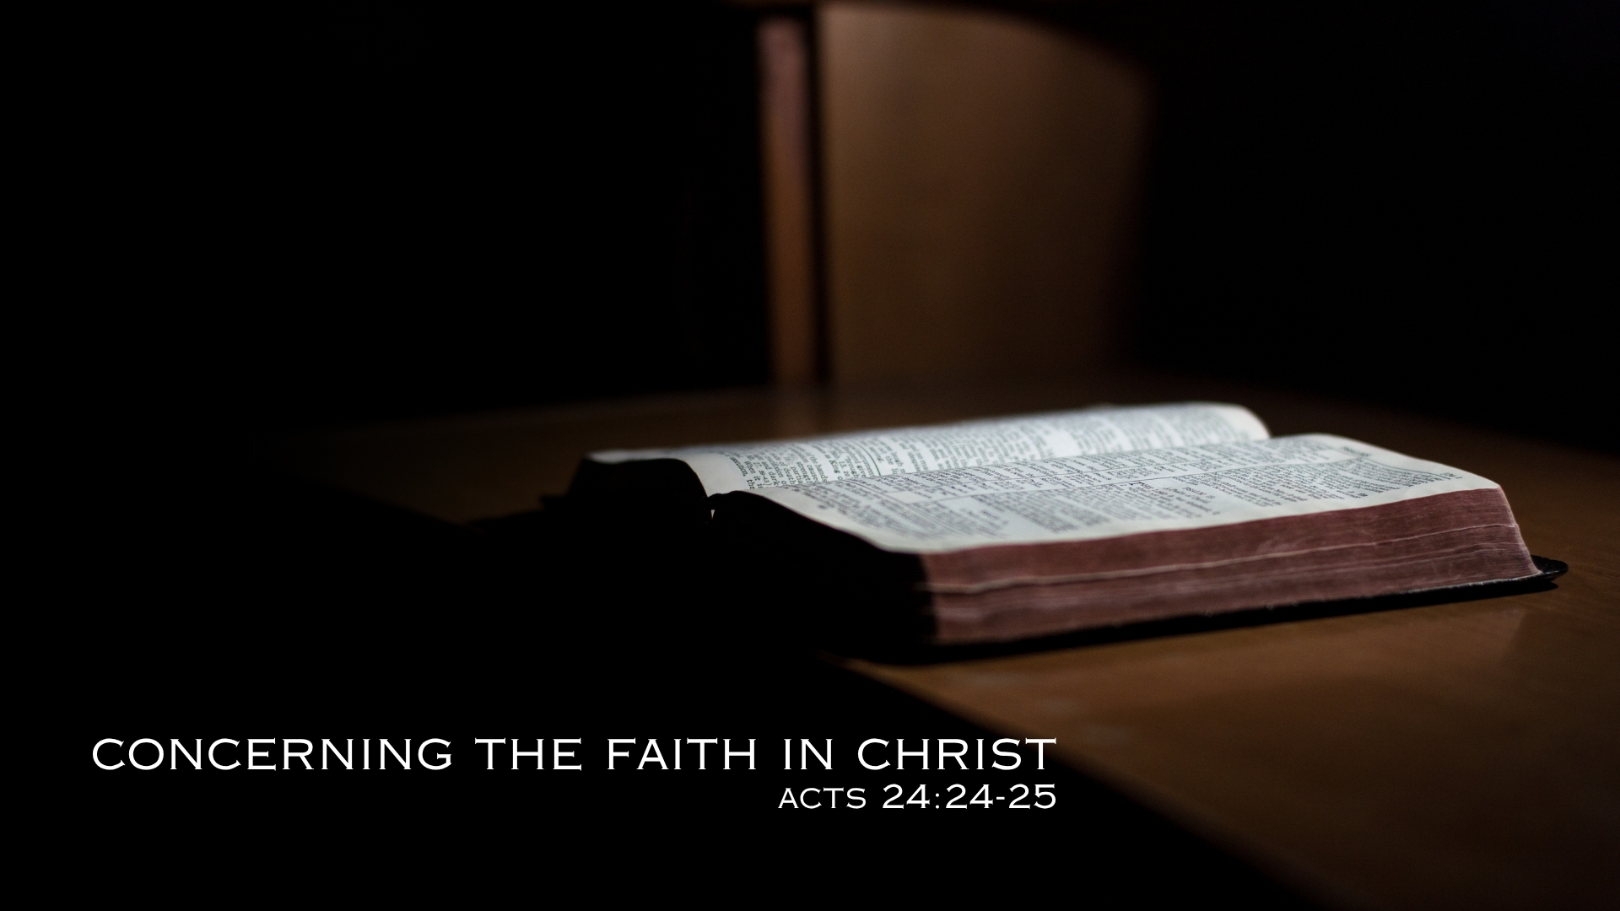

Slide 3
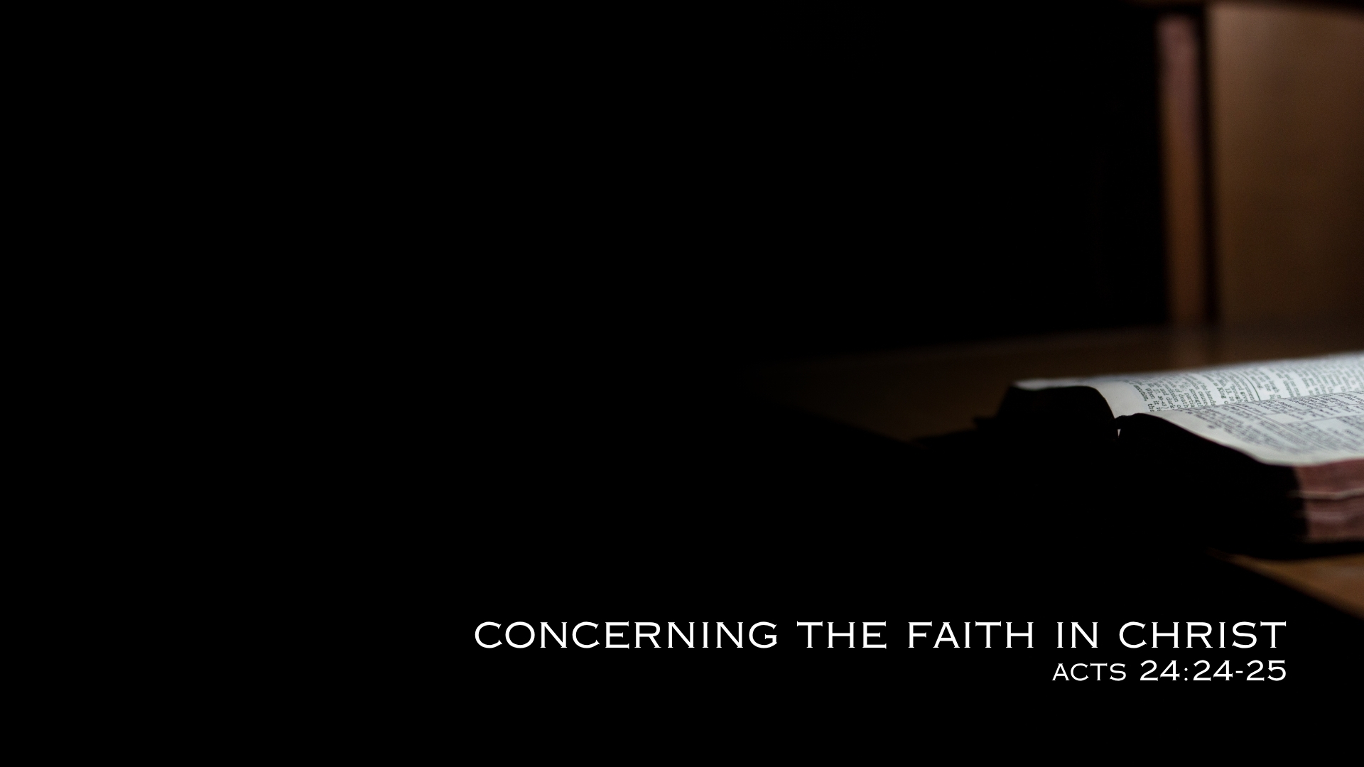
Reason (Acts 24:25; 26:24-25)
Righteousness (Romans 1:16-17; 6:13; 1 John 2:28-29; 3:1-3, 7-9)
Self-Control (2 Peter 1:5-6; Galatians 5:16-25; Romans 13:11-14)
Judgment (Hebrews 9:27; John 5:28-29; 2 Peter 3:10)

