Slide 2


Slide 3

Prior Questioning (Matthew 22:15-46)
Which commandment is preeminent? – (vv. 34-40)
The Hypocrisy of the Scribes and Pharisees (Matthew 23:3-5, 27-28, 29-30)
The Abuse and Avarice of the Scribes and Pharisees (Matthew 23:14, 25-26, 31-36)
The Teaching and Leading of the Scribes and Pharisees (Matthew 23:3-4, 13, 15-24, 31-36)

Slide 4
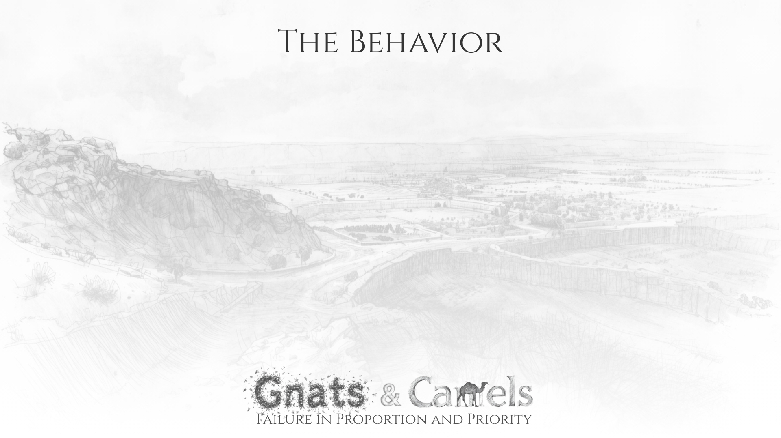
Biblical Principles are Filtered Through Human Wisdom
Specific charge – Matthew 23:23
Tithing commanded – Deut. 14:22-23; Lev. 27:30; Deut. 26:2
“These you ought to have done, without leaving the others undone.”
“neglected the weightier matters” (cf. v. 4 – “heavy”) (cf. Micah 6:8)

Slide 5
Biblical Principles are Filtered Through Human Wisdom
Illustration– Matthew 23:24
Gnats and camels are unclean – Leviticus 11:4, 20-23, 41
Their care to avoid something small led them to miss something huge.
Jesus’ view of the law – Matthew 22:36-40 (weightier matters, proportion and priority)
Human wisdom makes a mess of God’s revelation – “Blind guides” (v. 24).

Slide 6
Hypercriticism
Matthew 7:1-5 – not that improper judgment is made, but an irony in proportion.
Hypercriticism is not noble attention to detail. Usually, it is a tell that there are more fundamental matters out of order in that person’s life.
Contrast – Galatians 6:1-2; Luke 18:9-14

Slide 7
Hypocrisy
Matthew 7:5 – this judgment was wrong because it was hypocritical.
The Jewish leaders showed their hypocrisy in their failure in proportion and priority concerning things they swore by to convince others despite their dishonesty – Matthew 23:16-22 (James 5:12)
A façade of faithfulness due to strenuous attention to the trees while missing the entire forest – Matthew 23:23

Slide 8
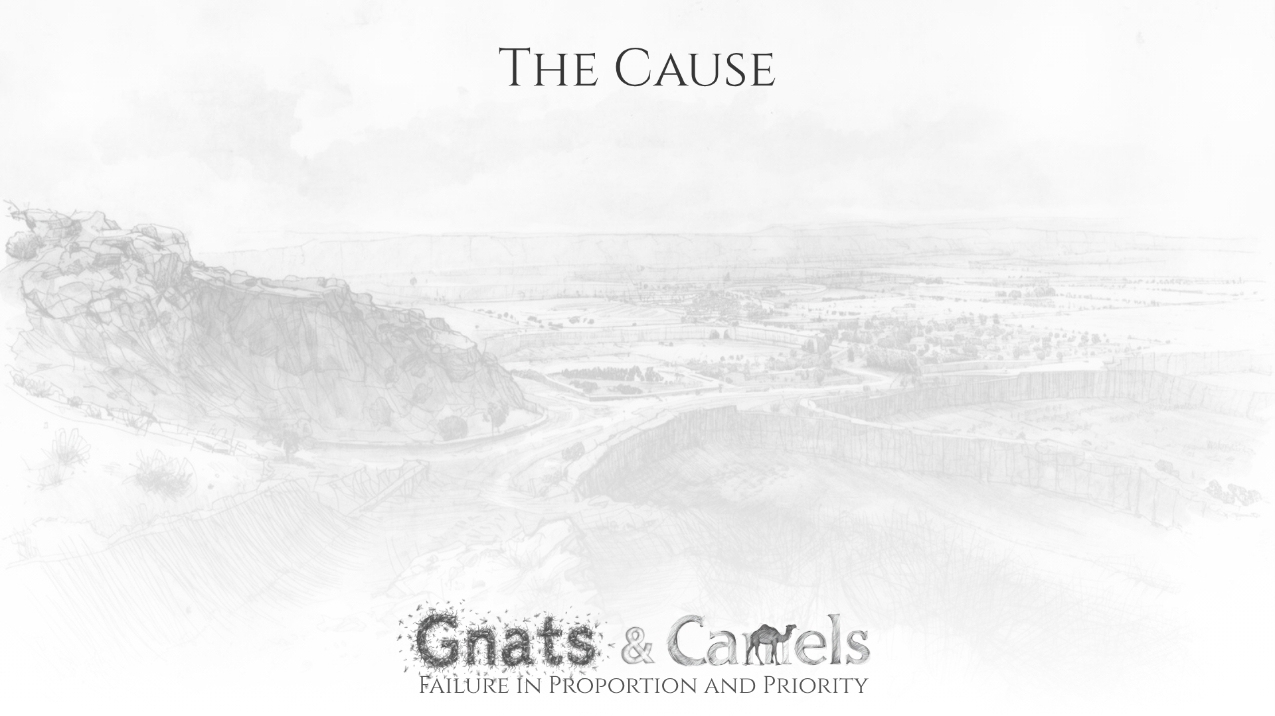
Bitter Zeal and Self-Seeking
Zeal in itself is not pure and godly. It can be bitter, and selfish, resulting in human reasoning, and hypercritical and hypocritical judgment.
James 3:13-18 – a contrast of wisdom.
(vv. 15-16) – fruit of earthly wisdom.
(vv. 17-18) – fruit of heavenly wisdom.
This zeal and seeking leads to gulping down camels while straining out gnats.

Slide 9
Errant Reaction
We must be ready to contend for the faith – Jude 3
However, we cannot allow issues that need to be addressed blind us to more fundamental matters.
Ephesus is an example – Revelation 2:1-7
When doctrinal zeal, and righteous indignation result in cold, unapproachable, impatient, not evangelistic, and shallow behavior, the gnat may be strained out, but the camel is swallowed.

Slide 10

Spiritual Disorientation (1 Cor. 4:6-13; Luke 5:30-32)
Gross Negligence (Hosea 6:6; Micah 6:8; Psalm 50:16-21)
False Security (Micah 3:9-12)
A Caricature of God and His People (Hosea 9:10; Psalm 115:8; Exodus 34:6-7)

